Slide 1
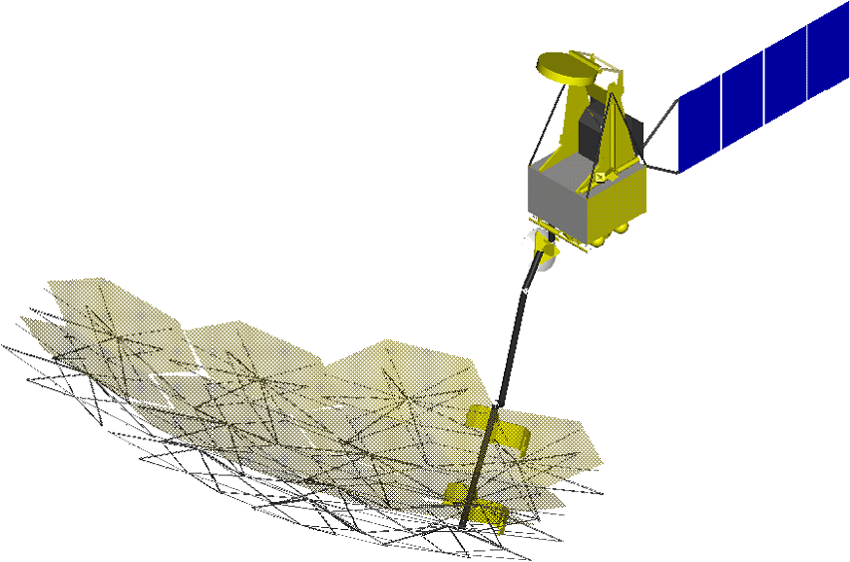
Space radio astronomy observations
Y.Hagiwara (NAOJ)

Slide 2
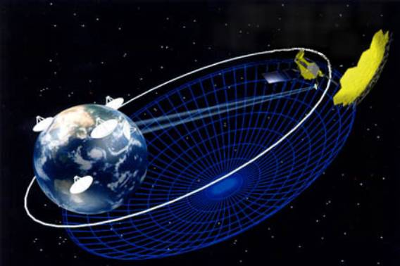
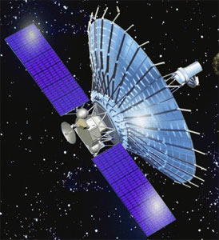
VLBI and Space-VLBI
Why Space VLBI?
- To improve angular resolution for resolving structures of astronomical objects such as distant active galactic nuclei (AGN)
- Angular resolution aiming by S-VLBI is approaching to order of 10 micro arcsec - closer to black hole
Minimum fringe spacing : spatial resolution = λ/d(orbit)
<λ/d(earth)
d(orbit)

Slide 3
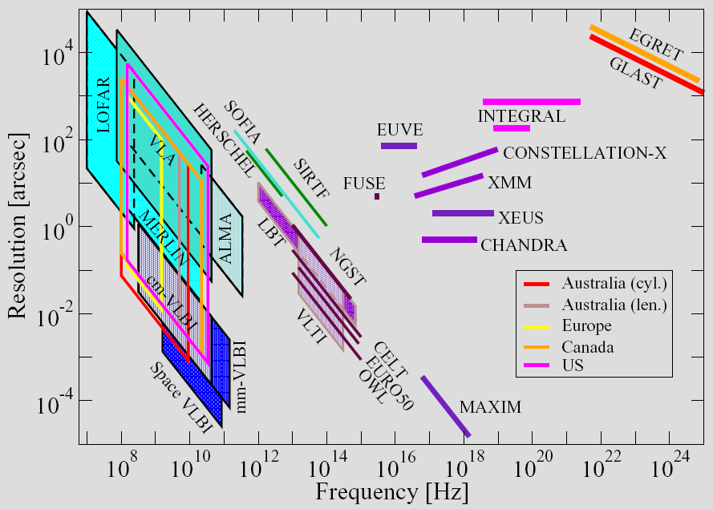
Comparison of angular resolution
VSOP1
VSOP2
Radioastron

Slide 4
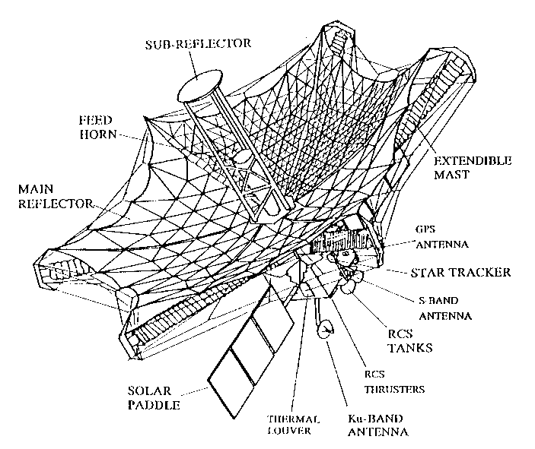
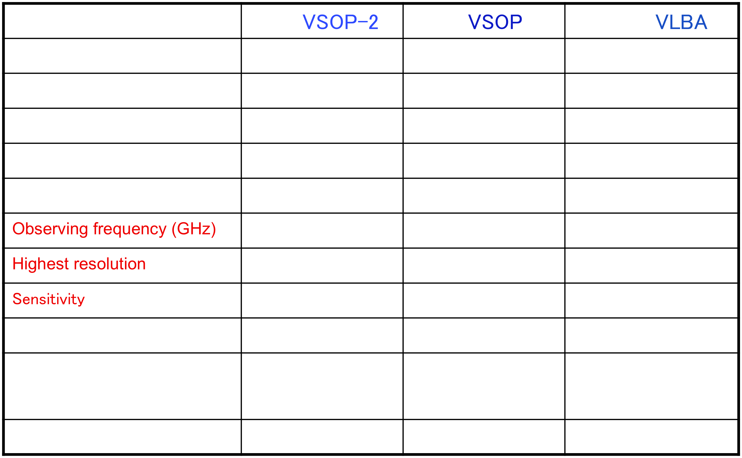
Ground- vs. Space-VLBI

Slide 5
Brief Overview of Space-VLBI Projects 1
Project | Institute | Period | Orbit (apogee) | Purpose
TDRSS | JPL (USA) | 1986 | 12,000 km | Communication with Space Shuttle
VSOP | ISAS (Japan) | 1997-2005 | 21,500 km | Ground-space communication and Astronomy
Radioastron | Astro Space Center (ASC) (Russia) | 2010 | 320,000 km | Astronomy (VLBI)
VSOP-2 | ISAS/JAXA (Japan) | 2015 (goal) (postponed from 2013) | 25,000 km | Astronomy (VLBI)
Millimetron | ASC + Europe | 2016 | 300,000 – 370,000km, or L2 Orbit | Astronomy (Single-dish, VLBI)

Slide 6
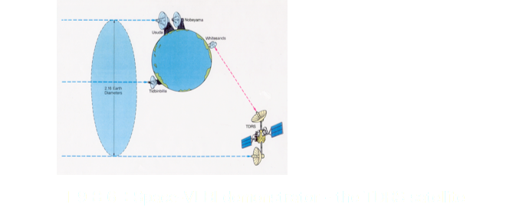
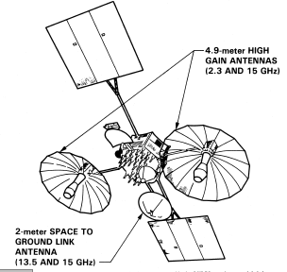
TDRSS
TDRSS was used exclusively for ommunication with
SpaceShuttle
-Only one TDRSS in orbit in 1986
ε_{A} = 0.4
T_{sys} = 320 K
Δν = 14 MHz
Downlooking satellite required telescopes
on opposite side of Earth
J.Ulvestad

Slide 7
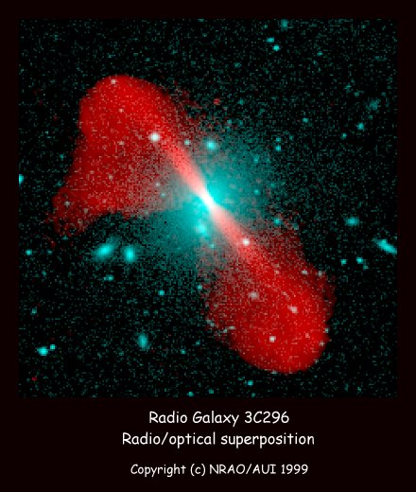
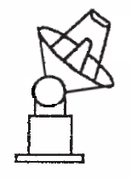
Frequencies of Space-VLBI
Three different frequencies
- Observing frequency
- Up-link (phase-transfer)
- For VSOP, phases (clocks) transmitted to
the spacecraftand corrected using
a two-way link
- On-board clocks (Hydrogen
maser) for
Radioastron
- VLBI Data down-link frequency
Main reflector
High-gain Antenna
Data Storage -> Correlator

Slide 8
Brief Overview of Space-VLBI Projects 2
Project | Observing Frequency | Up/down-link Frequency | Telescope Diameter (Main refl.) | VLBI data rate | Status
VSOP | 1.6 GHz (L) 4.9 GHz (C) | 15.2GHz/14.3GHz (Ku) | 8m | 128 Mbps | Finished (1997-2005)
Radioastron | 330 MHz(P),1.6 GHz (L), 4.9 GHz (C), 22 GHz (K) | 7-8GHz/15GHz (Ku) | 10m | 144 Mbps | Approved
VSOP-2 | 8 GHz (X) 22 GHz (K) 43 GHz (Q) | 40GHz/37-38GHz (Ka) | 9.2m | 1 Gbps | Approved (Technical review at end-June 2010)
Millimetron | 18-26 GHz 31-45 GHz 84-116 GHz 211-275 GHz 600-720 GHz | N/A | 12m | 16 Gbps | Approved In Russia but not in Europe

Slide 9
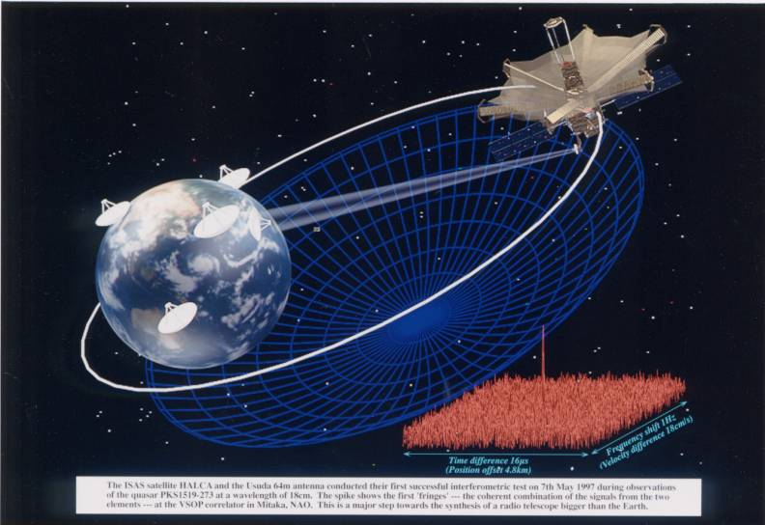
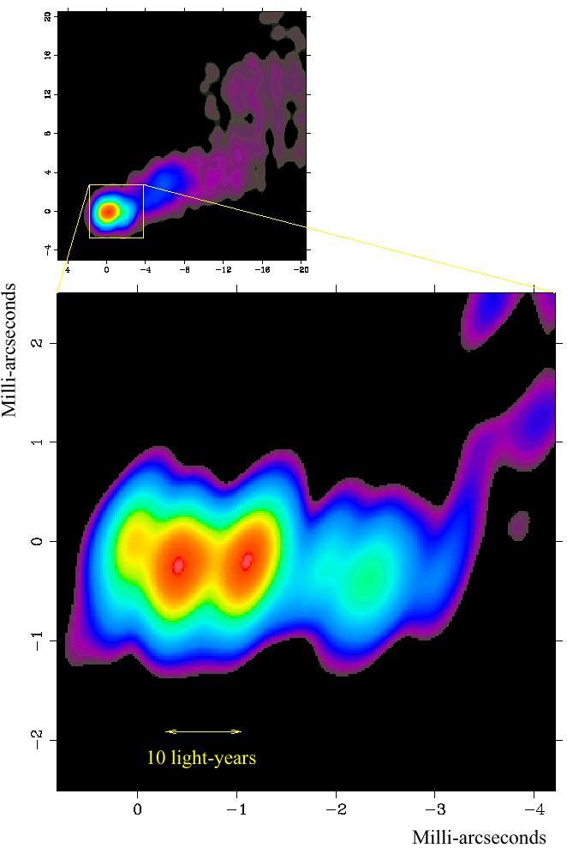
VSOP-HALCA (1997-2005)
VSOP: VLBI Space Observatory Programme
HALCA: Highly Advanced Laboratory for Communications and Astronomy
Observing bands:
1.6, 4.9 GHz
Launch: Feb. 12, 1997
Apogee 21,000km
Perigee 560 km
380 minutes orbit period
VLBA
3C345
Phase Link & Data Transmission:
Downlink 128 Mbps QPSK @ 14.2 GHz
Uplink CW @ 15.3 GHz
HALCA
J.Klare et al.

Slide 10
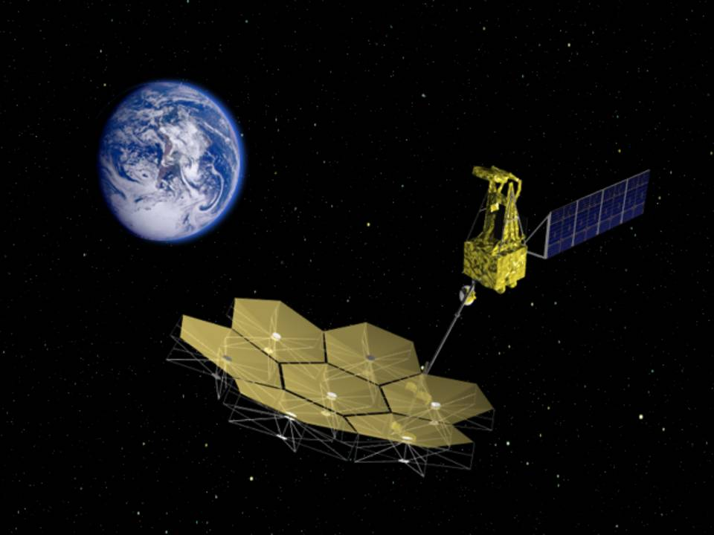
VSOP-2 (ASTRO-G)
Following the success of VSOP-HALCA, the next generation Space-VLBI
Project is approved at JAXA in Japan with an expected launch of after 2013
Spacecraft with 22GHz/43GHz receivers cooled to 20K and a non-cooled 8GHz receiver
Spacecraft with a 9.26 m deployable mesh antenna, dedicated for Radio Astronomy
Orbit
Apogee 25,000 km
Perigee 1,000 km
Inclination 31°
Orbit Period 7.5 hours
Mass 1200kg (Nominal)
1 Gbps Data Downlink
Mission lifetime 3 years
Observing bands 8, 22, 43 GHz
Dual polarization
Phase-referencing capability
1 module
Metal-mesh surface antenna constitutes
of 7 modules

Slide 11
Radioastron
Russian Space-VLBI project
10 m main reflector (solid surface)
Launch is being planned in 2010
Apogee height is up to Earth-Moon distance
350,000km, which provides 10 times better angular
resolution than ground-VLBI can attain
Observing frequency bands are 0.3, 1.6, 4.8, and
22 GHz
Maximum resolution expected to be
7 microarcsec at 22GHz !

Slide 12
Specification of VSOP-2 and Radioastron
 | VSOP-2 | Radioastron
Dish diameter | 9.26 m (mesh) | 10m (solid)
Apogee/perigee height. | 25,000 km/1,000 km | 350,000 km/10,000 km
Orbit inclination (ωi) | 31° | 51.6° (Initial value)
Orbital period | 7.5 hour | 9.5 days
Total mass (kg) | 1200 | 3660
Polarization | Dual | Dual
Data down-link | 1 Gbps | 144 Mbps
Observing frequency | 8-8.8,20.6-22.6,41-45 GHz | 0.3, 1.6, 4.8, 18-25 GHz
Observing bandwidth | 128 or 256 MHz | 4 or 32 MHz
Receiver | Cooled to 20K (22/43GHz bands only) | Passive cooling: Cooled to ~130 K for 1.6/4.8/22GHz band Receivers
System temperature (K) | 60-86(X),30-56(K),40-98 (Q) | 164(P),33(L),66(C),70(K)
Max. angular resolution | 38 micro arcsec | 7 micro arcsec

Slide 13
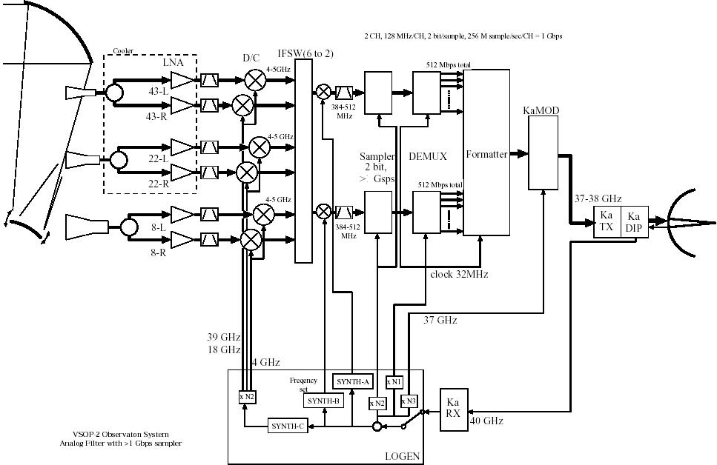
ASTRO-G system block diagram

Slide 14
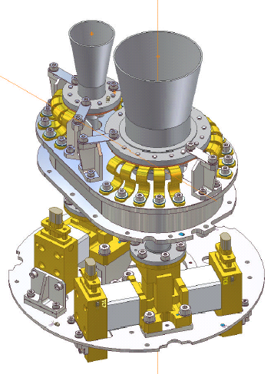
ASTRO-G Receiver system
２２/４３ GHz:
Dual frequency/polarization
Cooling method:
Stirling Cycle refrigerator, 2-stage cooling
Cooling temperature:
３０K
２２GHz Horn
43 GHz Horn
43 GHz Pol.
43 GHz LNA
２２GHz LNA
22 GHz Pol

Slide 15
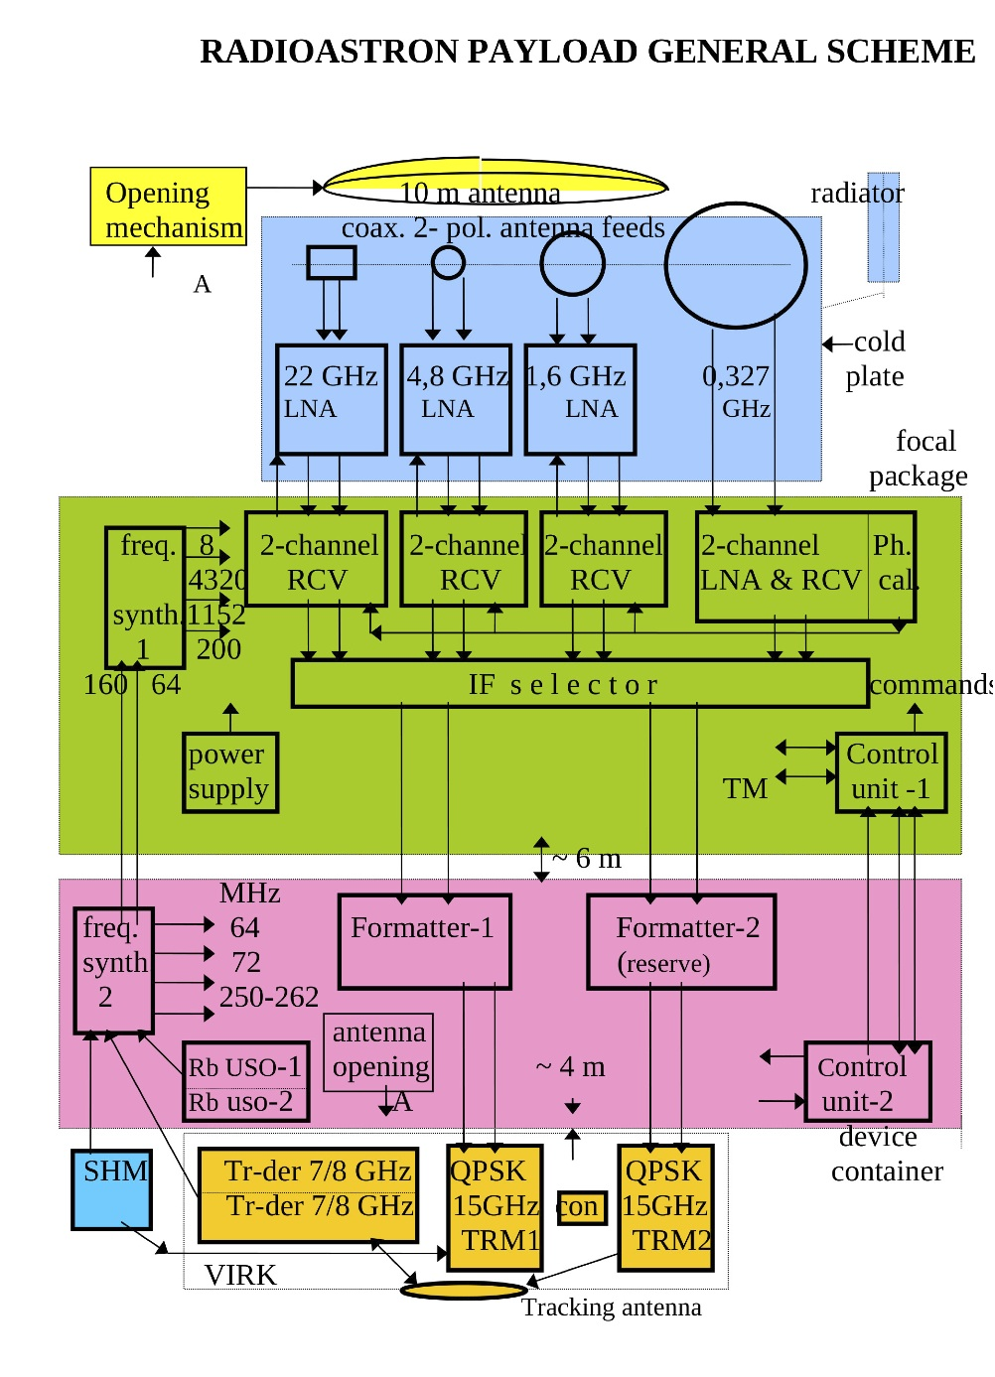
Radioastron system block diagram

Slide 16
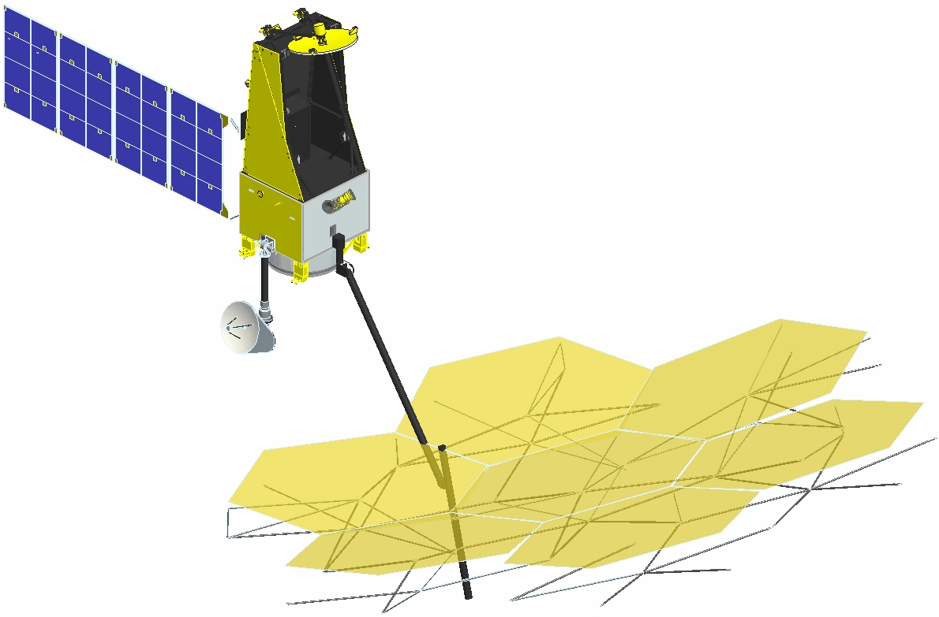
Up-/down –link frequency
 | VSOP-2 | Radioastron
Diameter of high-gain antenna (HGA) | 0.8m | 1.5 m
Up-link Freq. (phase-transfer) | 40GHz | 7-8GHz
Modulation | Sine wave
Transmission power | 0.1W
Down-link Freq. (VLBI-Data-transfer) | 37-38 GHz ( fc=37.536 GHz) | 15 GHz
Data rate | 1 Gbps (fixed) | 144 Mbps
Occupied Bandwidth | 880 MHz >
Modulation | QPSK | QPSK
Transmission power | 25W | 40 W
Telemetry Freq. (for commanding) | 2.3 GHz
Main refl.
HGA

Slide 17
VSOP-2 ground-link system

Slide 18
Observing frequency and bandwidths
Radioastron
Band | P | L | C | K
Frequency range (MHz) | 320-328 | 1636-1692 | 4804-4860 | 18372-25132
Band width for each polarization (MHz) | 4 | 32 (2x 16) or 8 (2 x 4) | 32 (2x 16) or 8 (2 x 4) | 32 (2x 16) or 8 (2 x 4)
VSOP-2
Band | X | K | Q
Frequency range (GHz) | 8.0-8.8 | 20.6-22.6 | 41.0-45.0
Band width for each pol. (MHZ) | 128 or 256 | 128 or 256 | 128 or 256

Slide 19
Spectral line observations with Space-VLBI
(Space-)VLBI is able to detect only high-brightness objects (Tb > 10⁷) such as maser, so that thermal molecular lines are not included
Band | P | L | C | X | K | Q
Project | RA | RA | RA | VSOP-2 | VSOP-2 RA | VSOP-2
Frequency (GHz) | 0.320 -0.328 | 1.636 -1.692 | 4.804 -4.860 | 8.0 -8.8 | 20.6-22.6 (VSOP2) 18.372 -25.132 (RA) | 41.0 - 45.0
Line rest frequency | None | OH: 1665, 1667MHz | None | None | H2O: 22.23508 GHz | SiO: 42.827 GHz 43.122 GHz

Slide 20
Redshifted Frequency at L/K-band
Request for observing red-shifted molecular lines, Hydroxyl (OH) and Water (H2O)
- Rest Frequency of OH emission is 1665, 1667MHz and H2O is 22.23508 GHz
but extragalactic emission is red-shifted
VSOP-2 (H2O)
- 20.6- 22.6GHz (20.6GHz corresponds galaxies at z = 0.079)
Radioastron (OH, H20)
- 1.637-1.696 GHz (OH gagalxies up to z=0.0104)
- 18.392-25.112 GHz (discrete, not continuous)
- ……22.136, 22.168, 22.200, 22.232 GHz,
-the frequency of the receiver can be tuned in the range of up to 1500 km/s.
(18.392 GHz => galaxies at z = 0.208)
Highest-redshift of water maser : z=2.2, 0.66,..

Slide 21
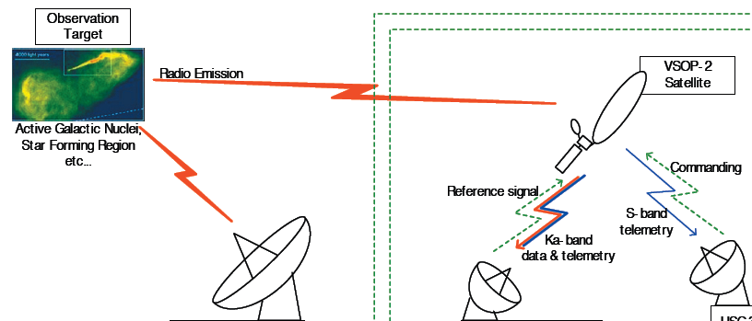
Frequency Management Activities of VSOP-2
Frequency Selection:
Observing bands, Space VLBI (Up/downlink data), TT&C
SFCG (Space Frequency Coordination Group)
Coordination among space agencies
Information for ASTRO-G was submitted in September, 2007
ITU-R SG7
General SVLBI (Space VLBI) coordination have already done by US (JPL) group at WP7B.
Recommendation ITU-R SA.1344 : SVLBI system description
“Preferred frequency bands and bandwidths for Space VLBI”
Up 40-40.5 GHz, Down 37-38 GHz
Sharing studies in 37-38 GHz band are going now.
Observing band protection in radio astronomy bands in 22/43 GHz is not clear now.

Slide 22
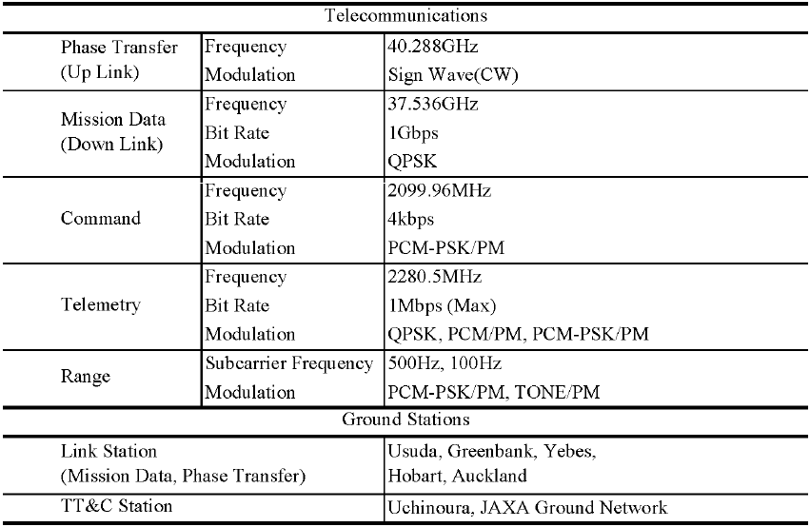
ASTRO-G frequency Selection
Observing band:
8.0 – 8.8 GHz, 20.6 – 22.6 GHz, 41.0 – 45.0GHz

Slide 23
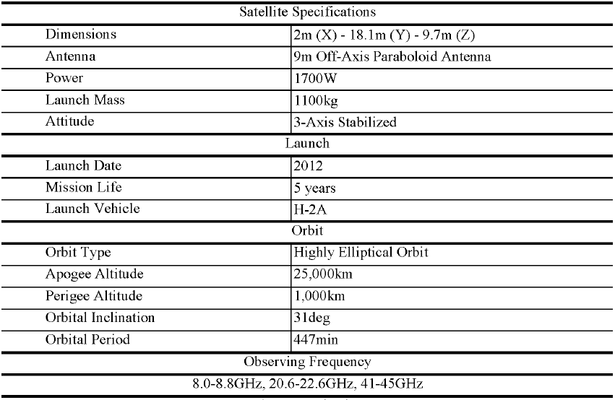

Slide 24
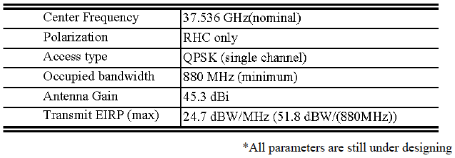
Status of the frequency sharing study for ASTRO-G in 37-38 GHz downlink
Space VLBI (SVLBI) system : Recommendation ITU-R SA.1344.
Drafting Group 3 in ITU-R SG-7 Working Party 7B (WP7B)
Sharing study to Lunar systems (SRS) and FSS.
WP7B chairman's report (Document 7B/168-E) was released last February
VSOP-2/ASTRO-G parameters are in Table 3.1 in Annex 8 to document 7B/168-E. But some of the parameters in this table have already updated. Difference of the table is as follows:

Slide 25
Frequency Management Activities of Radioastron
From ITU document form Radio communication study Group, 26 September 2008

Slide 26
Summary
Two space-VLBI missions expected be launched in 2010-2015. Observing frequencies range from microwave (300MHz) to millimeter wave (45GHz)
RFI expected around at non-protected frequency ranges. (This was true for earlier missions.), although dishes are looking
For future S-VLBI, allocation of wider frequency bandwidth will be required due to request for higher down-link rate
Astronomers request S-VLBI operational at higher frequencies and sensitivity (higher data rate)

