Slide 1
Primary Purpose of the
IUCAF Summer School
Masatoshi Ohishi
National Astronomical Observatory of Japan
IUCAF Chairman

Slide 2
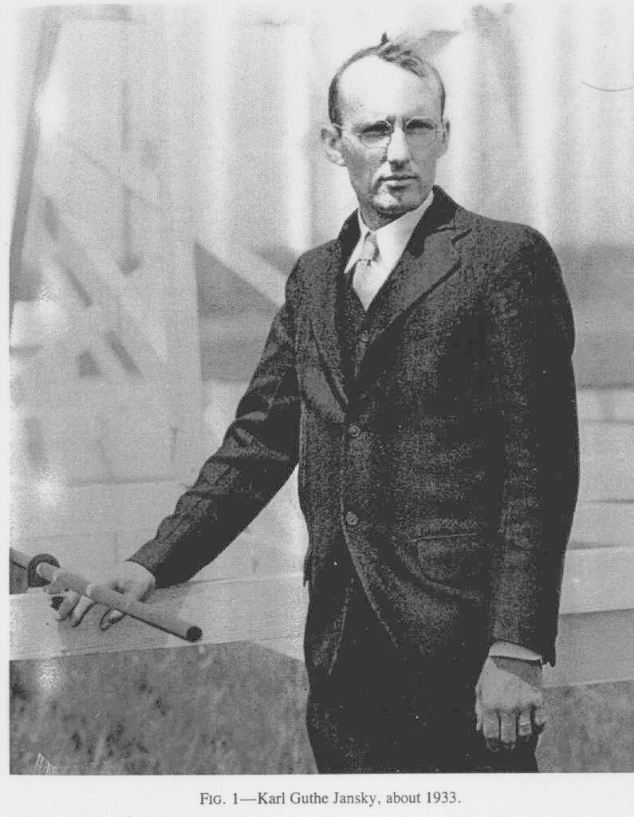
Radio Astronomy
Bell Telephone
Karl G. Jansky
Noise investigation on
the TransAtlantic wireless communication
@20.5 MHz
1932 July 8
noise peak with a period
of 23hours 56 minutes

Slide 3
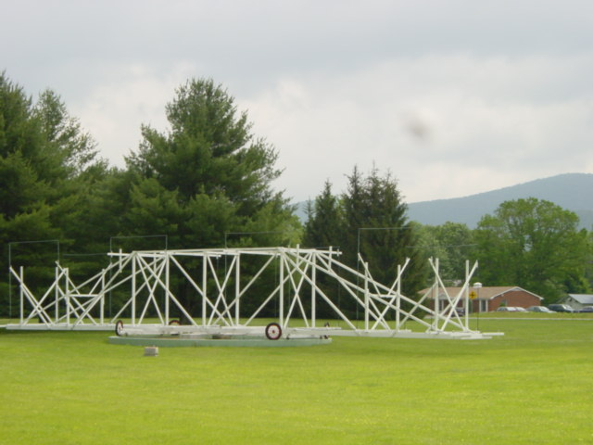
Replica Antenna @ Green Bank, WV, USA

Slide 4
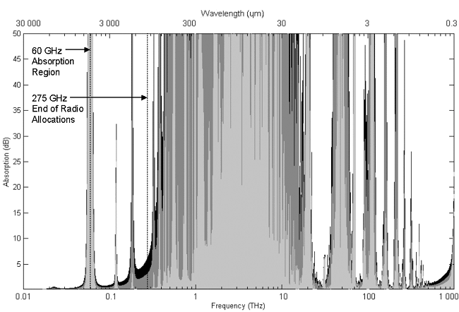
Atmospheric Absorption
Radio
window
Optical
window

Slide 5
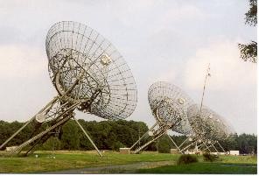
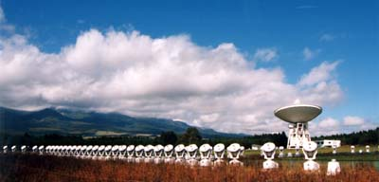
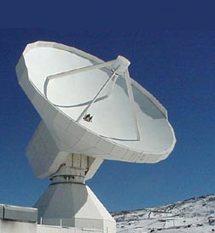
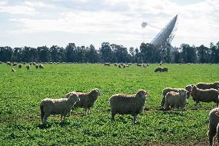
Radio Telescopes of the World

Slide 6
Arecibo Observatory, Puerto Rico
The huge "dish" is 305 m (1000 feet) in diameter, 167 feet deep.
It is a spherical (not parabolic) reflector.

Slide 7
Many Discoveries by RA
3K cosmic background radiation
→ expanding Universe
21cm HI line
→ our Galaxy is a spiral galaxy & the solar system is located 28,000 ly from G.C.
Many molecular lines
→ dense gas cloud – star-formation site
H₂O line at 22 GHz
→ discovery of a Black Hole
etc.

Slide 8
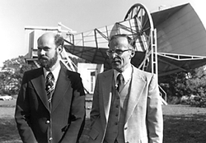

Slide 9
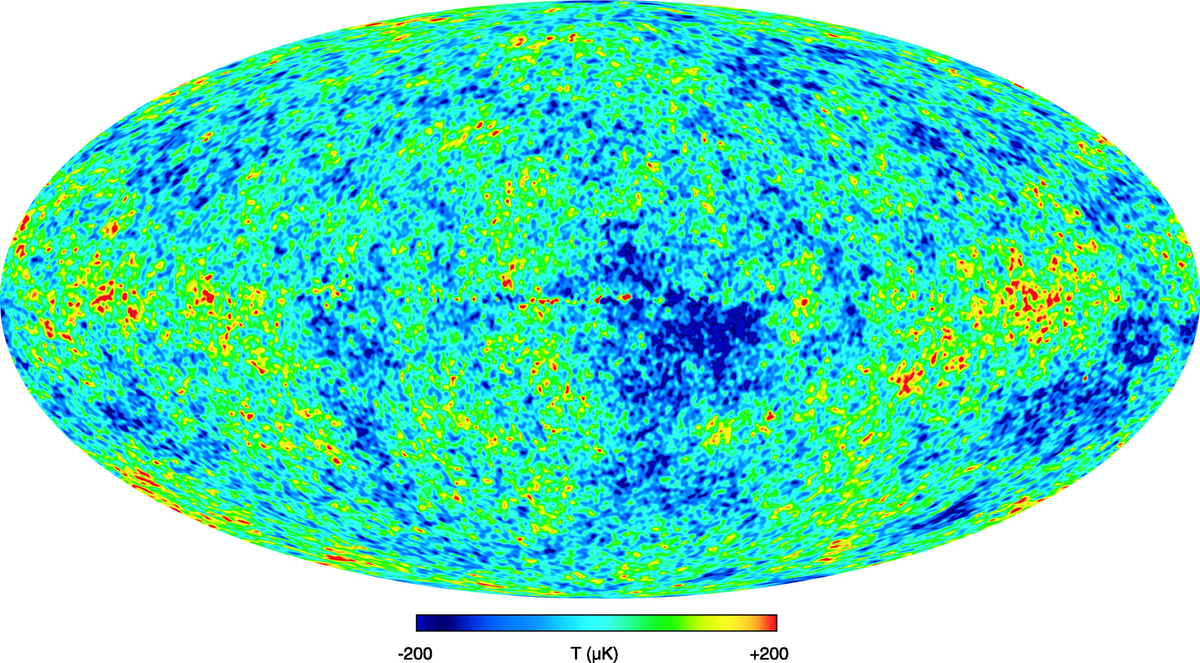
WMAP (Spatial Resolution of 0.2 deg)
@ 94 GHz

Slide 10
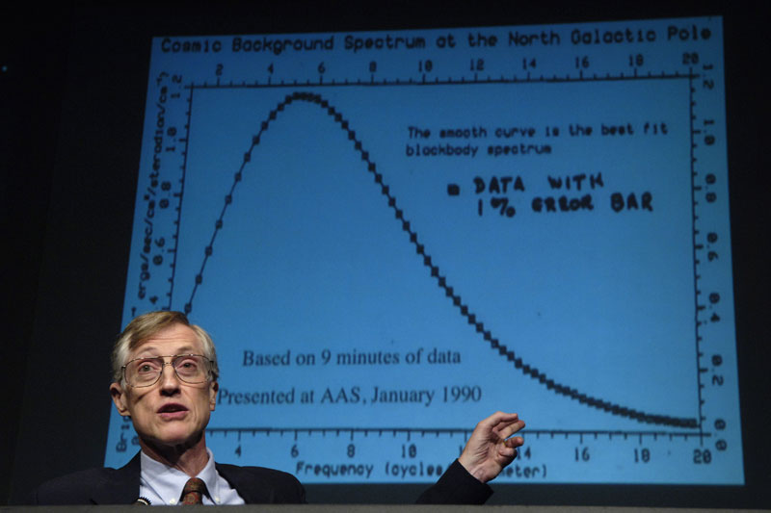

Slide 11
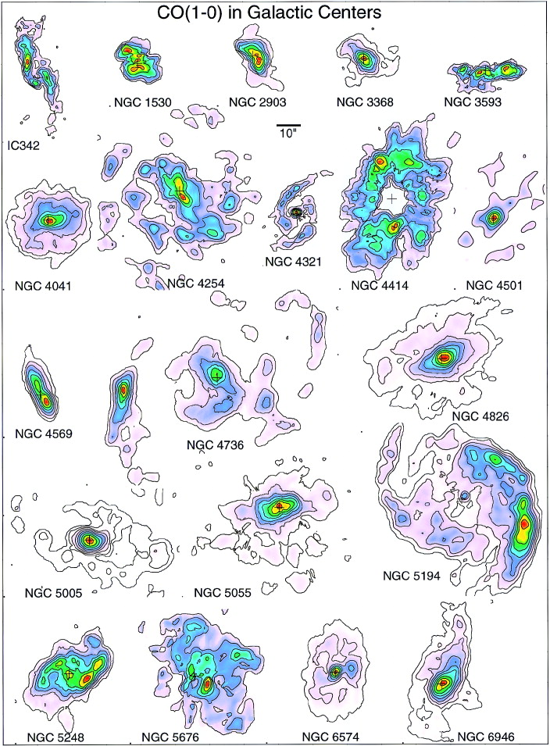
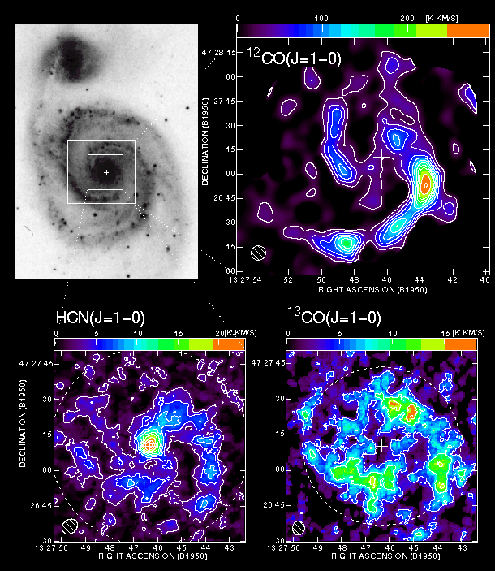

Slide 12
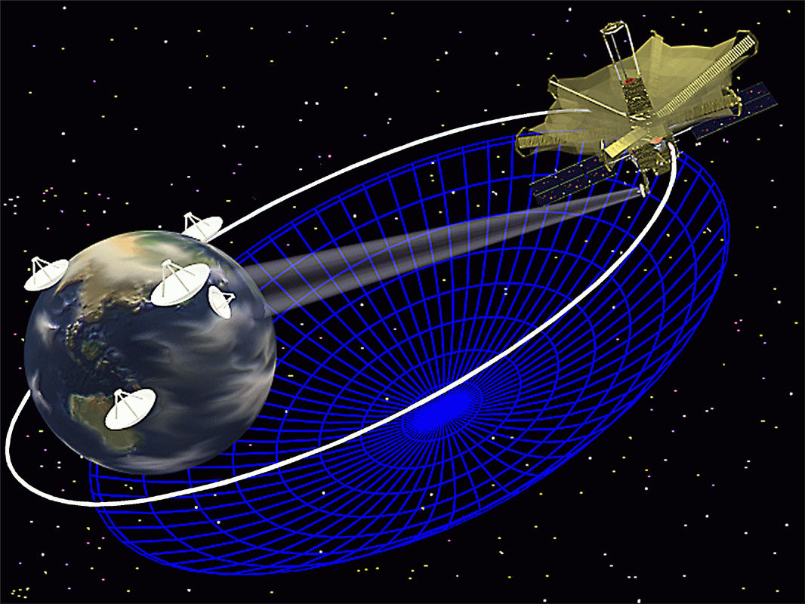
Space VLBI Observations
HALCA

Slide 13
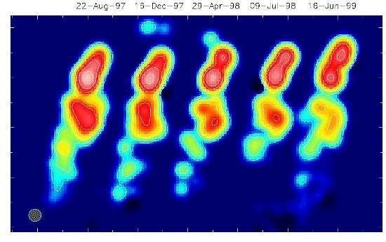
4C73.18 at 3.4 G light years

Slide 14
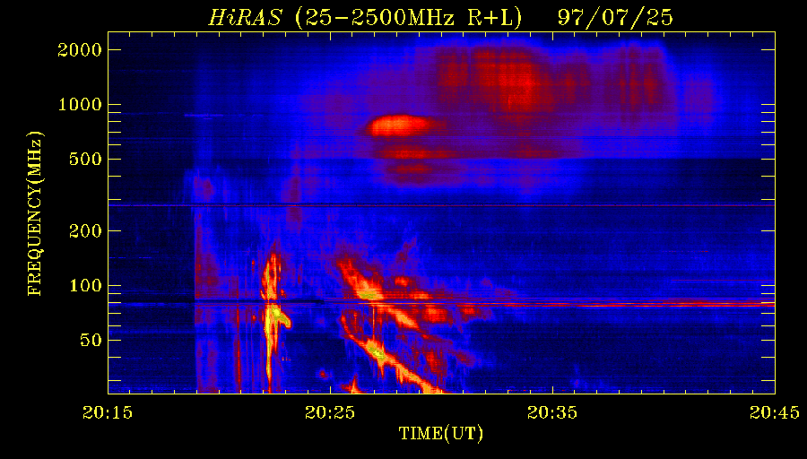
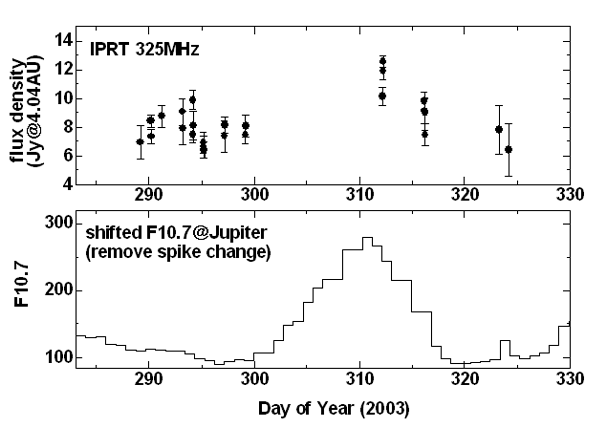
Objects and Intensities
Wavelength
10m
1m
10cm
Active Sun
10⁷
Galaxy Ｃｅｎｔｅｒbackground
10⁶
↑Solar Radio Burst Spectrum
(http://sunbase.nict.go.jp)
↑Galactic Noise Level
(Hiyama, 2004)
Jupiter
Quiet Sun
↓Jovian Radio Burst
(Konno et al. 2002)
10⁵
↓Jovian Synchrotron Radiation
10⁴
Cassiopeia A
Moon
Radio flux density [Jy]
JSR
10³
F10.7
M31
10²
Jovian synchrotron radiation (top) and solar f10.7 (bottom)
10
Protection
Criteria
for RAS
Jupiter
Rec. ITU-R RA.769
1
10
100
1,000
10,000
Frequency [MHz]
Cassiopeia-A Radio Map
(Oya & Iizama, 2003)
(Modified from Kraus, 1986)
(1Jy=10⁻²⁶W/m²/Hz)
Notes:
赤：銀河背景レベル
青：電波天文保護バンドにおけるITU-Rの干渉閾値勧告値（点）
黒：観測を実施している天体のスペクトル

Slide 15
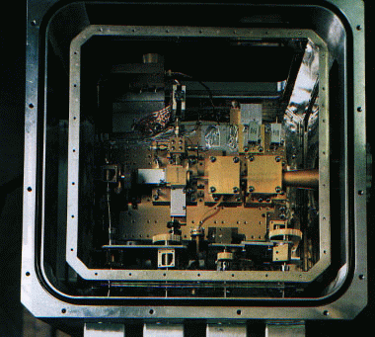
Receivers
Cooled Receivers
  SIS
  down to 4K
  Superconducting
  material
  HEMT
  Down to 20K
  Others with latest technology

Slide 16
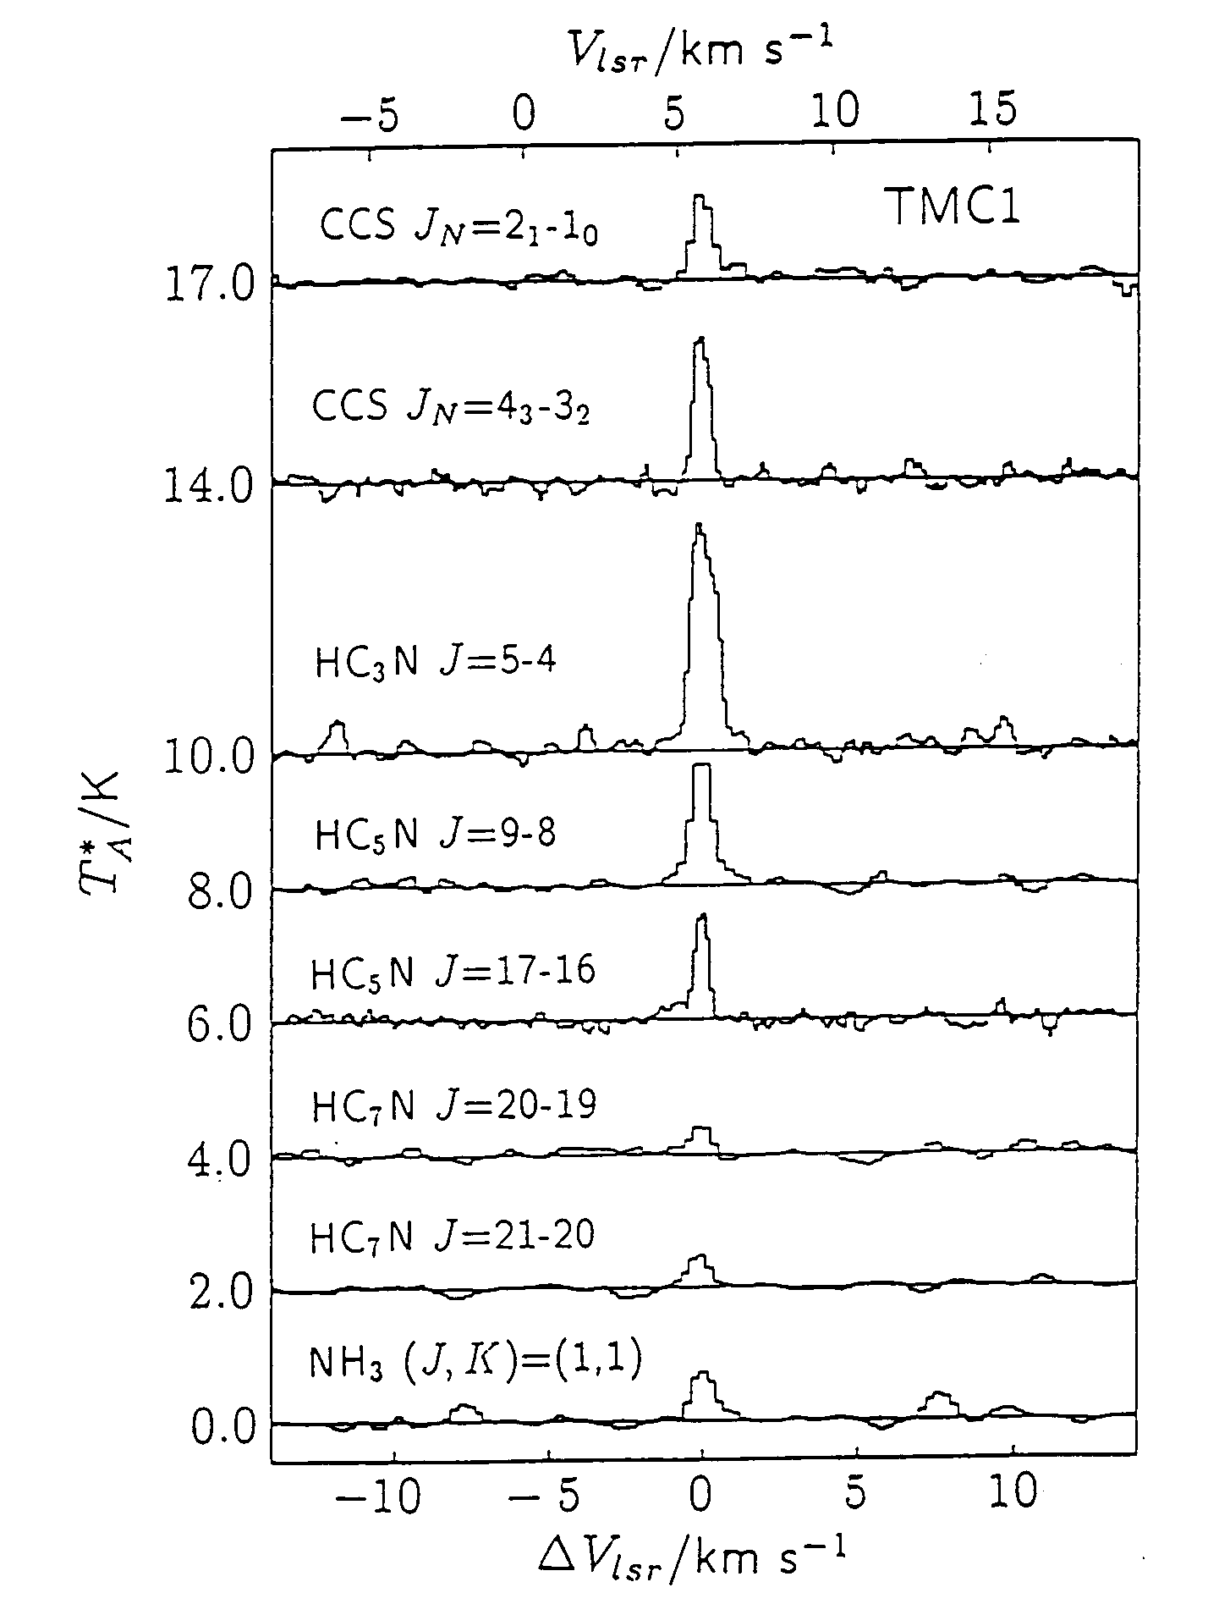
Line intensity
typically < 1 K
Receiver noise
a few 10 – 100 K
→ Signals from radio sources have negative signal to noise ratios !

Slide 17
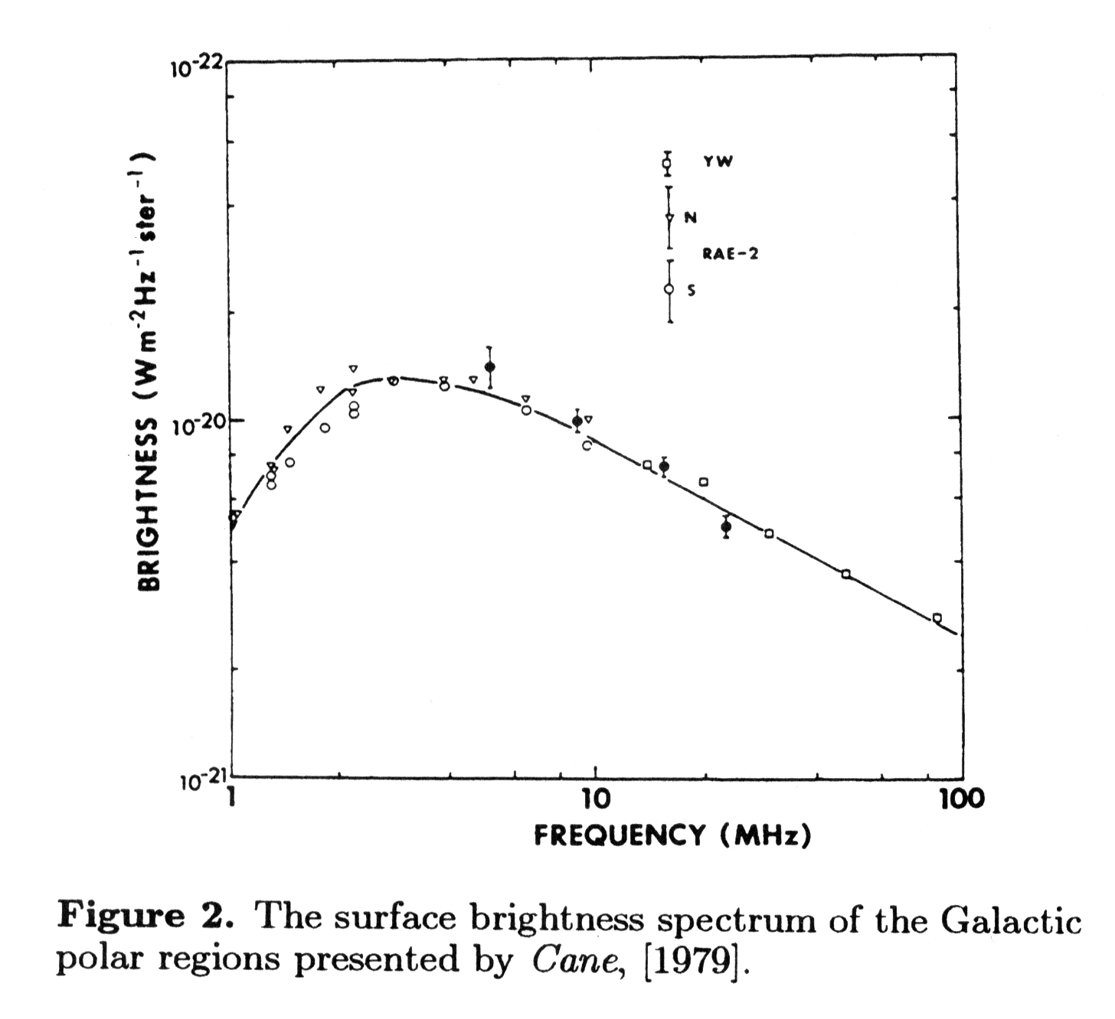
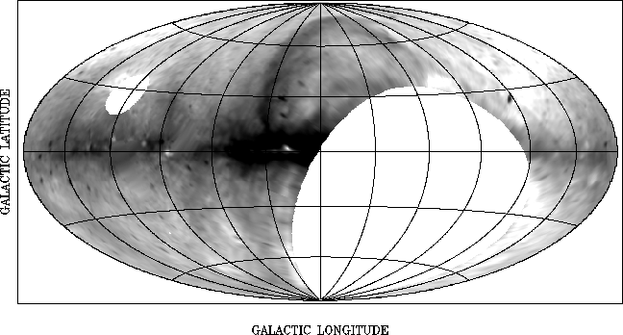
Char. of the Galactic Radio Spectrum
Strong Galactic noise always exists, and disturbs the detection of very weak natural signals
Galactic noise can be subtracted, since it is unpolarized and uncorrelated
→possible to detect weak signals

Slide 18
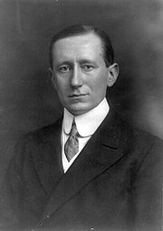
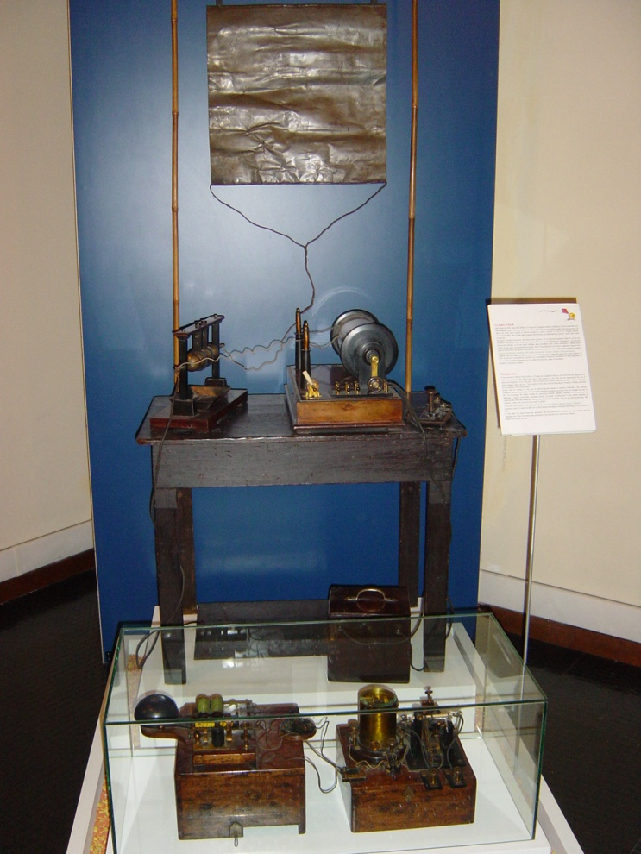
Wireless Communications in 1896
Guglielmo Marconi (1874 – 1937)
Invention of wireless telegraphy
The Nobel Prize in Physics 1909
Discovery of Ionosphere

Slide 19
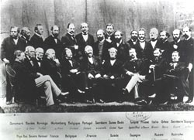
International Rule-Making Body
1844 Morse telegraph
1865 International Telegraph Union
1896 Marconi wireless telegraph
1906 International Radiotelegraph Convention
1927 International Radio Consultative Committee (CCIR)
Spectrum is a finite resource,
and must be shared by people
http://www.itu.int/en/history/
overview/Pages/history.aspx

Slide 20
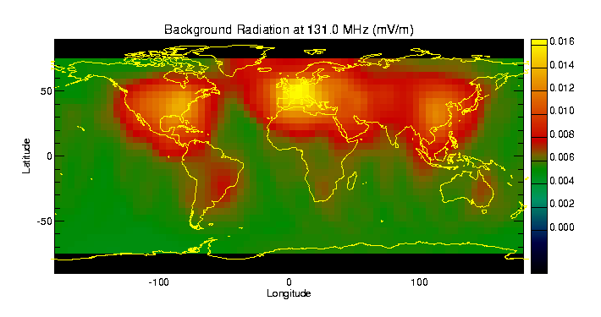
Where are the Quiet areas?

Slide 21
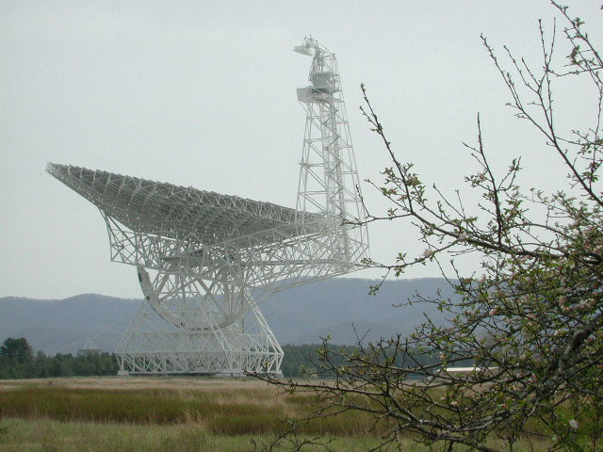
the NRQZ around the Green Bank observatory since 1958
The National Radio Quiet Zone (NRQZ) was established by the Federal Communications Commission (FCC) and by the Interdepartment Radio Advisory Committee (IRAC) in 1958 to minimize possible harmful interference to the National Radio Astronomy Observatory (NRAO) in Green Bank, WV and the radio receiving facilities for the United States Navy in Sugar Grove, WV. The NRQZ encloses a land area of approximately 13,000 square miles near the state
border between Virginia and West Virginia.

Slide 22
Spectrum Management
Radio frequency management is done by experts who meld years of experience with a curious blend of regulation, electronics, politics and not a little bit of larceny. They justify requirements, horse-trade, coerce, bluff and gamble with an intuition that cannot be taught other than by long experience
        Vice Admiral Jon L. Boyes
        U.S. Navy
Notes:
Well, there are few ways to entice people into spectrum management! Few teenagers are smart enough to decide that they want to go into spectrum management when they grow up. Even among technical people not too many are aware of what the activity is about, and most scientists are turned off when you begin an explanation. Important, maybe! But boooooring!!!! In fact, most of those in spectrum management, be they astronomers or lawyers, drift into it accidentally, and then some decide to stay for one reason or other. So, we thought that there had to be a better way, and hopefully this Summer School is going to turn out to be one of those better ways!
And while we are at it, I thought I'd give you a definition of Spectrum Management. When I happened to drift into this activity, I was given the office occupied by the previous incumbents. As usual, there were lots of junk left on the walls, a definition of spectrum management among them. It is the best that I found, and I kept on my wall! Here it is:

Slide 23
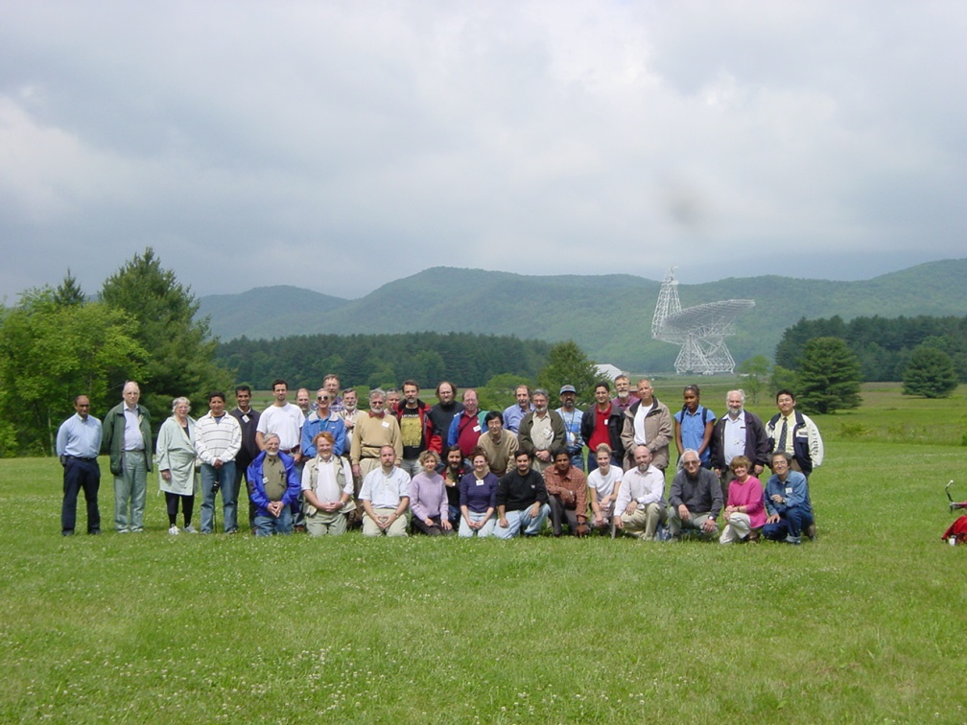
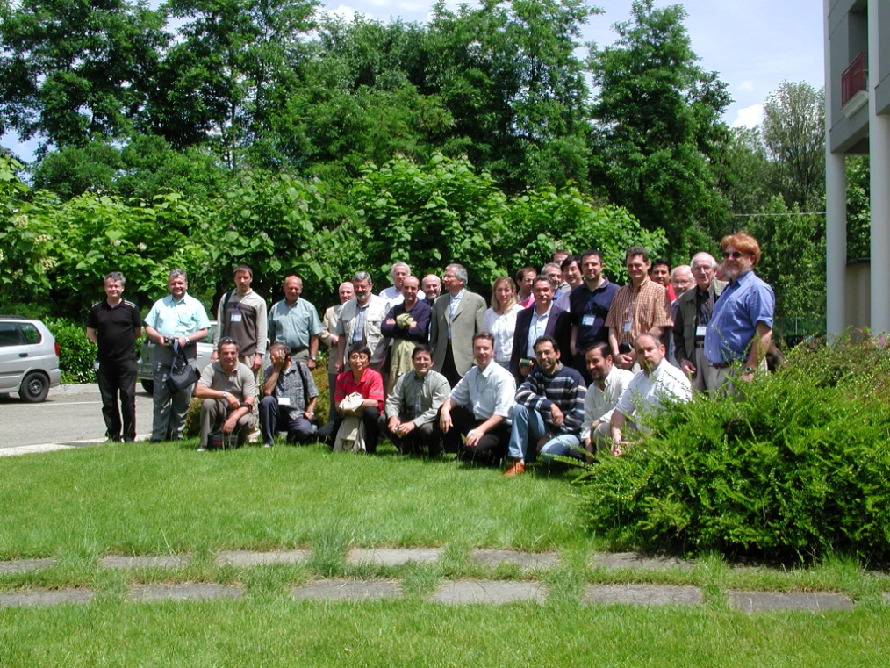
Past IUCAF SS
Green Bank, WV, USA
June, 2002
Castel San Pietro, Italy
June, 2005

Slide 24
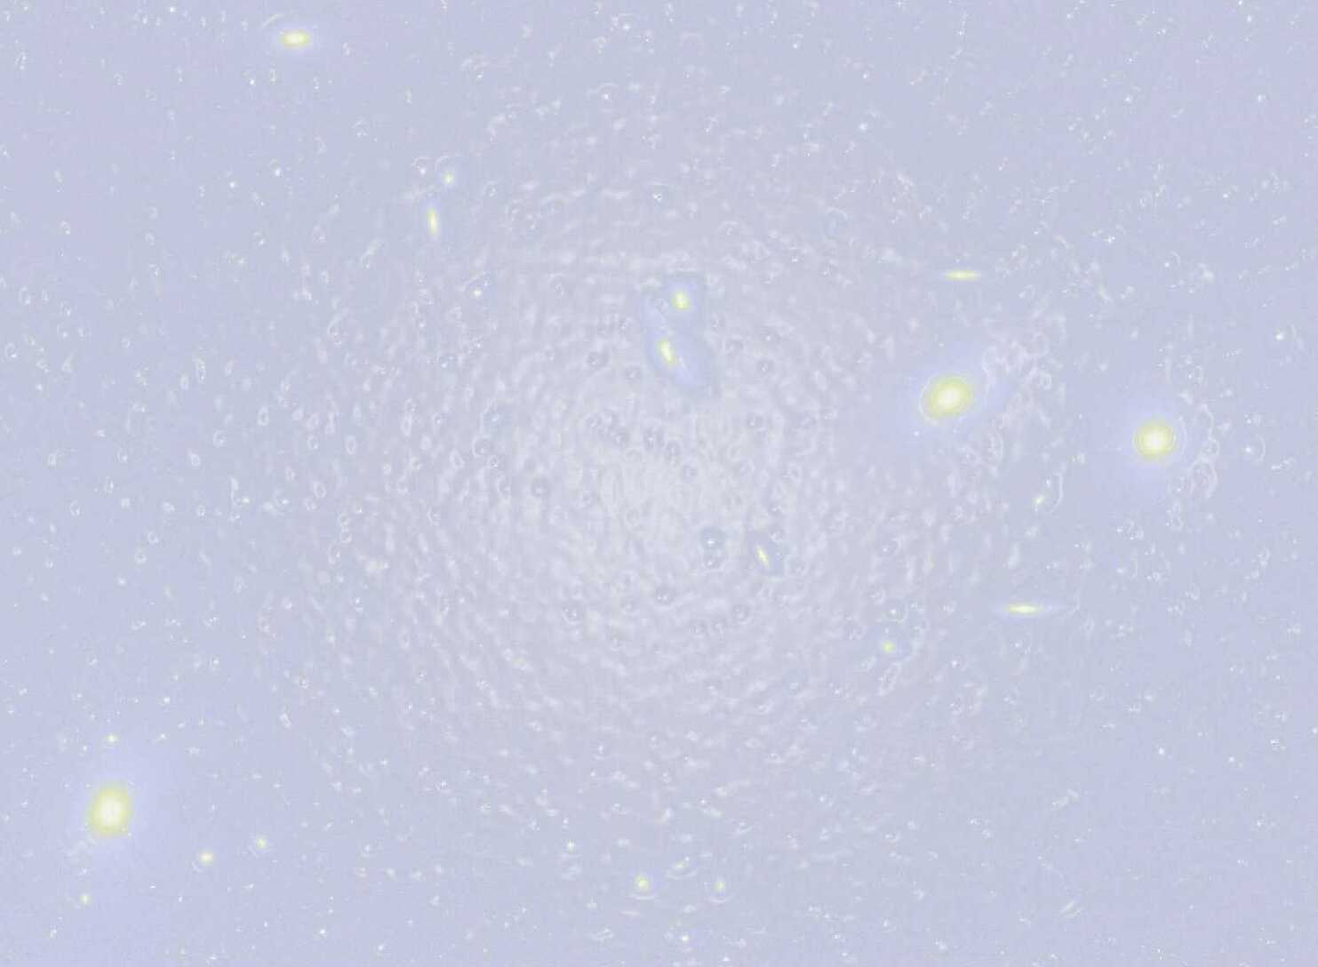
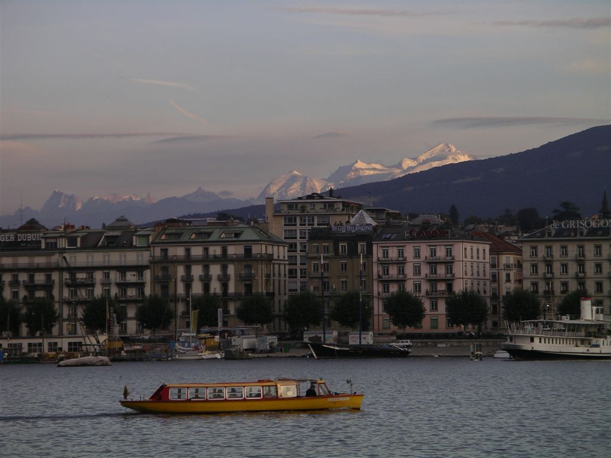
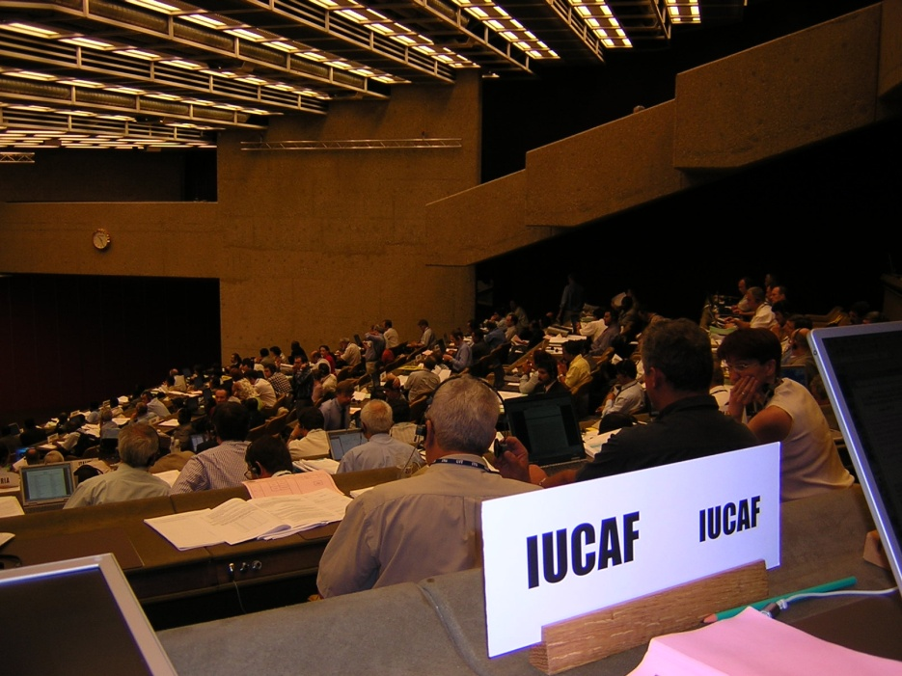
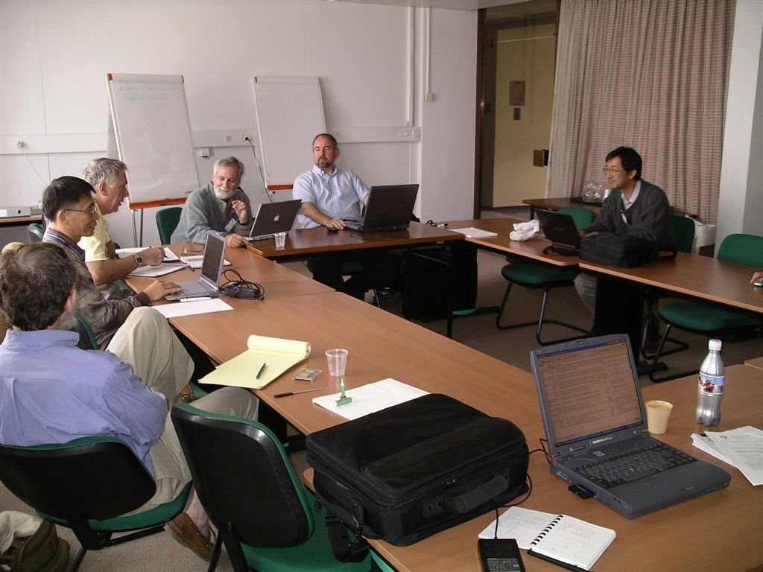
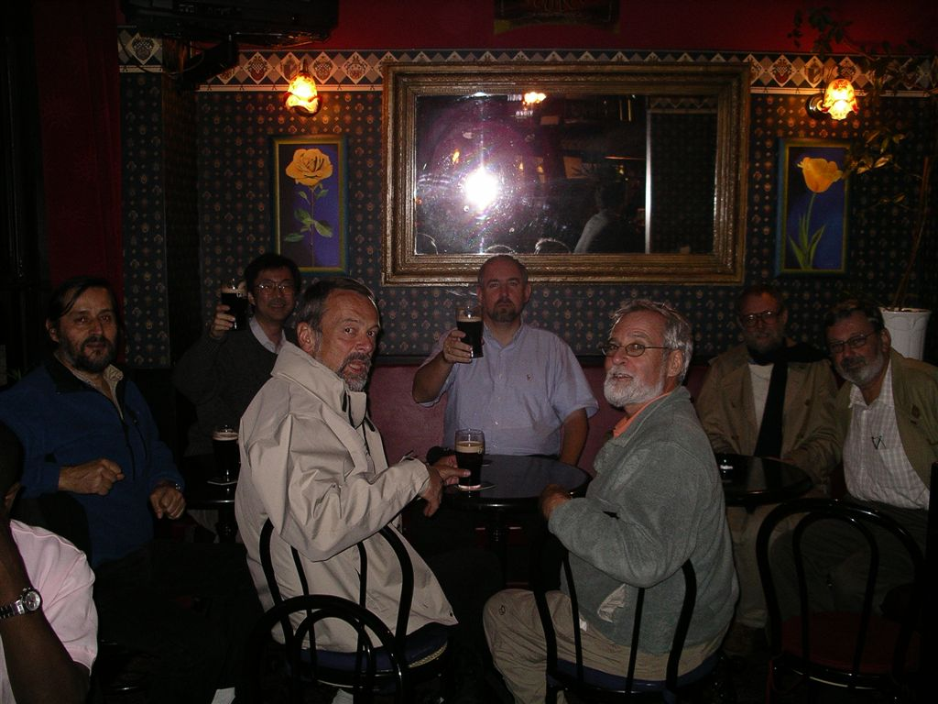
IUCAF in Action (in Geneva)

Slide 25
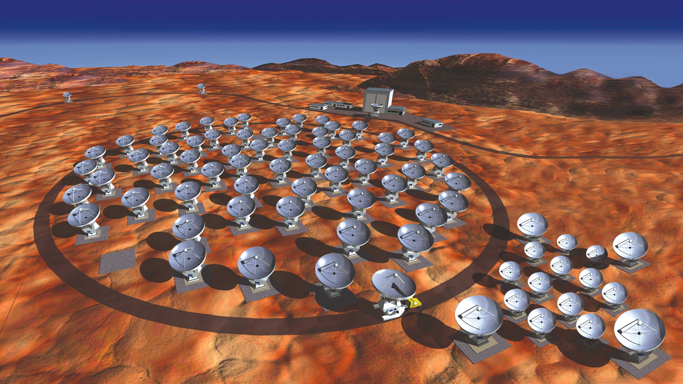
ALMA
(Atacama Large Millimeter/submillimeter Array)
Int. Collaboration – Japan/N.A/Europe
30~950 GHz, max. resolution ～0.01 sec

Slide 26
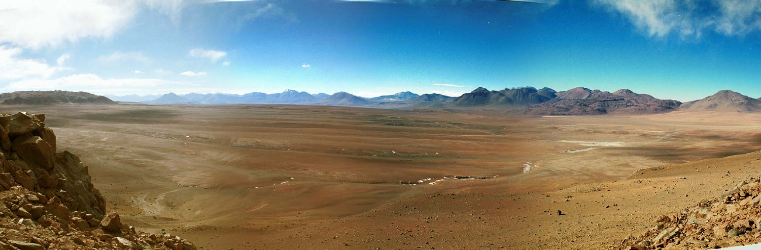
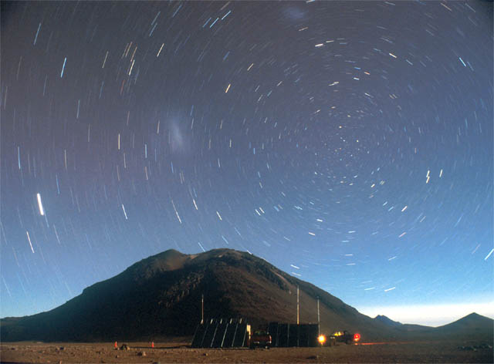
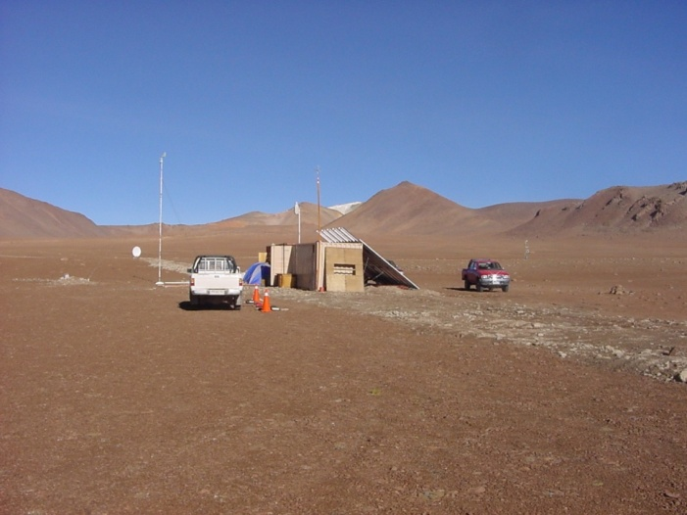
ALMA site (alt 4800m)

Slide 27
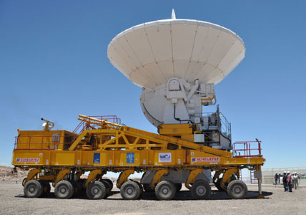
1st antenna delivered

Slide 28
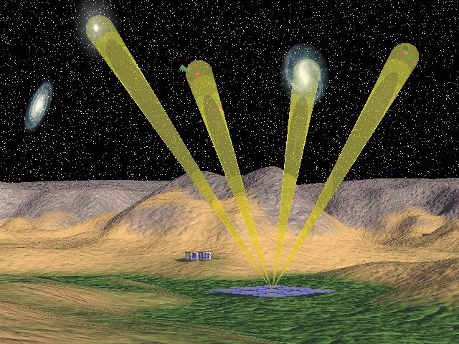
Square Kilometre Array
~ 1 km² collecting area in an interferometer array
wide frequency range: 0.1 – 25 GHz
configuration:
longest baselines >3000 km; 50% collecting area<5km
wide field of view: 50 sq. degree at <1 GHz (250 x moon)
total cost 1 B€; operating costs 70 M€/year

