Slide 1
IUCAF
Scientific Committee on Frequency Allocations for Radio Astronomy and Space Science
formerly known as the
Inter-Union Commission on the Allocation of Frequencies for Space Research and Radio Astronomy

Slide 2
The brief of IUCAF
To study and coordinate
the requirements of radio frequency allocations for passive radio sciences, such as radio astronomy, space research and remote sensing,
in order to
make these requirements known to the national and international bodies that allocate frequencies.

Slide 3
The “Inter-Union” aspect of IUCAF
Created in 1960 by ICSU (International Council for Science), a non-governmental organisation, representing 101 national scientific bodies and 27 international scientific unions that
coordinates interdisciplinary research
helps create international networks
in close relationship with, e.g., UNESCO
IUCAF is an interdisciplinary body of ICSU
Sponsoring ICSU Scientific Unions:
COSPAR space science
IAU astronomy
URSI radio science

Slide 4
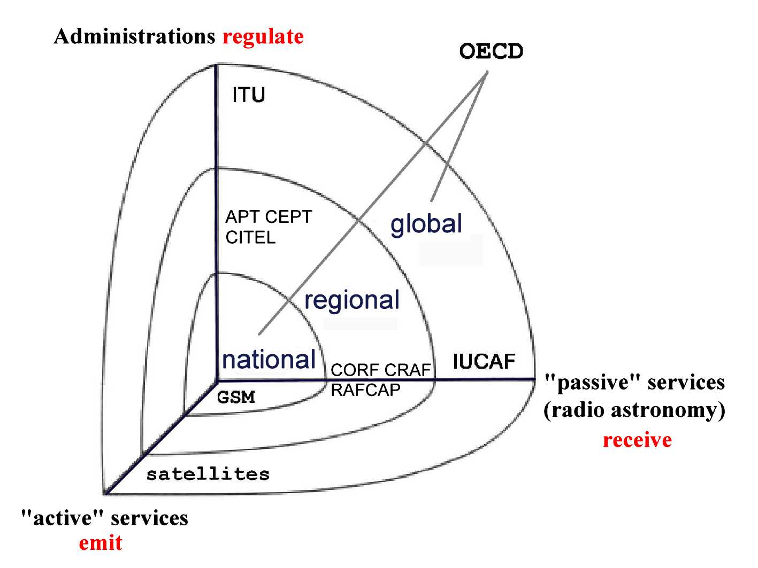
IUCAF’s place in the spectrum management problem space

Slide 5
Past IUCAF SS
Green Bank, WV, USA
June, 2002
Castel San Pietro, Italy
June, 2005

Slide 6
Weather Forecast

