Slide 1
ITU-R Recommendations and Reports
Masatoshi Ohishi (NAOJ)
Part of this ppt file was originally prepared by Prof. A. R. Thompson

Slide 2
Recommendations
The ITU-R Recommendations provide a body of technical, operational and regulatory / procedural information that has been agreed upon by the participating administrations. (Resolution ITU-R 1-5)
Not mandatory regulatory measures !
Respected by the administrations

Slide 3
Production of Recs.
Question
Agenda Item
Working Party
Task Group
Study based on
contributions
PDNR
APPROVE
Study Group
DNR
ADOPT
One objection
VOTE
Administration
New Rec

Slide 4
ITU-R Recommendation Series
BO Satellite Delivery
BR Recording for production, archival and play-out; film for
television
BS Broadcasting service (sound)
BT Broadcasting service (television)
F Fixed service
M Mobile, radiodetermination, amateur and related satellite
services
P Radiowave propagation
RA Radio astronomy
RS Remote Sensing systems
S Fixed satellite service
SA Space applications and meteorology
SF Frequency sharing and coordination between fixed satellite
and fixed service systems
SM Spectrum management
SNG Satellite news gathering
TF Time signals and frequency standards emissions
V Vocabulary and related subjects

Slide 5
How to Name Recs
Recommendation ITU-R RA.769-2
RA:Radio Astronomy
769: sequential number
-2 : Revision number

Slide 6
ITU-R Recommendations in the Radio Astronomy Series (1)
Basic Protection Criteria
RA.314 Preferred frequency bands for radio astronomical
measurements
RA.769 Protection criteria used for radio astronomical measurements
RA.1513 Levels of data loss to radio astronomy observations and
percentage-of-time criteria resulting from degradation by
interference for frequency bands allocated to radio astronomy
on a primary basis
RA.1860 Preferred frequency bands for radio astronomical
measurements in the range 1-3 THz
Coordination Zones
RA.1031 Protection of the radio astronomy service in frequency bands
shared with other services
RA.1272 Protection of radio astronomy measurements above 60 GHz
from ground based interference

Slide 7
ITU-R Recommendations in the Radio Astronomy Series (2)
Out-of-Band and Spurious transmissions
RA.517 Protection of the radio astronomy services from transmitters
operating in adjacent bands
RA.611 Protection of the radio astronomy service from spurious
emissions
RA.1237 Protection of the radio astronomy service from unwanted
emissions resulting from applications of wideband digital
modulation
Protection of regions in Space
RA.479 Protection of frequencies for radioastronomical
measurements in the shielded zone of the Moon
RA.1417 A radio-quiet zone in the vicinity of the L2 Sun-Earth
Lagrange point

Slide 8
ITU-R Recommendations in the Radio Astronomy Series (3)
Miscellaneous
RA.1630 Technical and operational characteristics of ground-based
astronomy systems for use in sharing studies with active
services between 10 THz and 1000 THz
RA.1631 Reference radio astronomy antenna pattern to be used for
compatibility analyses between non-GSO systems and radio
astronomy service stations based on the epfd concept
RA.1750 Mutual planning between the Earth exploration-satellite
service (active) and the radio astronomy service in the
94 GHz and 130 GHz bands

Slide 9
RA.769
Defines threshold levels of interference detrimental to RA observations, and recommends to meet these levels
Calculation method
Two modes
  Continuum mode (Table 1): total power into an entire RA band
  Spectral line mode (Table 2): power into a reference band width
Threshold values for both modes should be simultaneously met

Slide 10
flux
flux
S
S
C
C
→ frequency
→ frequency
Total power of interference does
not exceed the continuum mode
threshold value AND interference
power in ANY reference band does
not exceed the spectral line mode
threshold level
→ meets the Rec
Total power of interference does
not exceed the continuum mode
threshold value BUT interference
power in at least one reference
band exceeds the spectral line
mode threshold level
→ does not meet the Rec

Slide 11
SA.509 Sidelobe Model
32-25log Φ
Empirical sidelobe model for reflector antennas of diameter ≥ 100
wavelengths. 90% of sidelobe peaks lie below the curve.
Representative of symmetric parabolic-reflector antennas.
Φ
Ω
Solid angle Ω = 2 π (1-cos Φ)
In RA threshold calculations, sidelobe gain of 0 dBi is used for
reception of RFI.

Slide 12
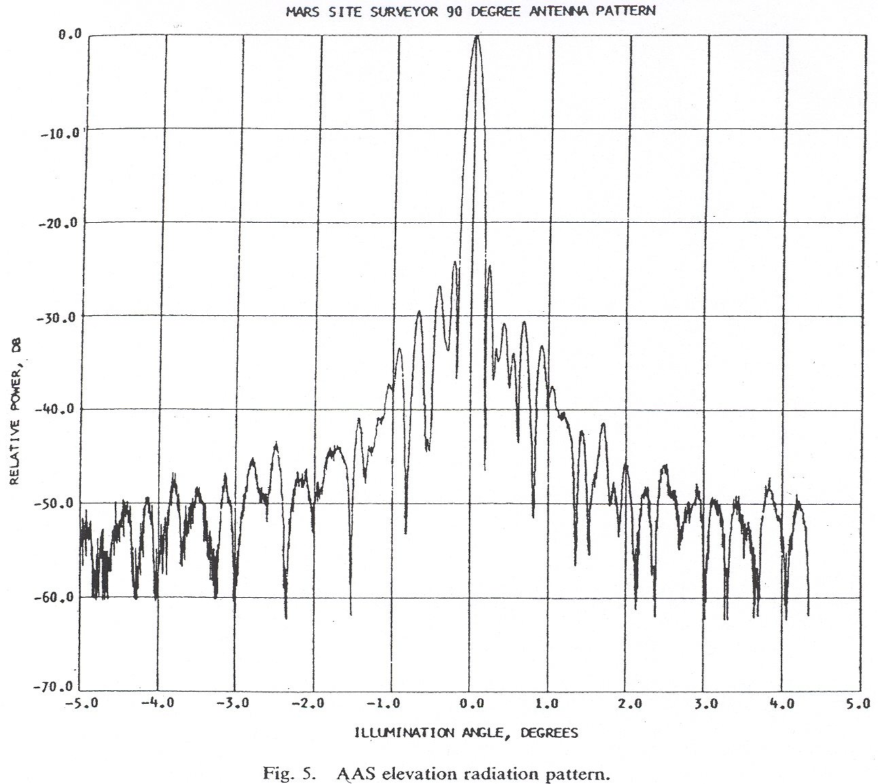
Example of sidelobes
210-ft antenna at S-band, from Levy, G. S., et al., IEEE Trans. AP-15, 311, 1967.
Notes:
.

Slide 13
Gain (G) and aperture (A) for detrimental threshold calculation
Ω =2 π (1- cosφ)
 | φ G = 1 (0 dBi) | Ω/2π
32-25 log φ (SA.509) | 19.05° | 5.5%
29-25 log φ (S.580) | 14.45° | 3.2%
34-30 log φ (RA.1631 and S.1248) | 13.59° | 2.85%

Slide 14
Threshold-level Formula
Voltage ratio at receiver output:
For Interference/rms noise = 0.1,
(see ITU-R RA Handbook Eq. 4.10)
Units of S_{H} are W m⁻²Hz⁻¹ (spectral power flux density)
Units of F_{H} are W m⁻² (power flux density)

Slide 15
Detrimental thresholds for total power observations
black, continuum; red, spectral line
RA Handbook Fig. 4.1 (p. 36)

Slide 16
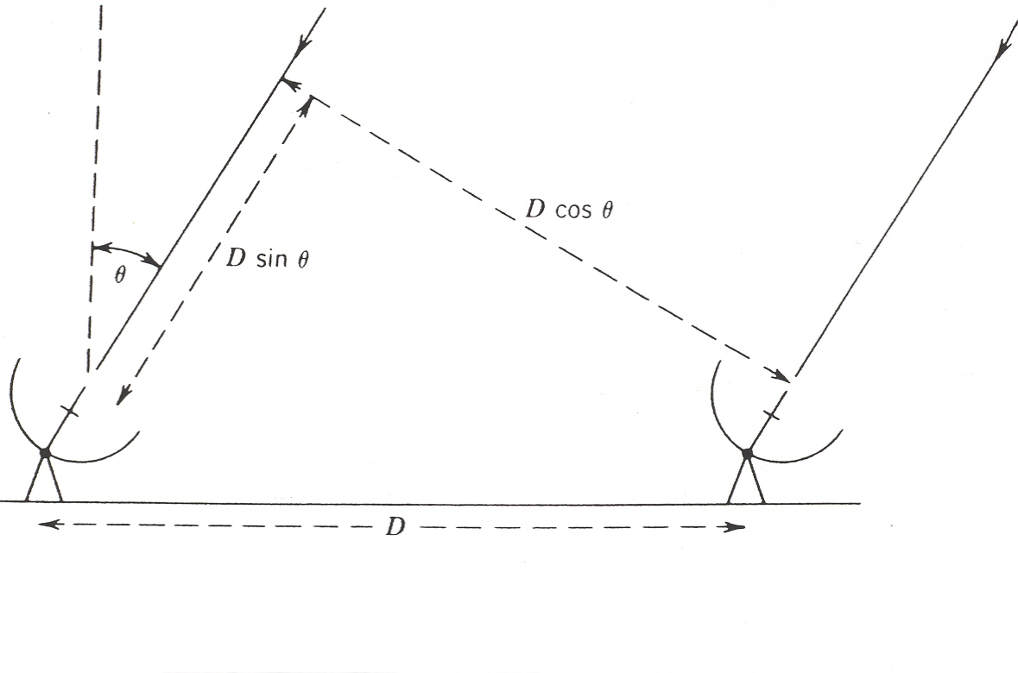
Basic Radio Interferometer
Fringe-frequency oscillations occur in the output of an interferometer as a result of the variation of the path difference D sin θ as the source moves across the sky. Removal of the fringe oscillations from the response to a source introduces similar oscillations into an RFI signal from a stationary transmitter. Time-averaging reduces the response to the RFI oscillations.

Slide 17
Interference threshold for VLBI
In VLBI, the natural fringe frequency is so high that the RFI fringe amplitude can be considered to be reduced to zero at the correlator output. However, the presence of RFI in the receiver can introduce errors into the system calibration. Thus the Interference threshold criterion for VLBI is the level at which the interference power within the receiver (before detection) is 1/100 of the noise power.
.
The power ratio interference/noise within the receiver is:
The RFI threshold for interference/noise = 1/100 is:

Slide 18
Detrimental thresholds for continuum observations
black, total power ; magenta, VLA (D and A);
blue, Merlin; red, VLBI
RA Handbook Fig. 4.2 (p. 40)

Slide 19
RA.1513
Defines tolerable fraction of interference that exceed the threshold level
Not fraction of time, but fraction of “Data Loss”
RA bands on a primary basis only
Data loss due to any single network
  <2%
Aggregated data loss due to all networks
  <5%; methodology of apportionment between different networks is to be studied

Slide 20
Reports
A technical, operational or procedural statement, prepared by a Study Group on a given subject related to a current Question or the results of studies referred to in § 3.3 (Resolution ITU-R 1-5)

Slide 21
Production of Reps.
Question
Agenda Item
Working Party
Task Group
Study based on
contributions
PDNRep
APPROVE
Study Group
DNRep
ADOPT
Administration
New Rep

Slide 22
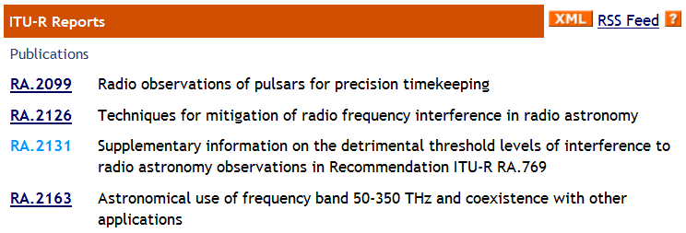
RA series Reports

Slide 23
Rep. ITU-R RA.2131
Conversion from spfd/pfd to field strength
Comparison between Rec RA.769-1 and 769-2
  One administration claims that it denies “769-2”, but prefers to “769-1”
  “769-1” and “769-2” levels are identical for
  f < 50 GHz
  “769-2” contains threshold levels for the 22GHz band

Slide 24
How to Get ITU-R Recs/Reps ?
Visit the ITU publication site at
http://www.itu.int/publications/sector.aspx?lang=en&sector=1
Click ITU-R Rec/Rep on the left
Select Rec/Rep series
Select individual Rec/Rep
Select version
ADD to CART

