Slide 1
World Radiocommunication Conferences (WRCs)
Tomas E. Gergely
Summer School on Spectrum
Management and Radio Astronomy
Mitaka, Tokyo,
Japan
June 2010

Slide 2
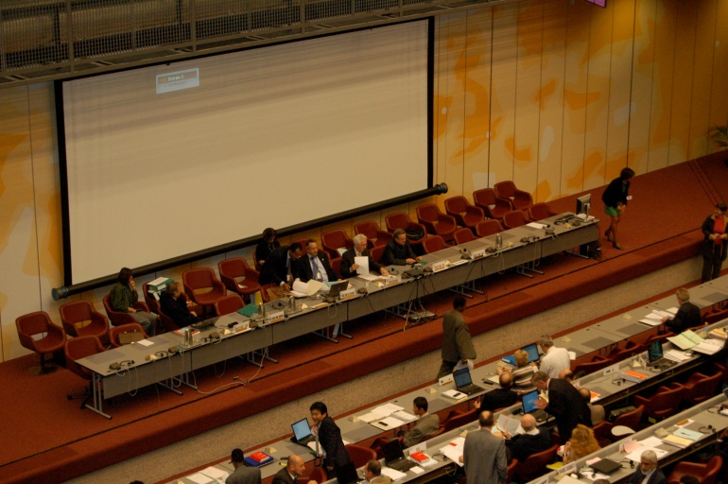
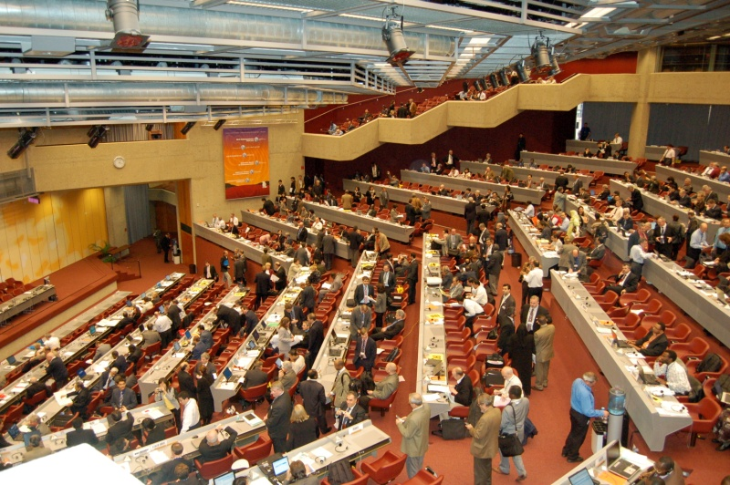
WRCs: Introduction
WRCs Are a Big Deal!
WRC-07 attended by:
over 2800 delegates
from 164 countries
and 104 observers from
member organizations
Considered
  over 400 documents

Slide 3
For a Feel of a WRC (WRC-97) as Experienced by An Astronomer, see:
http://dsnra.jpl.nasa.gov/freq_man/wrc97.html

Slide 4
The ITU Framework
International uses of the radio spectrum are regulated by the
International Telecommunication Union (ITU), (a specialized agency of the United Nations) through the Radio Regulations
The International Table of Allocations is part of the Radio
Regulations (Article 5). At present, within the ITU,
radiocommunication is considered to encompass the
spectrum below 3 000 GHz, but spectrum allocations cover
only up to 275 GHz.
WRC-12 will revise footnote 5.565 that deals with passive
uses of the 275 – 1000 GHz range, to cover up to 3 000 GHz
Countries are sovereign with regard to the uses and the
regulation of the radio spectrum within national borders and
are under no obligation to adopt or follow the International
Table of Allocations inside their territory, but mostly do so,
out of convenience.
The Radio Regulations are an international treaty that covers
all aspects of radiocommunications, in particular, the use of
the radio-frequency spectrum by all radio(communication)
services and the geostationary orbit.

Slide 5
How Can WRCs Impact
Radio Astronomy?
Directly Through:
    Allocations:
      In-Band sharing
      Adjacent band allocations (satellite downlinks)
      Footnotes
      Establishing (or not establishing) standards (e.g. spurious emissions, frequency tolerances, etc.)
      Other regulations (e.g. coordination requirements )
Mandating Studies that may affect the status of radio astronomy in various bands
Other Regulations (e.g. data required for the registration of Radio Observatories, Earth Stations, etc. )
Placing Radio Astronomy issues (or related issues) on the agenda of a future WRC

Slide 6
How Do WRCs Work:
Agendas and Proposals
The scope of each WRC is limited by an Agenda
Each WRC develops and formally adopts a draft Agenda (contained in a Resolution) for the next conference, and a provisional agenda for the following one.
Agendas may contain many unrelated items, e.g.: AIs 1.6 and 1.8 (WRC-12)
  1.6 Revision of footnote RR 5.565 and extending it up to 3 000 GHz
  1.8 Sharing between the fixed service and other services (including the
  RAS) in the 71-238 GHz range ;
The draft Agenda for each WRC must be formally approved by the ITU Administrative Council, which meets annually. Once approved by the Council, the Agenda is submitted to Member States for final adoption, and is finalised about 12 months after the previous WRC developed it.
An issue that is not on the Agenda cannot be treated, so often there is considerable competition (fight) among items wanting a place on the Agenda.
WRCs work by considering Proposals, that may be submitted only by Members (Administrations ) in good standing (ratified the convention and paid their dues)
The deadline for submitting proposals is (usually) set six months prior to the beginning of the WRC (and this deadline is often ignored)

Slide 7
Proposals: An Example
MOD USA/38/2
Reasons: To provide necessary allocations for non-GSO MSS feeder links (Earth-to-space) and (space
to-Earth) in support of existing non-GSO MSS service link allocations below 1 GHz while ensuring
protection of currently allocated services.
ADD USA/38/6
5.MSSDN Additional allocation: The band 1 430-1 432 MHz is also allocated on a primary basis to the
mobile-satellite service (space-to-Earth), limited to feeder links for non-geostationary systems in the
mobile-satellite service with service links below 1 GHz. In order to protect the radio astronomy service
in the 1 400-1 427 MHz band, the aggregate power flux‑density radiated by all space stations produced
in the 1 400-1 427 MHz band shall not exceed the level of –180 dB(W/m²) in a 27 MHz band and a level of
–196 dB(W/m²) in any 20 kHz portion of the 1 400-1 427 MHz band, at the site of any radio astronomy
station for more than 2% of the time.
1 429-1 452 FIXED MOBILE except aeronautical mobile | 1 429-1 452 FIXED MOBILE 5.343
5.341 5.342 ADD 5.MSSDN ADD 5.MSSCOOR | 5.341 ADD 5.MSSDN ADD 5.MSSCOOR

Slide 8
STRUCTURE OF WRC-07
PLENARY
(Chairman)
Com 6
Future Agendas
Revision of Res and Recs
Com 1
Steering
Com 2
Credentials
Com 3
Budget
Com 7
Editorial
COM 4
13 Agenda Items
COM 5
14 Agenda Items

Slide 9
How Do WRCs Work:
Mechanics
Compromise is sought to the maximum extent possible, votes are avoided as much as possible
One country, one vote rule favors the formation of (regional) blocs:
  CEPT, APT, CITEL, Arab Bloc, etc.
Delegations, representing members e.g. IUCAF), work by trying to influence Administrations by:
      Lobbying
      Distributing Information papers
      Addressing the Floor, when allowed to do so
      Any other way possible, (some legal, some less so)
Radio Astronomers participate through:
      National Delegations (participate in developing national positions, delegation meetings, as spokespersons, etc., they are however, bound by national positions)
      IUCAF (free to lobby, not bound by [but in most cases also unable to] influence national positions)
      Most countries do not allow simultaneous participation in national and Member delegations, but some do.

Slide 10
The Mechanics of WRCs
Proposals are attributed to the various committees (or subcommittees) and are introduced there in some detail
Subcommittees or drafting groups are formed, until a manageable size of interested people is reached (sometimes nested 5-6 levels deep)
Consensus is sought in the subgroups, often many meetings may be necessary to resolve an issue (e.g. to resolve the GLONASS related issue at WRC-07 (Res. 739), six meetings were necessary)
If consensus is reached, the consensus proposal is elevated to the parent group for approval (and so on, until it reaches the plenary)
If consensus is impossible to reach, Chairman of parent group is informed and takes over
Votes are taken only as a last recourse, when all attempts at
reaching consensus failed
Often there is only a partial resolution of an issue, with resolutions for further studies, and the issue may be revisited at the next WRC
Much (but not all!) Depends on the chairpersons’ ability to conduct the meetings and force consensus
One consequence of this procedure is that the most difficult problems are left to the end of the WRC, and end up treated in large groups

Slide 11
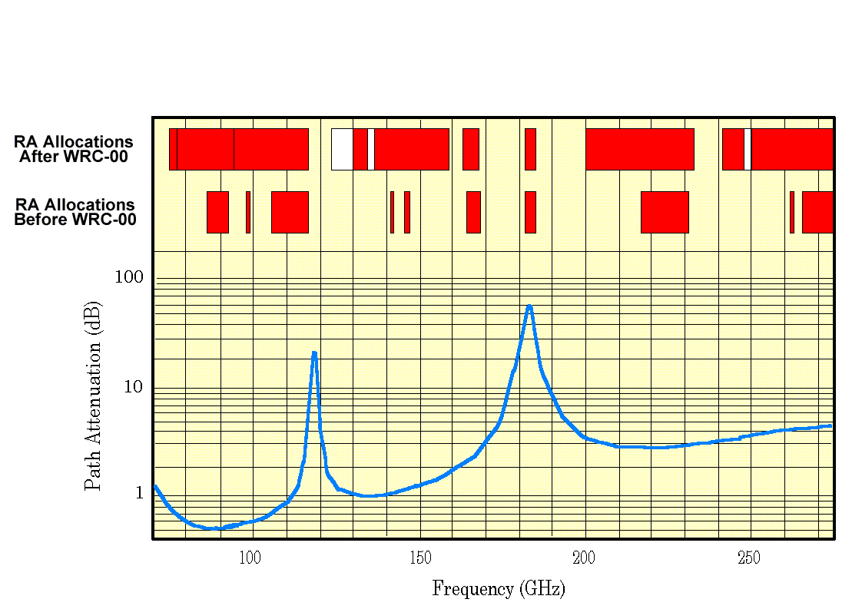
Consensus Reached : Mm-wave Allocations (WRC-00)
REASONS FOR SUCCESS:
Systems Above 71 GHz Are Under Development, But Are Not Yet Operational, So No Costly Assets Needed to Be Relocated
Astronomers coordinated proposals very closely and carefully during the process leading up to the WRC. This resulted in nearly identical proposals by the three large regional groups within the ITU (CITEL, CEPT and APT)
Astronomy Proposals Were Also Carefully Coordinated With Remote Sensing Community (and Amateurs)
Flexibility Shown By Astronomy Community In Developing Proposals
Active Services Distracted By Many Other WRC Related Concerns
Few Active Commercial Requirements in This Spectral Region Yet (But Situation Changing Rapidly, e.g. FCC Push to Commercialize 90- 94 GHz )

Slide 12
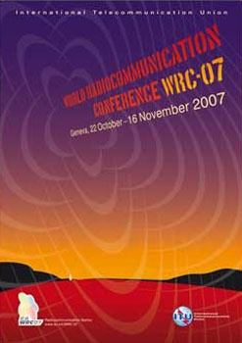
WRC Output
The output of a WRC is contained in the
“Final Acts”, a treaty level document, that
usually has to be ratified, by each country’s
parliamentary process.
Administrations may exempt themselves from
complying with some provisions of the Final
Acts, by taking a “reservation”. Reservations
are appended to the Final Acts.

Slide 13
WRC-12 AI 1.6 - The Item of Major
Interest to Radio Astronomy
Res. 950 - Revision of footnote 5.565, based
on ITU-R studies
    Revise the listing of bands in the 275 - 1000 GHz range,
  currently in the footnote
    Extend the range of the footnote, to cover up to 3000 GHz
Res. 955 - Consider possible procedures for free- space optical links, based on ITU-R studies

Slide 14
(Some) Other WRC-12 Agenda Items of Interest to Radio Astronomy
AI 1.4. “….to consider, …. further regulatory measures to facilitate introduction of new aeronautical mobile (R) service (AM(R)S) systems in the bands …5 000-5 030 MHz”
  Issue: airborne transmitters may be operating next to the primary 4990-5000 MHz radio astronomy band
AI 1.18”… extending the existing …radiodetermination-satellite service (space-to-Earth) allocations in the band 2 483.5-2 500 MHz in order to make a global primary allocation, and determine the necessary regulatory provisions….”
    Issue: 2nd harmonic of downlink falls on 4990-5000 MHz RA band, currently subject to footnote RR 5.402, that urges protection of RA
AI 1.21. “to consider a primary allocation to the radiolocation service in the band 15.4-15.7 GHz…”
    Issue: Strong, possibly airborne transmitters operating next to the 15.35-15.4 GHz passive band
AI 1.20 “spectrum identification for gateway links for high altitude platform stations (HAPS) in the range 5 850-7 075 MHz in order to support operations in the fixed and mobile services”
  Issue: Potential interference with observations of the 6650-6675.2 MHz band, identified for observations of the 6668 MHz methanol line

Slide 15
AIs that May Impact Radio Astronomy
AI 1.2 “Taking into account ITU-R studies ….to take appropriate action with a view to enhancing the international regulatory framework”
AI 1.8 “ to consider the progress of ITU‑R studies concerning the technical and regulatory issues relative to the fixed service in the bands between 71 GHz and 238 GHz…”
AI 1.19 “ to consider regulatory measures and their relevance, in order to enable the introduction of software-defined radio and cognitive radio systems”
AI 1.25 to consider possible additional allocations to the mobile-satellite service
AI 8.2 “to recommend ….items for inclusion in the agenda for the next WRC” - (possibly 2015)
  Are There any Astronomy/Science Related Requirements? If so, it’s not too soon to start work to place it on the Agenda.

Slide 16
WRC Preparations:
The International Process
Preparations for the (next) WRC start as soon as one ends. They are channeled towards the Conference Preparatory Meeting (CPM), that prepares a report containing the “technical” basis for the various agenda items
First CPM meeting, held immediately after the WRC, determines the content and organization of the CPM report, based on the WRC agenda
Studies, often mandated in WRC resolutions are carried
out (or not!) In the various study groups
“Responsible” SGs draft CPM text, with input from other “interested” SGs
Draft CPM report is put together by chapter rapporteurs
Second CPM meeting held, usually 6 months before the
WRC, to finalize CPM report
CPM meetings have become very political and often serve to stake out preliminary positions for the WRC, rather than attempting to solve technical issues

Slide 17
REFERENCES
Kuiper, T. B. H. ,”WRC-97, Geneva, Nov. 2-7”, at:
http://dsnra.jpl.nasa.gov/freq_man/wrc97.html
ITU related :
Websites of the International Telecommunication Union (ITU):
http://www.itu.int/en/pages/default.aspx
http://www.itu.int/ITU-R/index.asp?category=conferences&rlink=wrc&lang=en
Radio Astronomy at WRC’s:
Findlay, J.W. “IUCAF and Frequencies for Radio Astronomy”, in IAU Colloquium No. 112 (D. L.Crawford, ed.), Light Pollution, Radio Interference and Space Debris, 1991, Astr. Soc. Pacific Conf. Ser. , Vol. 17
Robinson, B. “Frequency Allocation: The First Forty Years”, Ann. Rev. Astron. Astrophys., 1999, 37, 65

Slide 18
Back Up Slides

Slide 19
WRCs: History (1)
1865 First International Telegraph Convention signed in Paris by the 20 founding members; International Telegraph Union (ITU) established
1906 First International Radiotelegraph Conference held in Berlin signs the first International Radiotelegraph Convention. The annex to this Convention contained the first regulations governing wireless telegraphy. Expanded and revised by numerous radio conferences, these are now known as the Radio Regulations
1927 Washington D.C. Conference held to establish the International Radio Consultative Committee (CCIR)
1932 Madrid Conference, decides to combine the International Telegraph Convention of 1865 and the International Radiotelegraph Convention of 1906 to form the International Telecommunication Convention, and to change the name of the Union to International Telecommunication Union.
Atlantic City Conference held with the aim of developing and modernizing the 1947 organization. The ITU becomes a UN specialized agency. The International Frequency Registration Board (IFRB) is established to coordinate the increasingly complicated task of managing the radio-frequency spectrum. The Table of Frequency Allocations, introduced in 1912, is declared mandatory.
1959 CCIR sets up a study group responsible for studying space radiocommunication.
1963 Geneva, Extraordinary Administrative Conference for space communications held to allocate frequencies to the various space services for the first time.

Slide 20
WRCs: History (2)
New Regulations (in Particular, Frequency Allocations) Are
Adopted at and by WRCs, and Are Incorporated Into the RR
Before 1993 WRCs came in two flavors: Specialized and G-WARCs, and were held on an “as needed” basis
WRCs held between 1979 and 1992:
  1979 G-WARC (WARC-79)
  1983 Mobile WARC (WARC
  Mob-83)
  1984 HFBC WARC (HFBC-84)
  1985 WARC on Geostationary
  Orbit Use (ORB-85)
  1987 HFBC WRC (HFBC-87)
  1987 Mobile WARC (WARC
  Mob-87)
  1988 WARC on Geostationary
  Orbit Use (ORB-85)
  1992 WARC for Dealing with
  Allocations in Certain Parts
  of the Spectrum (WARC-92)
1993 – 2003 WRCs Have Been Held Regularly, every 2-3 yearsI With Broad Agendas, with no Content Restriction
(Though Administrations Attempt to Control the Number of Agenda Items)
WRCs held since 1993:
  Geneva 1995 (WRC-95)
  Geneva 1997 (WRC-97)
  Istanbul 2000 (WRC-00)
  Geneva 2003 (WRC-03)
  Geneva 2007 (WRC-07)

Slide 21
Radio Astronomy at WRCs
1950 Zurich URSI GA Need to have frequency bands reserved for radio astronomy
discussed for the first time.
1959 WARC, Geneva, Ch. Seeger, RA Representative (4 months, at $15 per diem!):Radio
Astronomy recognized as a “service”
    Protection provided to the HI line in the RR
    Footnote protection provided to other bands
    Further discussions and “studies
    ” at Space WARC-63
    IUCAF formed, to prepare RA positions for WARC-63
1963 Space WARC, Geneva:
    IUCAF participates, for the first time
    OH line discovery announced, secondary allocations to main OH lines made
1971 WARC-ST, Geneva:
    Allocations up to 275 GHz
    Table allocations to RA: OH (1665 & 1667 MHz), NH3 (23.7 GHz)
    and HCN(86.3 and 88.6 GHz)
    Footnote allocations to 7 other lines
    Recommendation on the Shielded Area of the Moon Reserved for RA
1979 G-WARC, Geneva, 14 RA Representatives for various periods, 6 weeks
    16 bands allocated in the Table to RA, up to 116 GHz
    18 bands allocated by footnote above 140 GHz above 140 GHz
    Recommendation 66 approved, first concerns about out-of-band emissions

Slide 22
Radio Astronomy at WRCs (2)
1987 Mob-WARC, Geneva, 1 RA Representative
    Limited Impact on RA
1988 WARC-Orb, Geneva, 1 RA Representative
1992 WARC, Malaga-Torremolinos, 9 RA Representatives (6 IUCAF, 3 on Nat. Delegations):
    1610-1626.5 MHz allocated to MSS (IRIDIUM), 1612 MHz RA allocation upgraded to primary, RR 733E approved
1993 WRC, Geneva, 2 RA Representatives, both IUCAF
    Agenda and timing of future conferences, no substantive issues
1995 WRC, Geneva, 9 RA Representatives (5 IUCAF, 4 on National Delegations
    Frequencies allocated to Teledesic (Broad-band systems), various footnotes protecting RA approved Radio Regs “simplified”
1997 WRC, Geneva, 14 RA Representatives (7 IUCAF, 7 on National Delegations)
    First Appearance of Aggregate interference pfd’s (and epfd concept), FSS allocated to 40.5-42.5 GHz
    Recommendation 66 revised
    15 GHz radio astronomy allocation is protected to specific pfd level
    Protection of RA at 42 GHz is addressed
2000 WRC, Istanbul, 17 RA representatives (3 IUCAF, 14 on National Delegations)
    71- 275 GHz spectrum realigned, to accommodate passive needs
    3 RA bands protected to specific pfd levels from adjacent satellite downlinks)
    42 GHz RA allocations protected
2003 WRC, Geneva, 17 RA representatives ( 4 IUCAF, 13 on National Delegations)
    5 GHz RA allocation protected from RNSS (Galileo) emissions
    1.4 GHz conditional satellite allocations
    Non-mandatory consultation between RA observatories and satellite operators if unwanted emission exceed 769 levels.

Slide 23
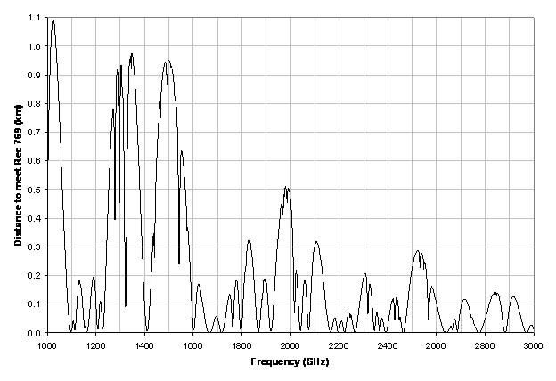
Distance at which Rec. ITU-R RA.769 is met, under near worst case assumptions
(see A. Clegg - US WP7D/71)

