Slide 1
IUCAF’s Roll
Masatoshi Ohishi
National Astronomical Observatory of Japan
IUCAF Chairman

Slide 2
In 1960 ICSU set up the Inter-Union Commission “IUCAF” to work towards keeping parts of the radio spectrum clear for passive, scientific use.
Represents URSI, the IAU and COSPAR at the International Telecommunications Union (ITU).
Formation was partly prompted by the potential threat from Project WEST FORD. (Needles in orbit).
In 1961 CORF was established “to serve as the United States counterpart to IUCAF.”

Slide 3
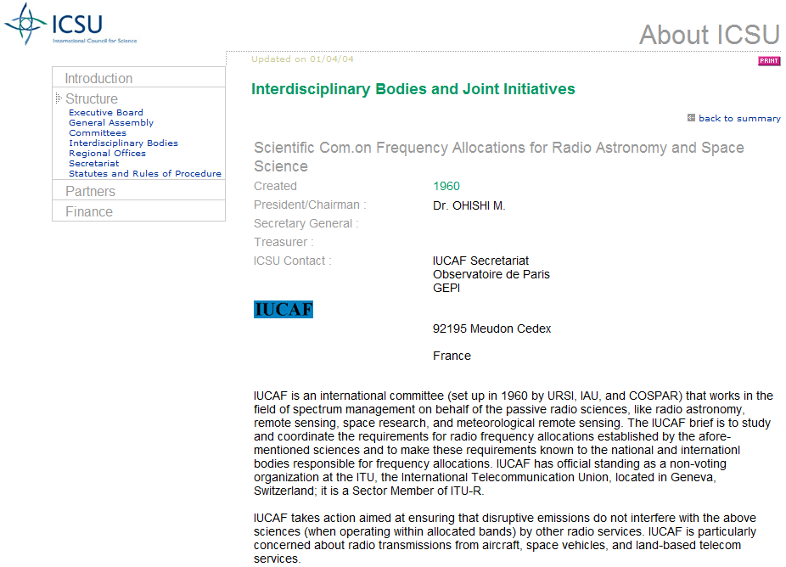

Slide 4
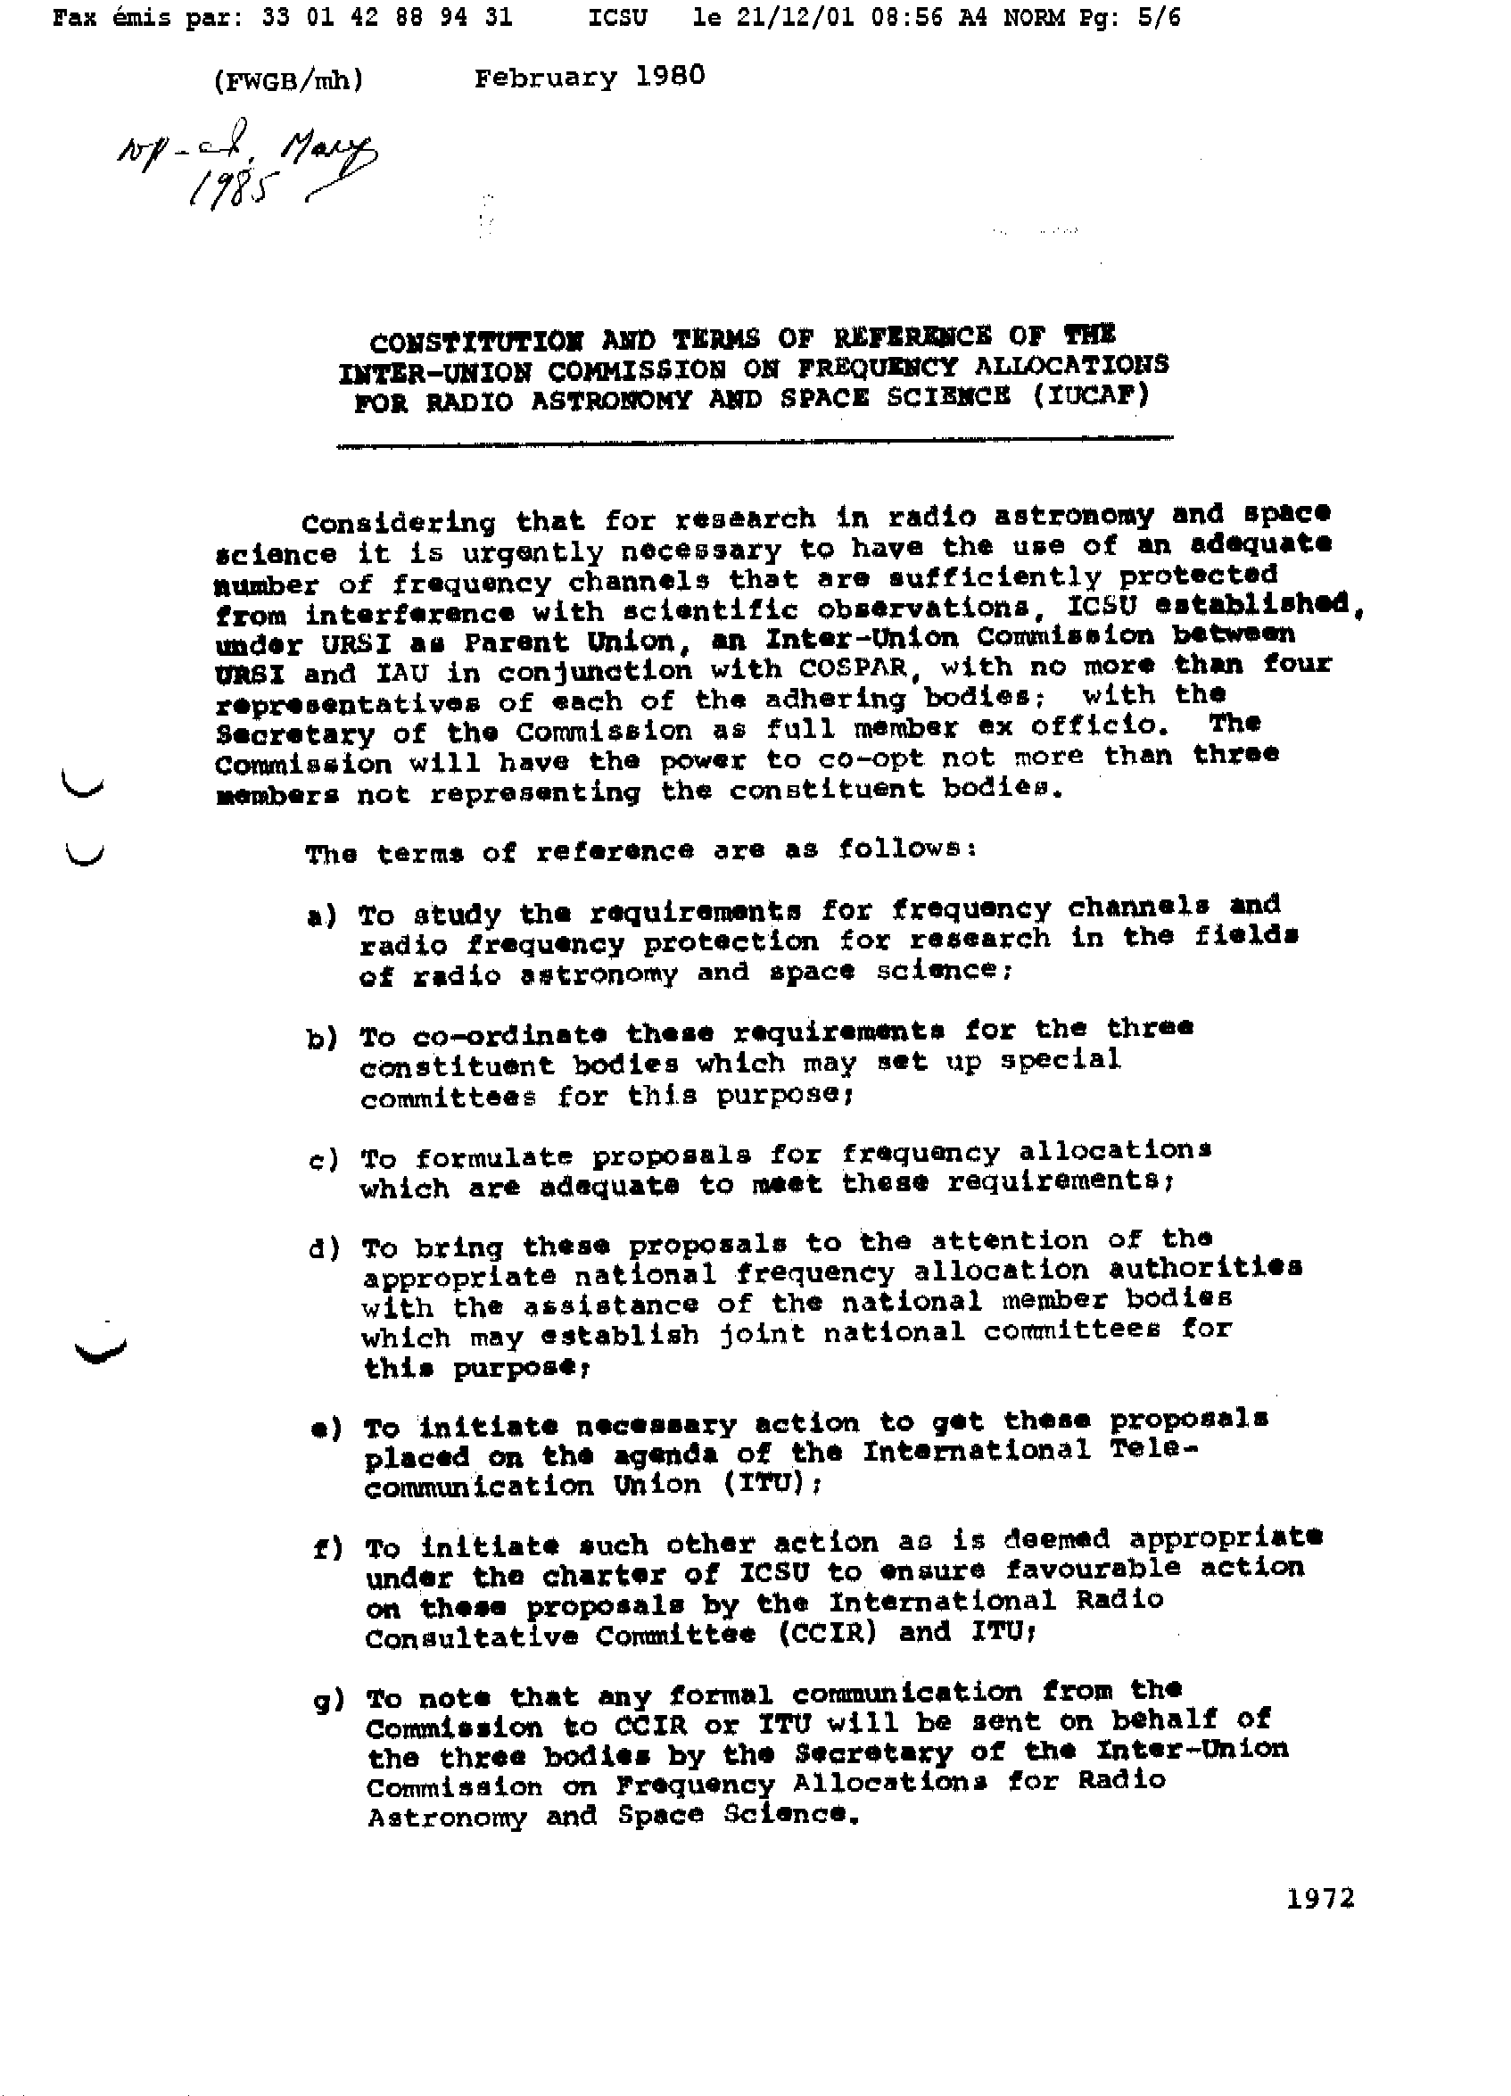

Slide 6
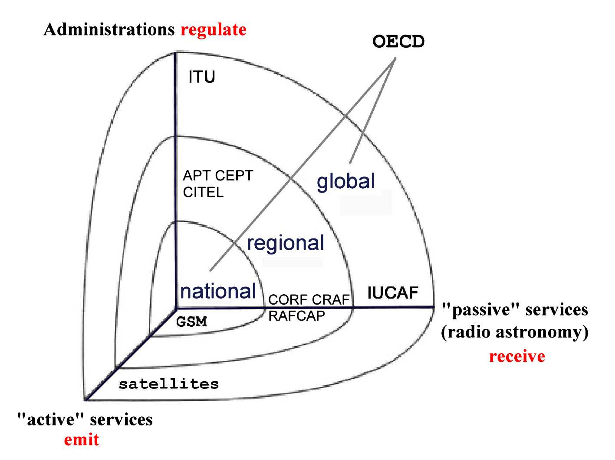
IUCAF’s place in the spectrum management problem space

Slide 7
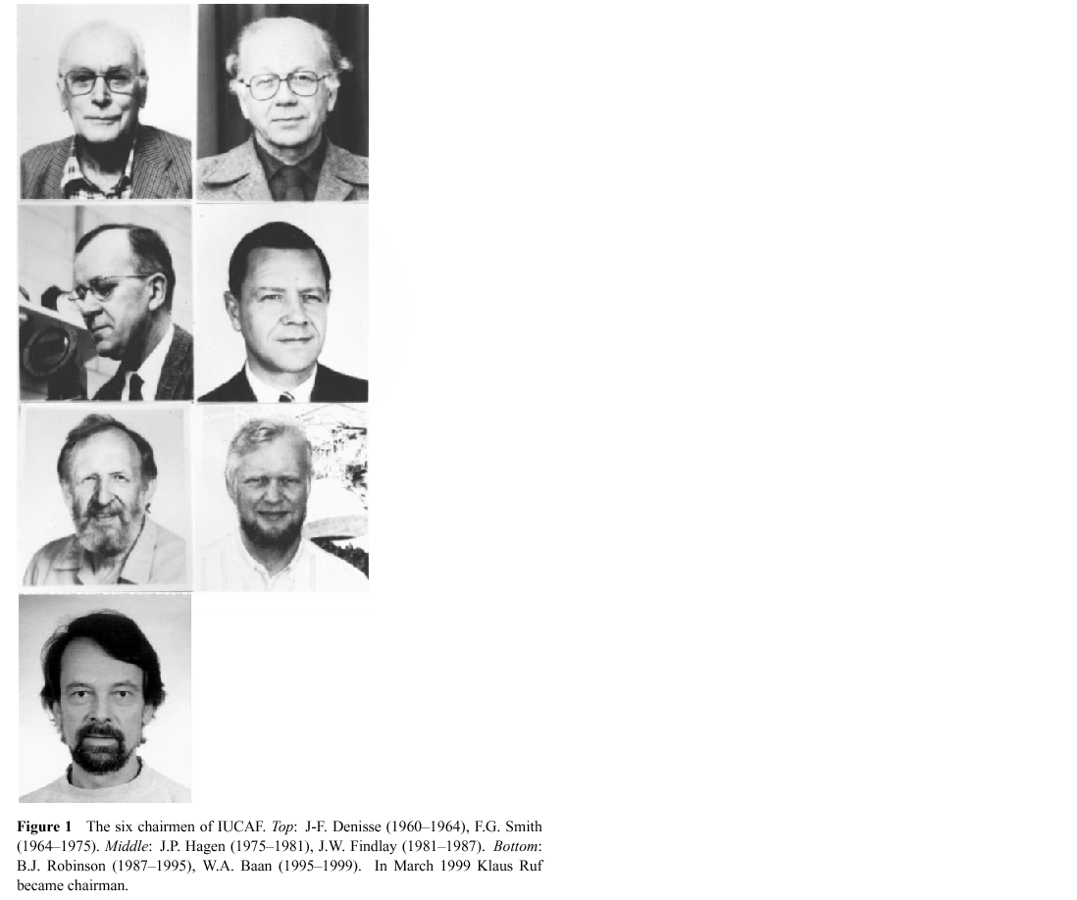
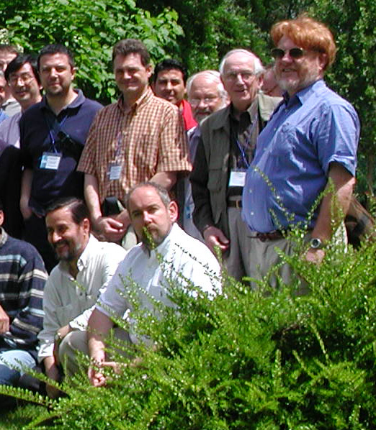

Slide 8
Many successes over the years:
At WARC 1979 India had proposed that 322-328.6 MHz be allocated to radio astronomy (Deuterium).
The NATO countries and the USA supported this allocation (this was still in the “cold war” period).
The Soviet Union had an extensive radar network around the Middle East at 327 MHz.
In May 1960, it had tracked the Gary Powers U2 spy plane over Soviet territory.
A radio astronomy allocation at 327 MHz would effectively shut down the radar network!

Slide 9
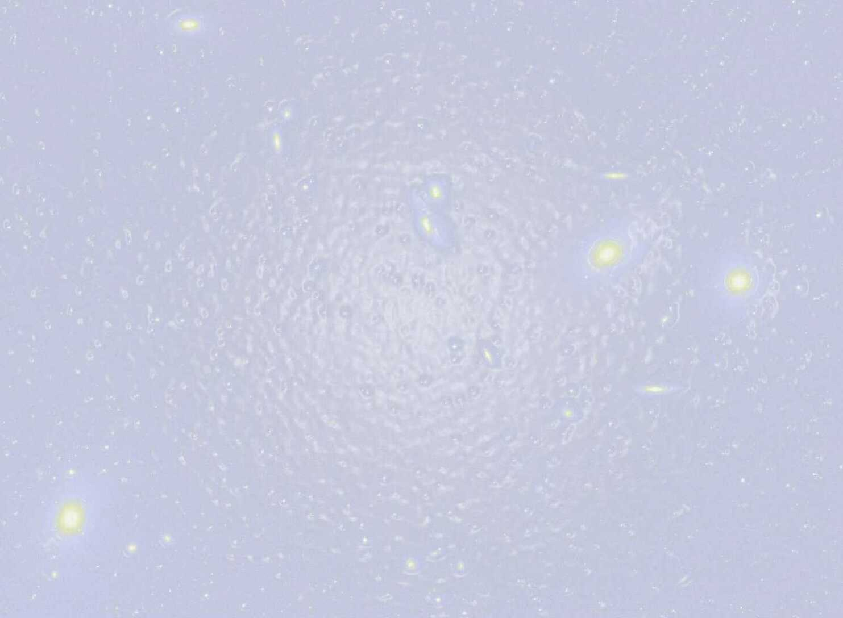
IUCAF membership
COSPAR Y. Murata RA Japan
IAU H. Chung RA Korea (ITU-R SG7 vice Chairman)
H. Liszt (vice Chair) RA USA
A. Tiplady RA South Africa
M. Ohishi (Chair) RA Japan
K. Tapping RA Canada URSI S. Aanthakrishnan RA India (Com J Chair)
A. Tzioumis RA Australia (Com J)
W. van Driel (past Chair) RA France (Com J)
I. Häggström IO Sweden (Com G)
S. Reising RS USA (Com F)
at large W. Baan RA the Netherlands
D. Emerson RA USA
A. Vasiliev ex officio advisor (ITU)
+ Correspondents (geographical, optical)
IO: ionospheric studies, RA: radio astronomy, RS: remote sensing

Slide 10
IUCAF’s place in the worldwide spectrum management circus
IUCAF
COSPAR Committee on Space Research
IAU International Astronomical Union
URSI International Union of Radio Science
CORF Committee on Radio Frequencies (USA)
CRAF Committee on Radio Astronomical Frequencies (EUR)
RAFCAP Radio Astronomy Frequency Committee in the Asia-Pacific Region
ICSU International Council of Scientific Unions
ITU International Telecommunication Union
RA Radiocommunication Assembly
SG 7 Radiocommunication Study Group7
WRC World Radiocommunication Conference

Slide 11
IUCAF activities
Participate in meetings:
ITU-R (as Sector Member): 7D , 1A, 1B, CPM’s & WRC’s
SFCG (as observer)
Organise:
Workshop on RFI Mitigation (Groningen, 2010)
Summer School on SM (Tokyo, 2010)
Business sessions in IAU/URSI/COSPAR GA
URSI GA 2011 (Istanbul)
IAU GA 2012 (Beijing)
Yearly budget: ~8 000 EUR (travel grants);
can apply for ICSU grants for organising
international, interdisciplinary activities.

Slide 12
Unite our Voice
Pre/Mid-** IUCAF Meetings
Discuss toward a single view
White Paper (position paper)
IUCAF position for WRC agenda items
Distribute to members and friends
Used in national/regional meetings

Slide 13
Coordination Gateway
CloudSat → Klaus’s lecture in detail
Agreement in SFCG between IUCAF and Sat. community (SFCG Resolution 24-1)
Rec. ITU-R RA.1750
Coordination between Downlinks (RR 5.208B)
Resolution 739 (WRC2003 → Rev.WRC2007)
Unwanted emissions due to FSS, MSS, RNSS, BSS
IUCAF is designated as an official gateway between GLONASS (1610.6-1613.8 MHz)
http://www.iucaf.org/CloudSat/

Slide 14
A long History on GLONASS
1983: Strong interference to the ~1612 MHz RA band. Radio Astronomy had lower status to navigation services – so we couldn’t complain.
WARC-1992: “While the conference was going through a very moribund state … an Australian proposal to enhance the status of radio astronomy at 1612 MHz was approved. During the crucial vote, the Russian, Belorussian & Ukrainian delegates were discussing something else, had taken off their earphones and were not listening to the simultaneous translation … With that vote, radio astronomy gained full primary status in the band.”
Glonass now had lower status than Radio Astronomy in this band, but

Slide 15
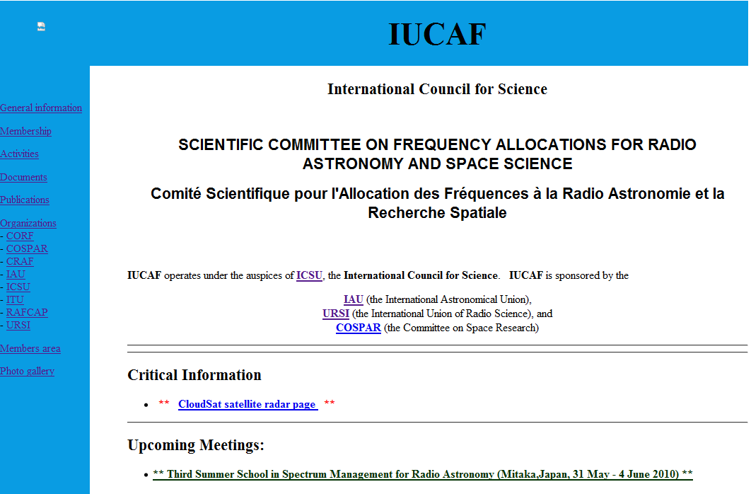
http://www.iucaf.org

Slide 16
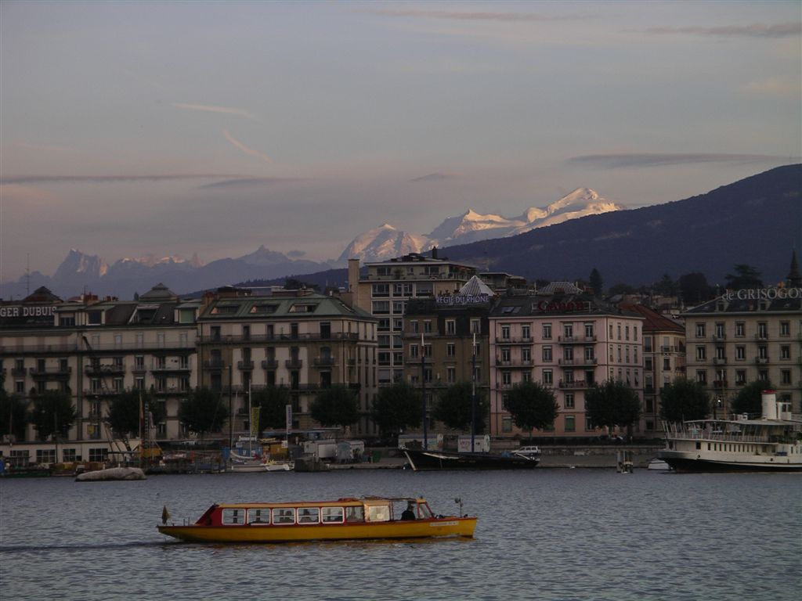
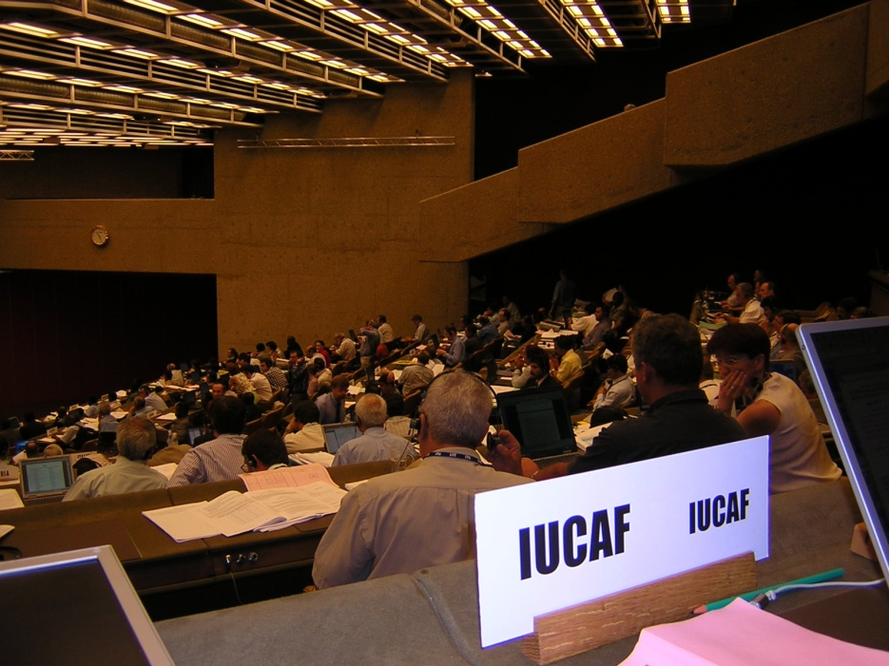
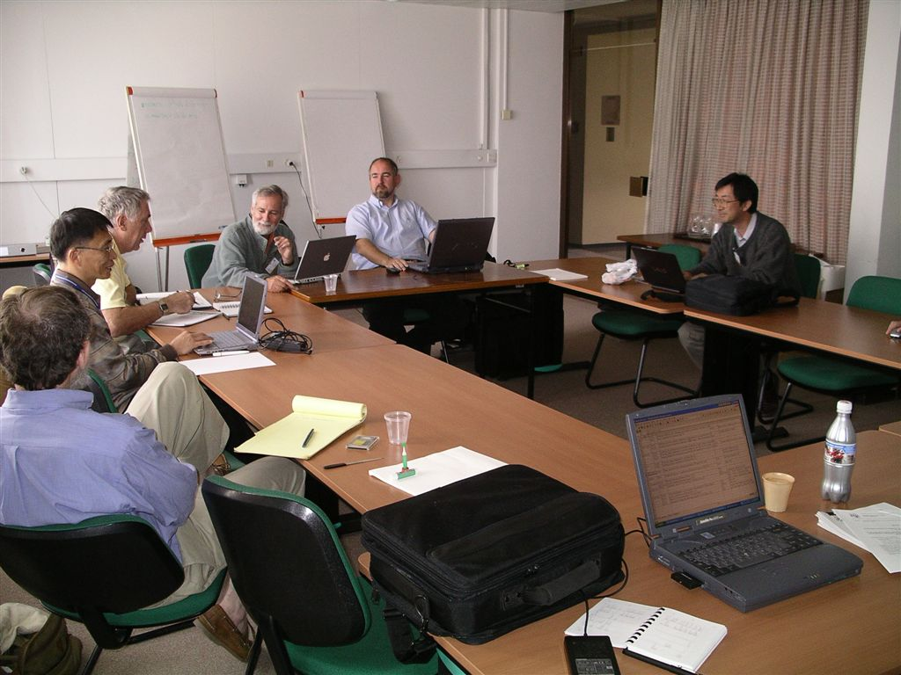
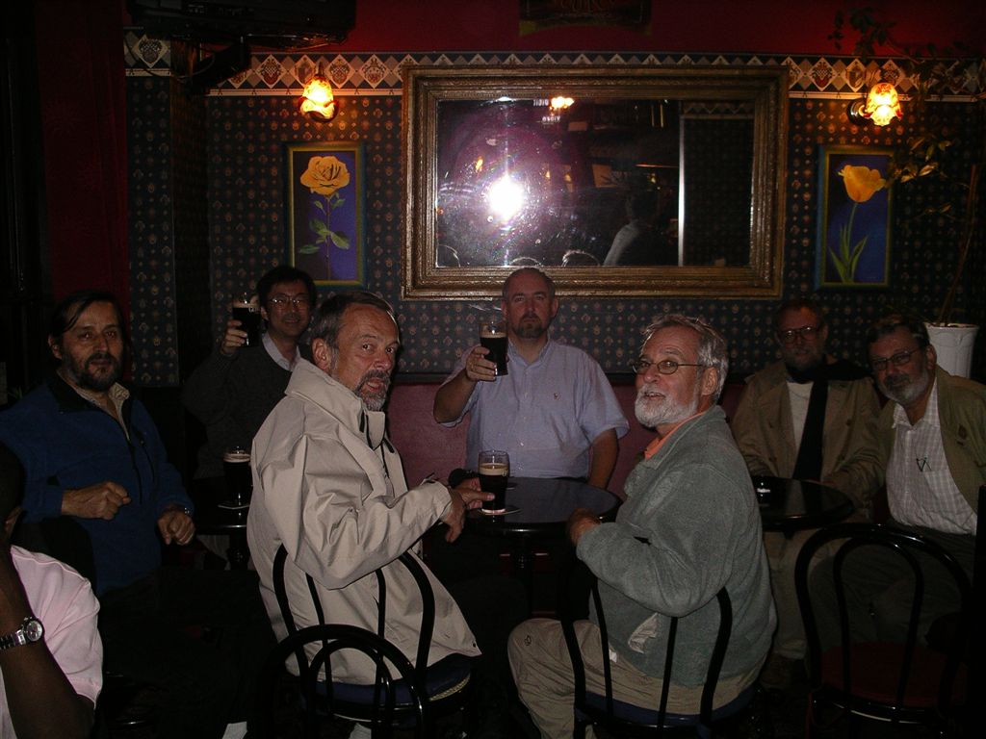
IUCAF in Action (in Geneva)

Slide 17
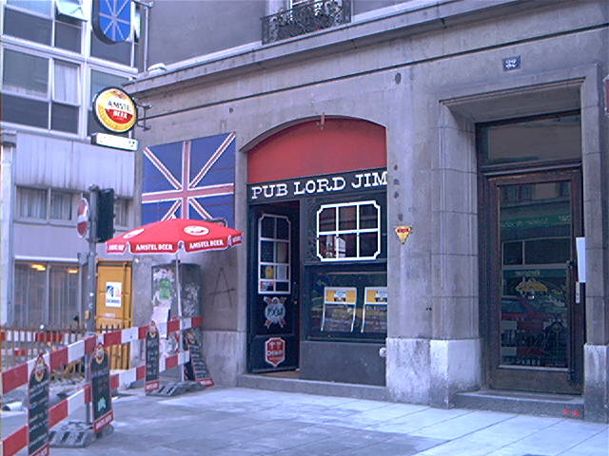
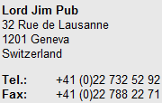
http://www.lordjimpub.ch/

Slide 18
“IUCAF members had to evolve from being starry-eyed astronomers as they encountered a world of politics, lobbying, entertainment, threats, espionage and bribery. On one occasion, an offer (in Geneva) of two million dollars in cash “to shut up” proved no match for dedication to the joys and excitement of twentieth-century astrophysics.”
Brian Robinson, “Frequency Allocation: The First Forty Years.”
Ann Rev. Astron. Astrophys. 1999, 37:65-96

Slide 19
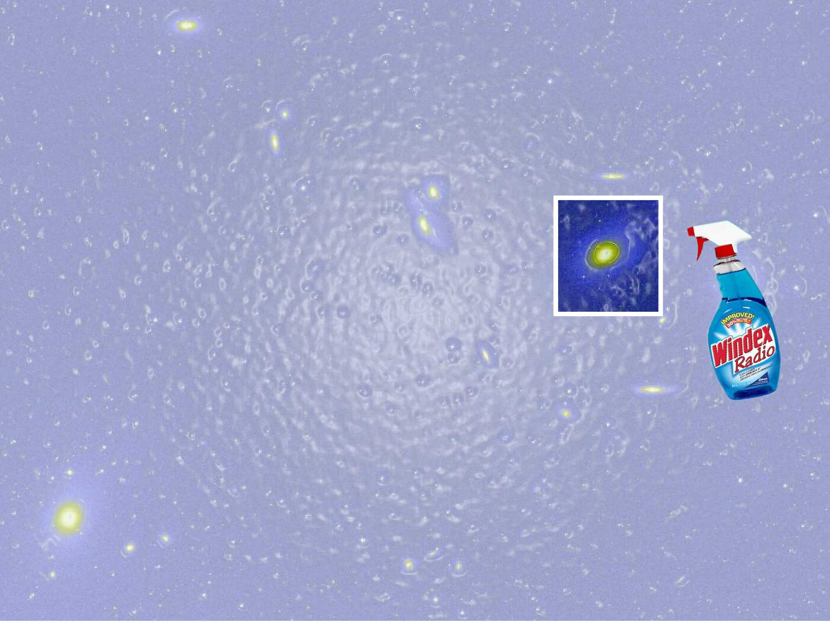
Keeping our Windows
on the Universe Clean

