Slide 1

Power Line Telecommunications (PLT)
M. Ohishi (NAOJ)
http://en.wikipedia.org/wiki/Pandora

Slide 2
Several Names
Power Line Telecommunications (PLT)
Power Line Communications (PLC)
Broadband over Power Lines (BPL)

Slide 3
PLT systems
Make use of radio frequency signals applied on the power lines used for the distribution of mains electricity. Because electrical power lines are not designed for the transmission of high data rate signals, PLT signals on electrical power lines have the potential of causing interference to radiocommunication services.

Slide 4
RR 15.12
“Administrations shall take all practicable and necessary steps to ensure that the operation of electrical apparatus or installations of any kind, including power and tele­communication distribution networks, but excluding equipment used for industrial, scientific and medical applications, does not cause harmful interference to a radiocommunication service and, in particular, to a radionavigation or any other safety service operating in accordance with the provisions of these Regulations¹.”
¹15.12.1 and 15.13.1 In this matter, administrations should be guided by the latest relevant ITU-R Recommendations

Slide 5
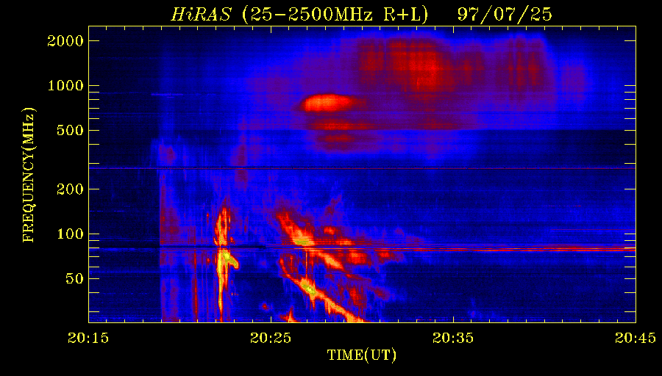
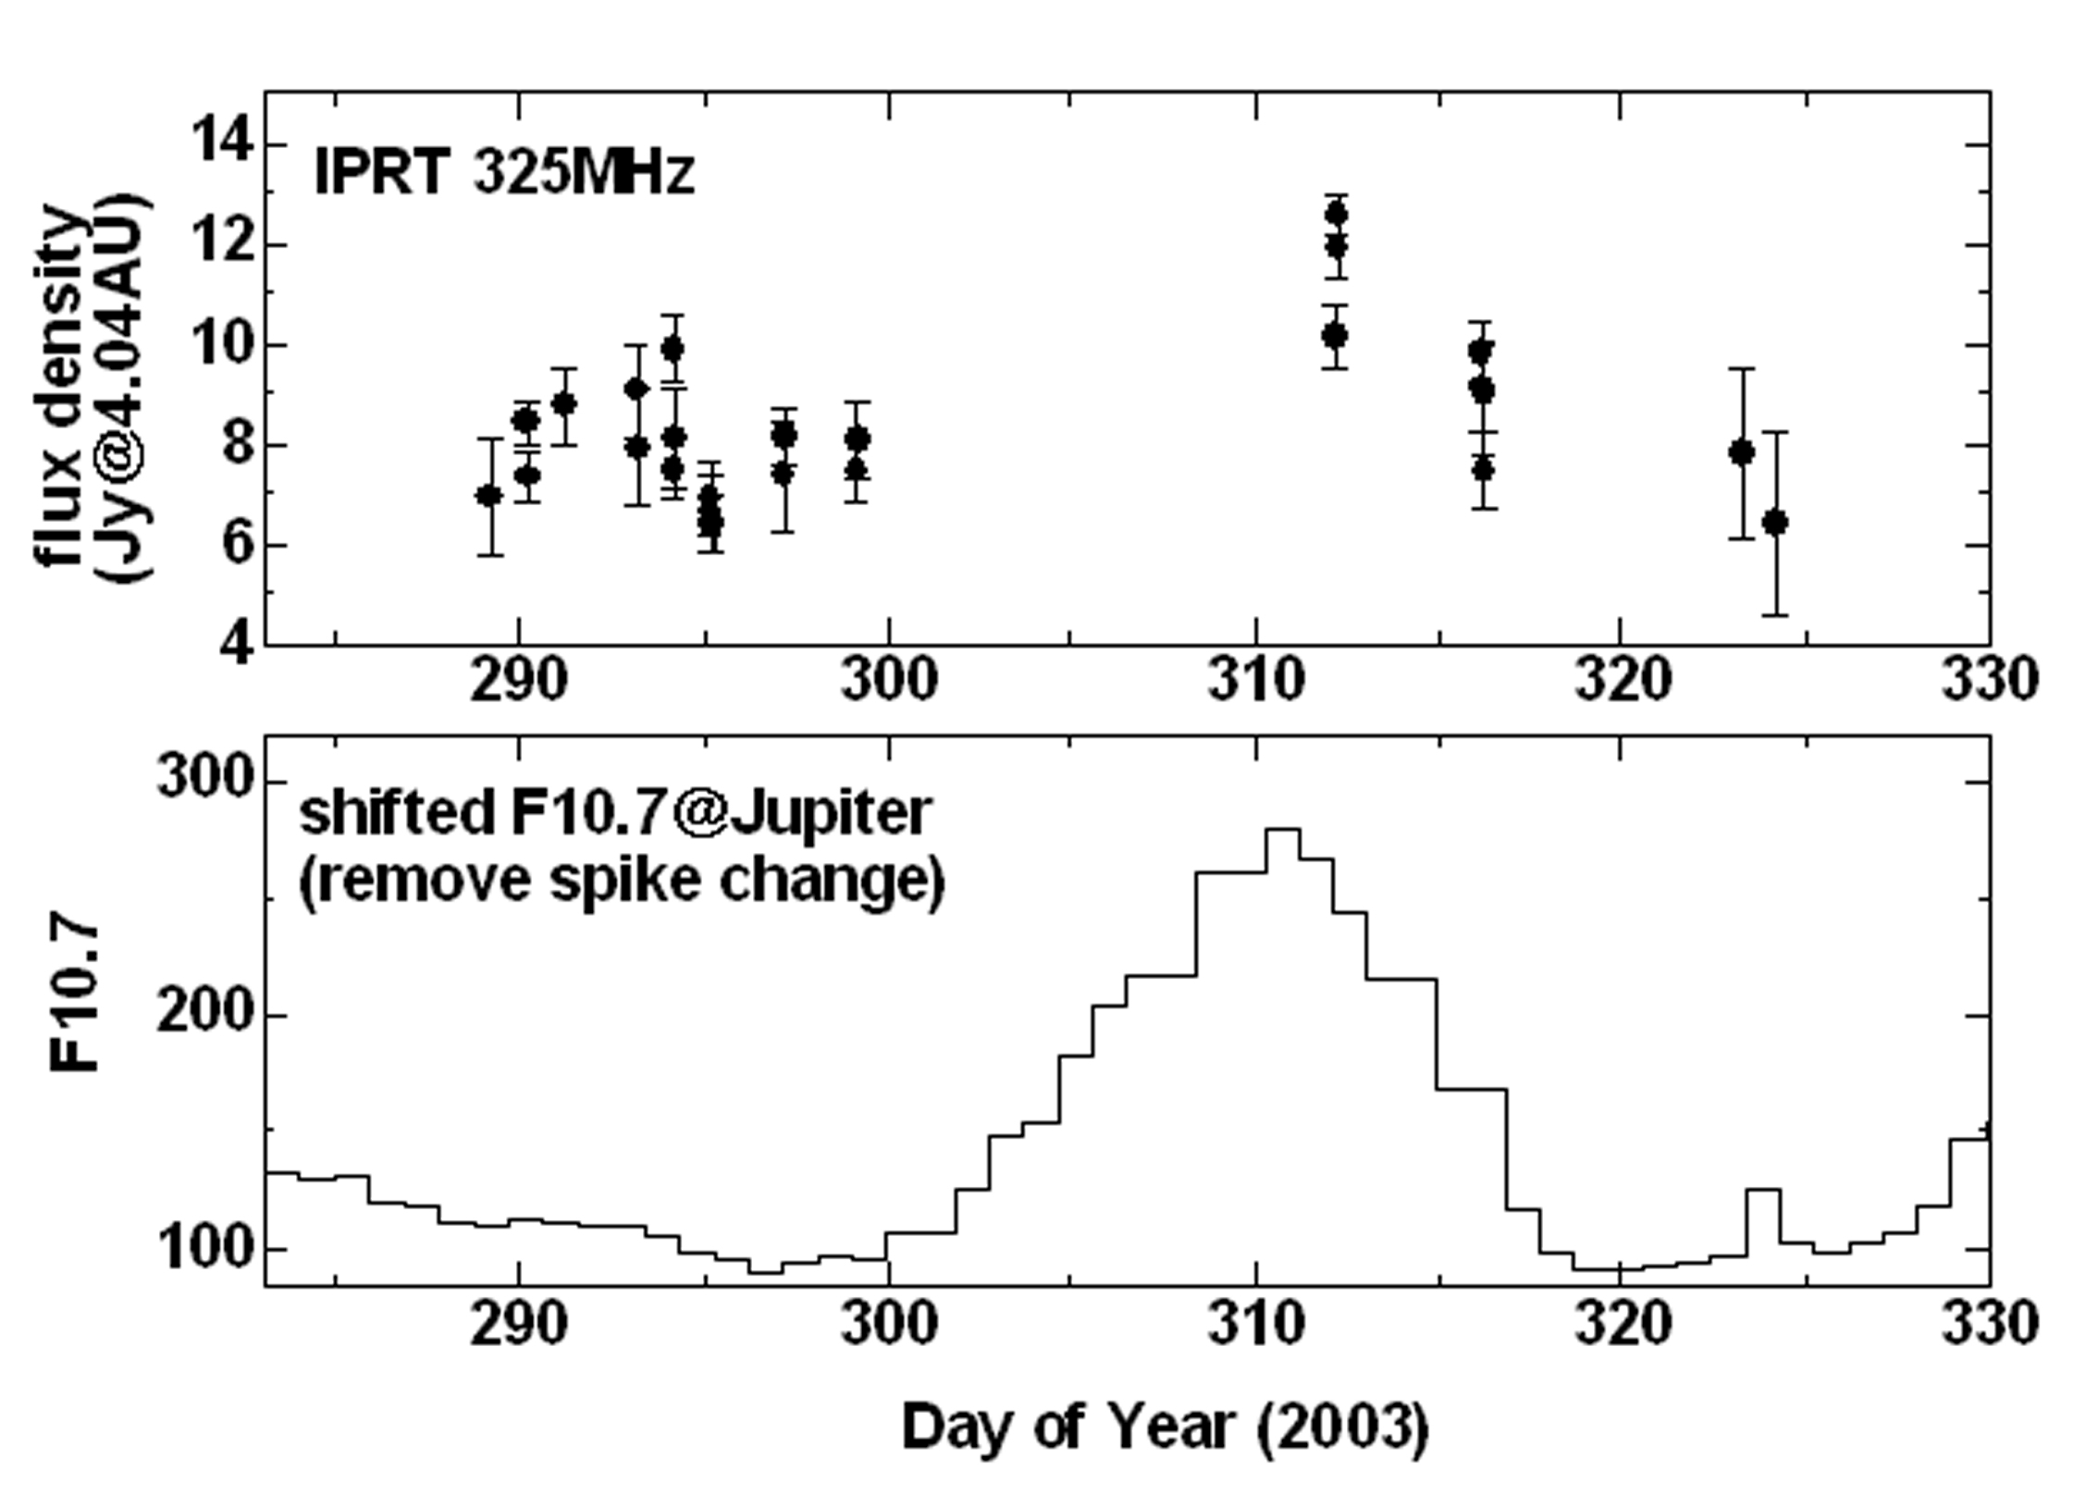
Objects and Intensities
Wavelength
10m
1m
10cm
Active Sun
10⁷
Galaxy Ｃｅｎｔｅｒbackground
10⁶
↑Solar Radio Burst Spectrum
(http://sunbase.nict.go.jp)
↑Galactic Noise Level
(Hiyama, 2004)
Jupiter
Quiet Sun
↓Jovian Radio Burst
(Konno et al. 2002)
10⁵
↓Jovian Synchrotron Radiation
10⁴
Cassiopeia A
Moon
Radio flux density [Jy]
JSR
10³
F10.7
M31
10²
Jovian synchrotron radiation (top) and solar f10.7 (bottom)
10
Protection
Criteria
for RAS
Jupiter
Rec. ITU-R RA.769
1
10
100
1,000
10,000
Frequency [MHz]
Cassiopeia-A Radio Map
(Oya & Iizama, 2003)
(Modified from Kraus, 1986)
(1Jy=10⁻²⁶W/m²/Hz)
Notes:
赤：銀河背景レベル
青：電波天文保護バンドにおけるITU-Rの干渉閾値勧告値（点）
黒：観測を実施している天体のスペクトル

Slide 6
the RA bands
Frequency Bands(MHz) | Frequency Bands(GHz)
13.360 - 13.410 25.550 - 25.670 37.5 - 38.25 73 - 74.6 150.05 - 153 322 - 328.6 406.1 - 410 608 - 614 1 400 - 1 427 (HI) 1 610.6 - 1 613.8 (OH) 1 660 - 1 670 (OH) 2 655 - 2 700 4 800 - 5 000 (H₂CO) | 10.6 - 10.7 14.47 – 14.50 (H₂CO)0 15.35 - 15.40 22.21- 22.50 (H₂O) 23.6 - 24.0 (NH₃) 31.3 - 31.80 42.5 - 43.5 (SiO) 76 - 116 123 - 158.5 164 - 16700 200 - 231.500 241 - 275

Slide 7
Regulations to PLT
US
  1.705-80 MHz
  Limits to E-field
  30μV/m @ 30m
  (< 30 MHz)
  Excluded bands
  Exclusion zones
  47 km from a RA obs.
Germany
  Based on ECC Rec (05)04
  Limits to E-field
  40-8.8 log(f) μV/m @ 3m (1-30 MHz)
  27 μV/m @ 3m (30 - 1000 MHz)

Slide 8
Regulation for Japanese Broadband
PLT since October 2007
Fundamental idea：
No interference to the HF radio services by restricting the leaked electric field at a distance of 10 m not to exceed the ambient noise level
  Targeted ambient noise level values:
  28dBμV/m (2-15MHz), 18dBμV/m (15-30MHz) → too high !!
Regulate the common mode current (CM) from a PLT modem
  Limits to the CM, I_{CM}, from a PLT modem
  20dBμA (2-15MHz), 10dBμA (15-30MHz) RMS 9kHz
  When connected to a specific ISN (Impedance Stabilized Network)
  LCL=16dB, DMZ=100Ω, CMZ=25Ω (LCL: values measured at outlets)
No measure to protect the RAS !

Slide 9
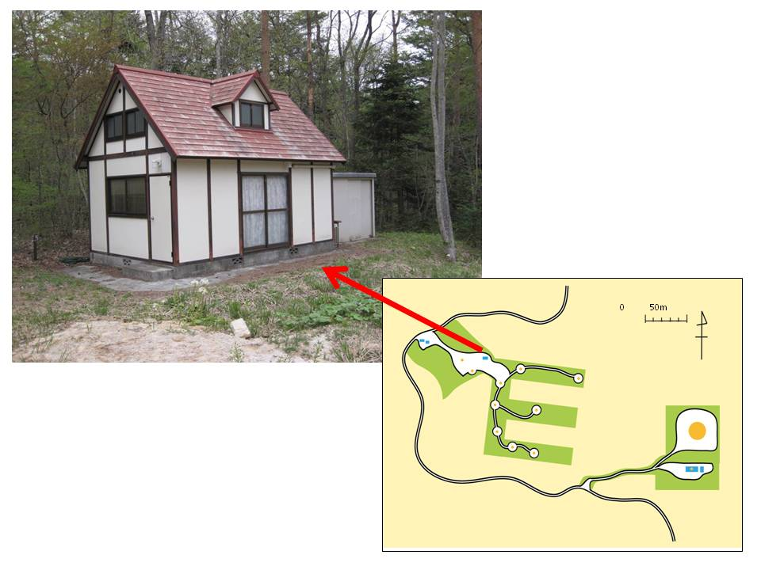
PLT modems & Location
PLT Modems：
HD-PLC & UPA,
one pair each
Location：
Iitate Observatory,
Tohoku U.
(Iitate, Fukushima)
House： 3.6m x 5.4m
Measurement Directions：
W, S, SE @ 5/10/30m
No residences within 1.5km
→ Very low
man-made noise

Slide 10
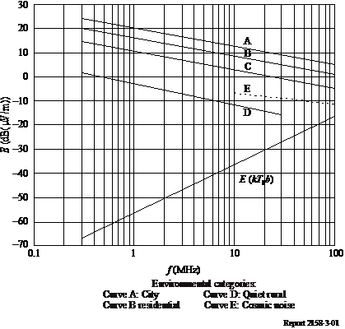
Man-made Noise
Rec ITU-R P.372
Four categories:
City / Residential / Rural / Quiet Rural
Cosmic (Galactic) noise
B = 9 kHz

Slide 11
Leakage Measurements
Loop Antenna
  ETS-Lindgren 6512
  (passive loop φ 60cm)
  Height： 1m (lower edge)
  Convert H to E
Spectrum Analyzer
  NEC SpeCAT2
  2-26 MHz
  RBW=8kHz
  RMS, MAXHOLD
Current Probes
  Fair-Rite #43 2643102005
  Primary: 1 turn (CMI)
  2 turn (DMI)
  Secondary: 7 turns
  I [dBμA]=P[dBm]+84
  for DMI
  I [dBμA]=P[dBm]+90
  for CMI

Slide 12
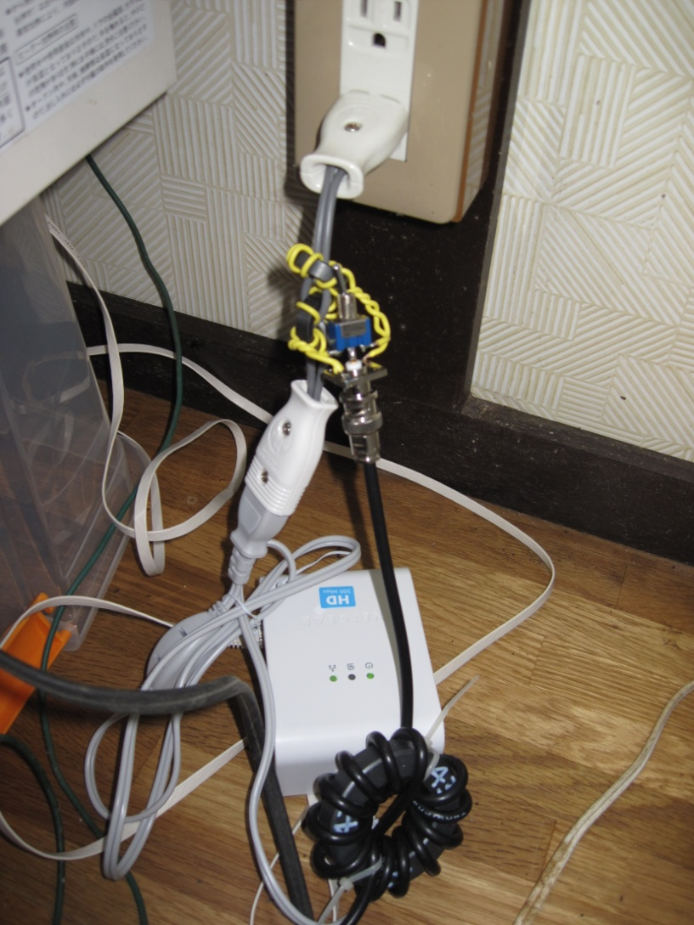
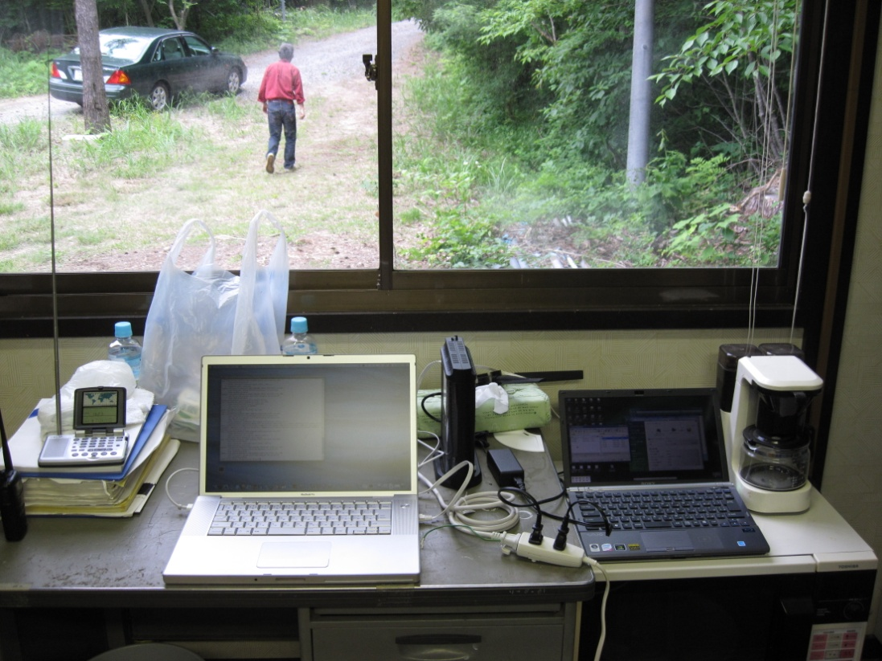
Photos (1)

Slide 13
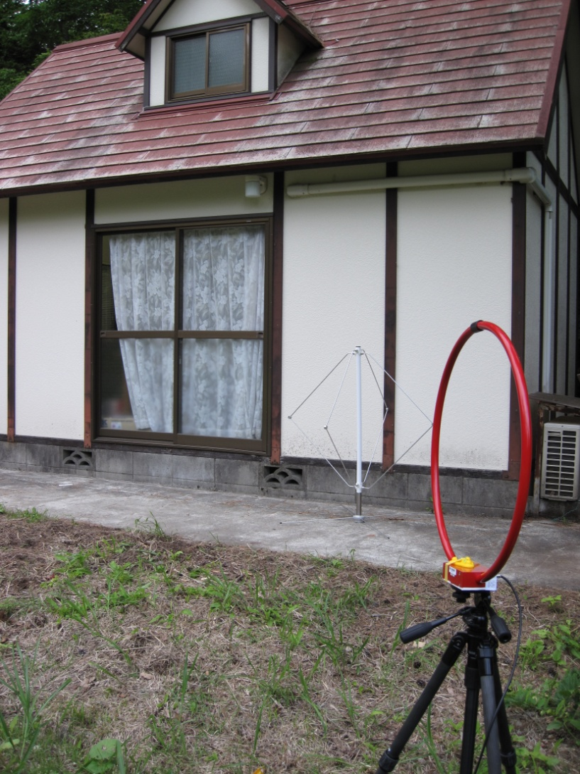
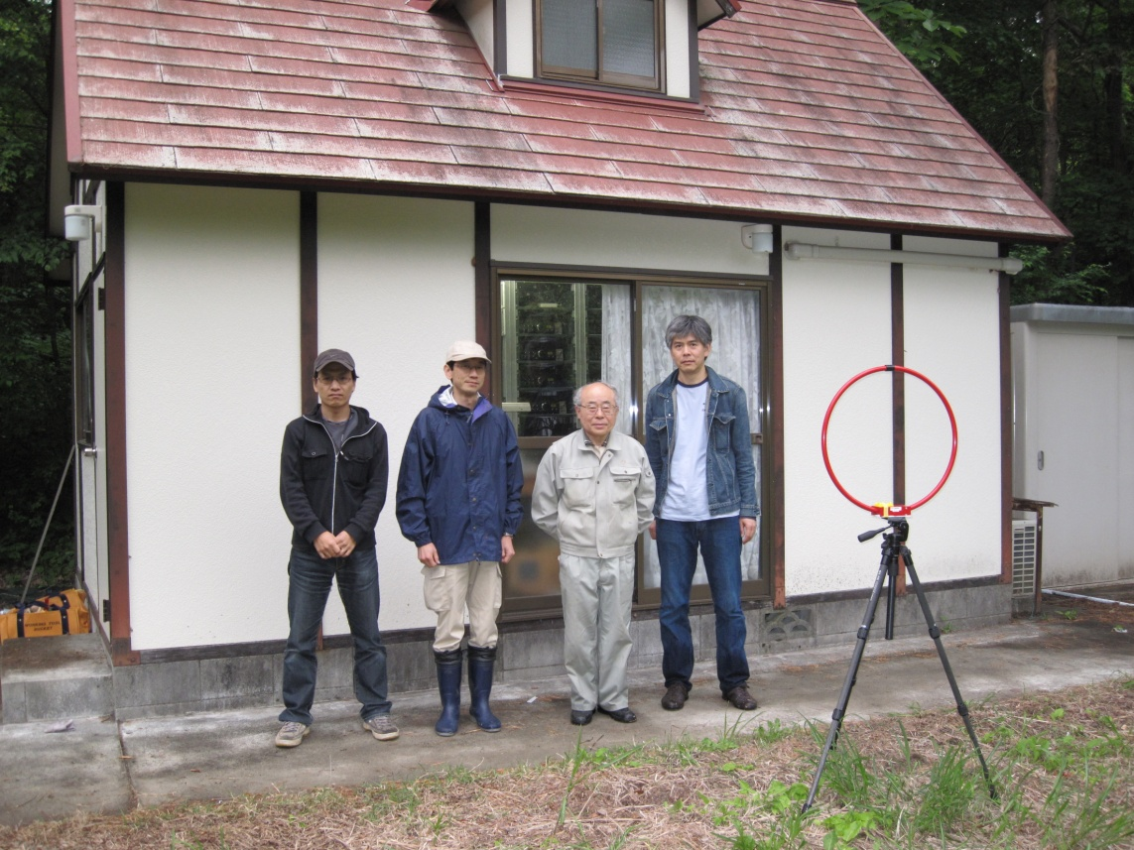
Photos (2)

Slide 14
Recoding the SW Broadcasting
SW Radio: SONY ICF-SW07
IC Recorder: SANYO ICR-PS285RM
PLT modem: Panasonic BL-PA510 (HD-PLC, OFDM)
SW broadcast at 15370 kHz (China Radio International) was clearly audible. The PLT disturbance masked the CRI at d=5&10m, but at 30m the PLT noise did not mask so much.

Slide 15
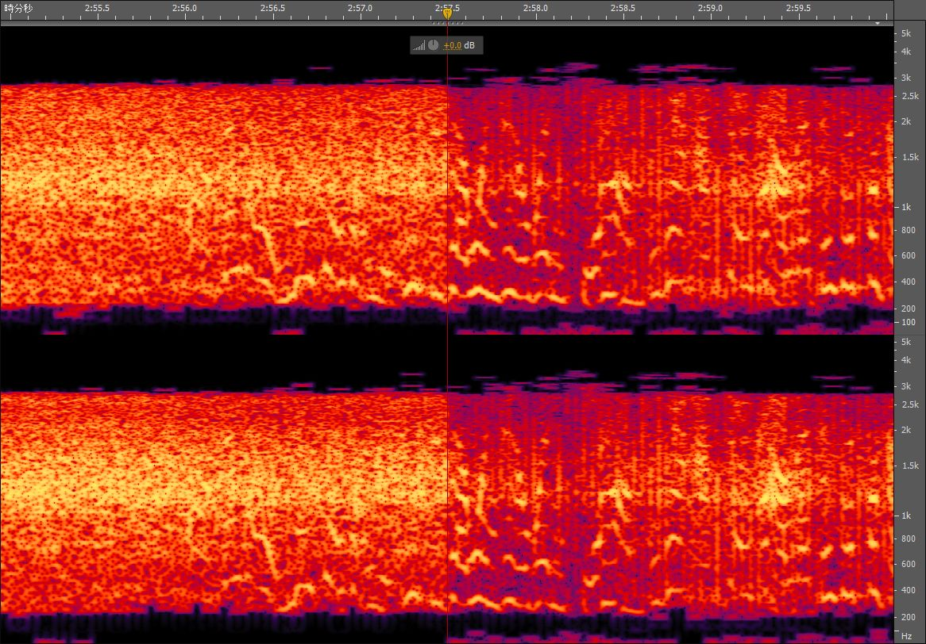
Time 2:55.5 2:56.0 2:56.5 2:57.0 2:57.5 2:58.0 2:58.5 2:59.0 2:59.5 3:00.0
Hz
5k
3k
2k
1.5k
1k
800
600
400
200
5k
3k
2k
1.5k
1k
800
600
400
200

Slide 16
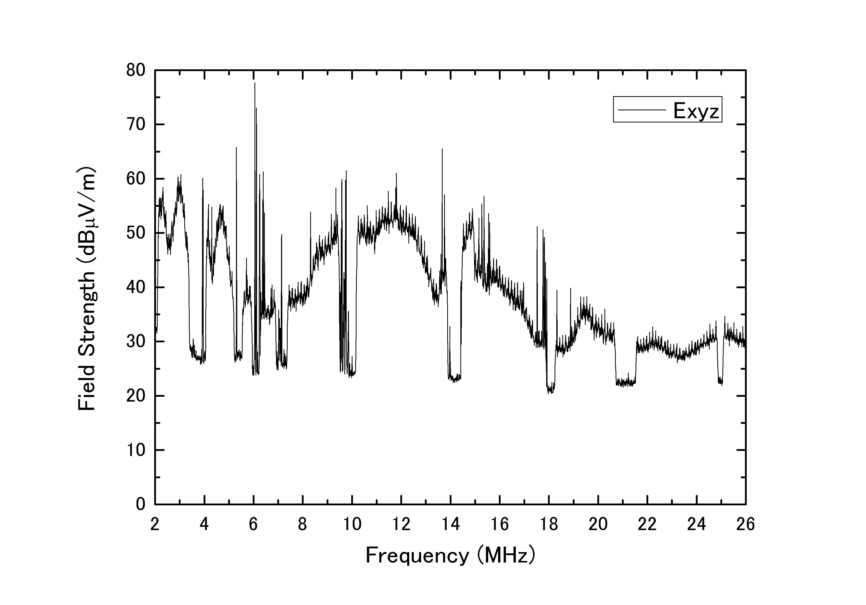
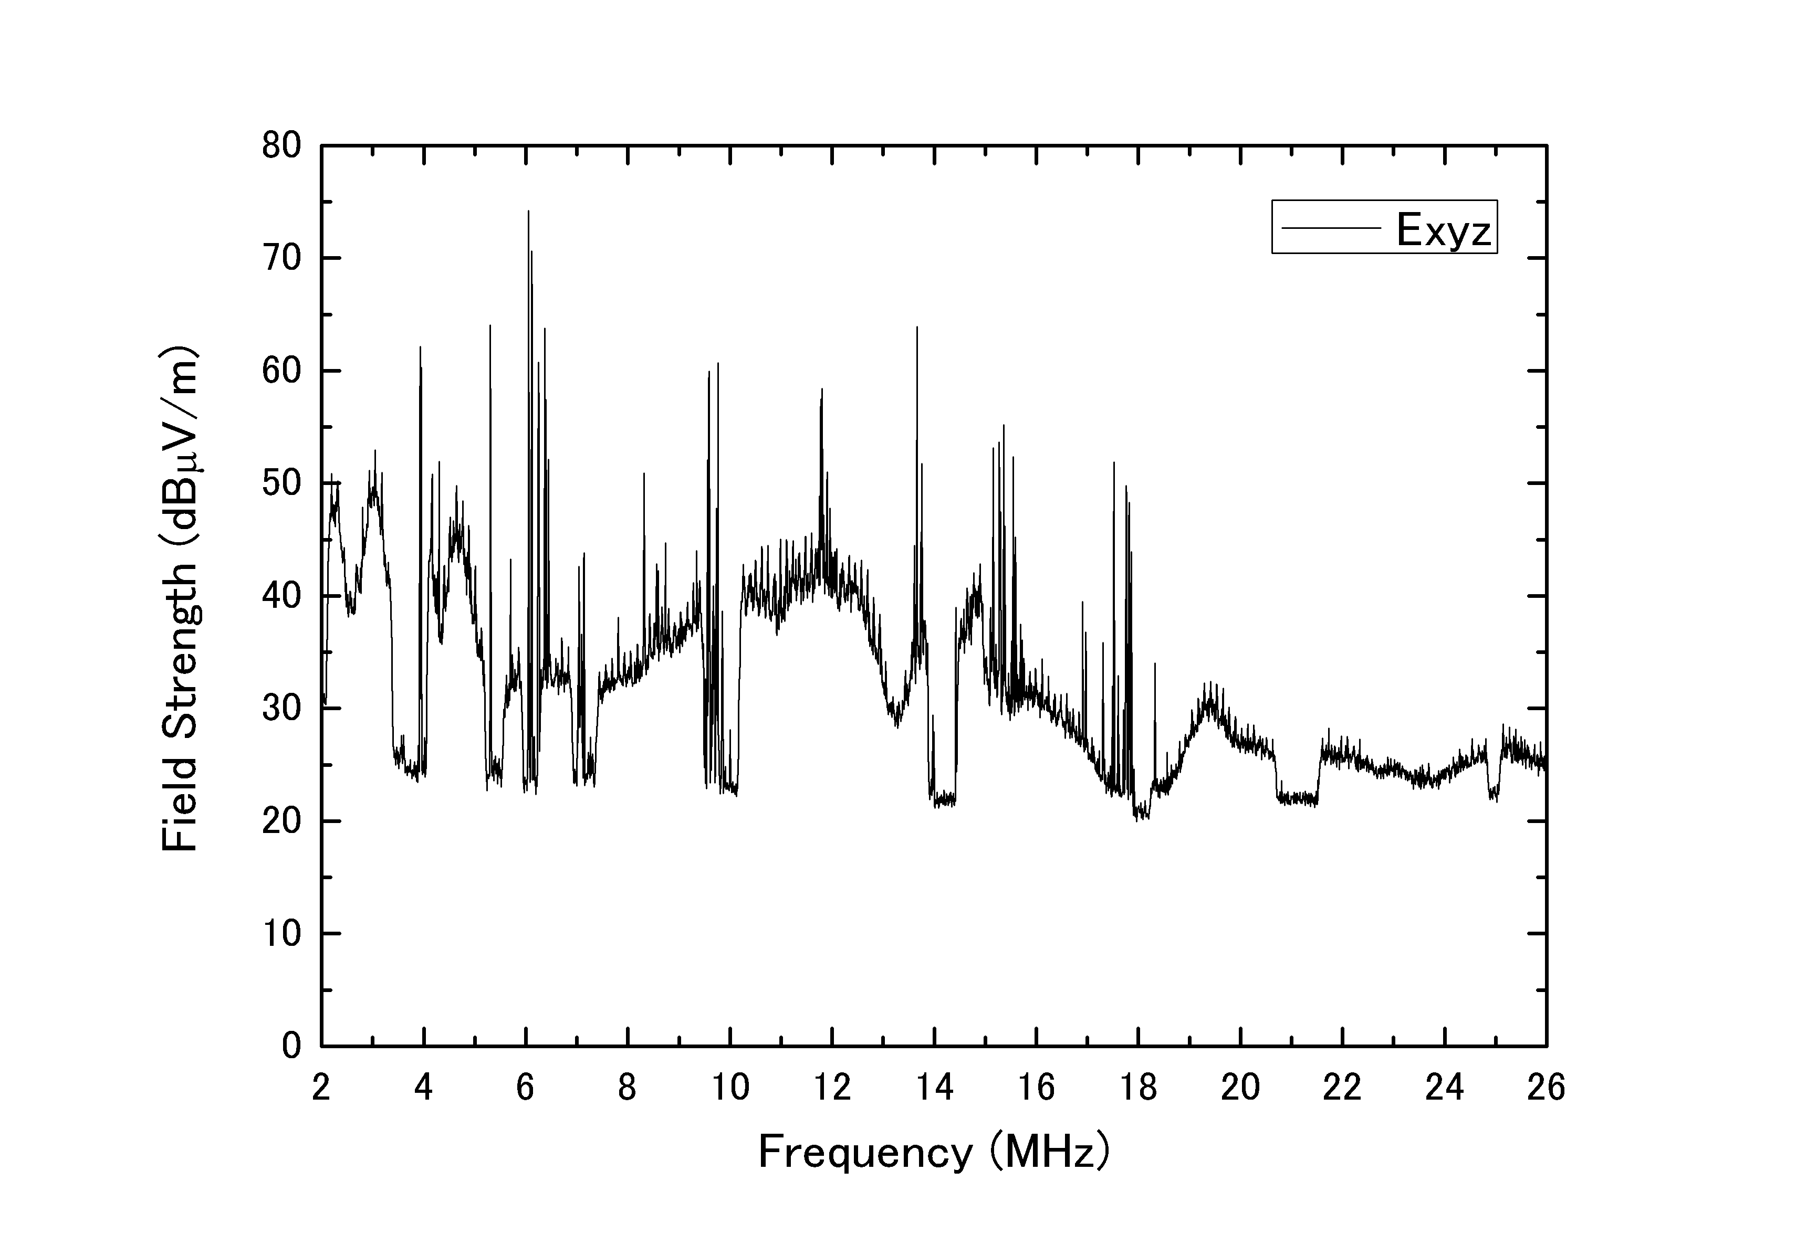
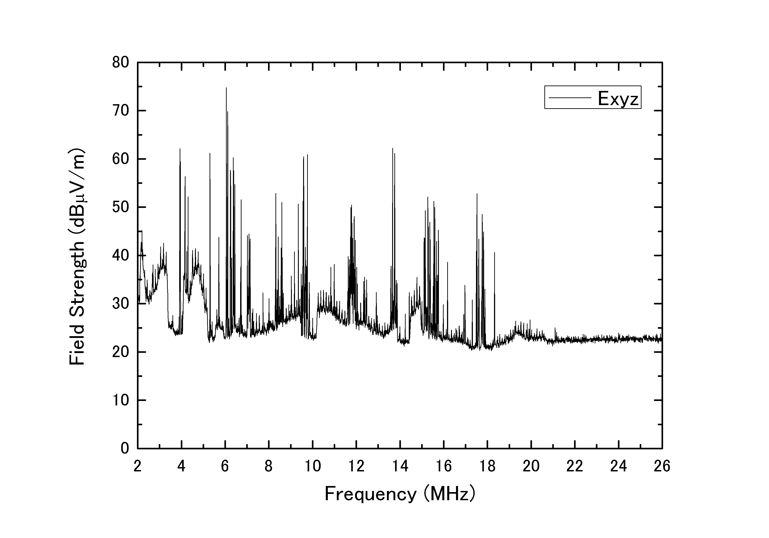
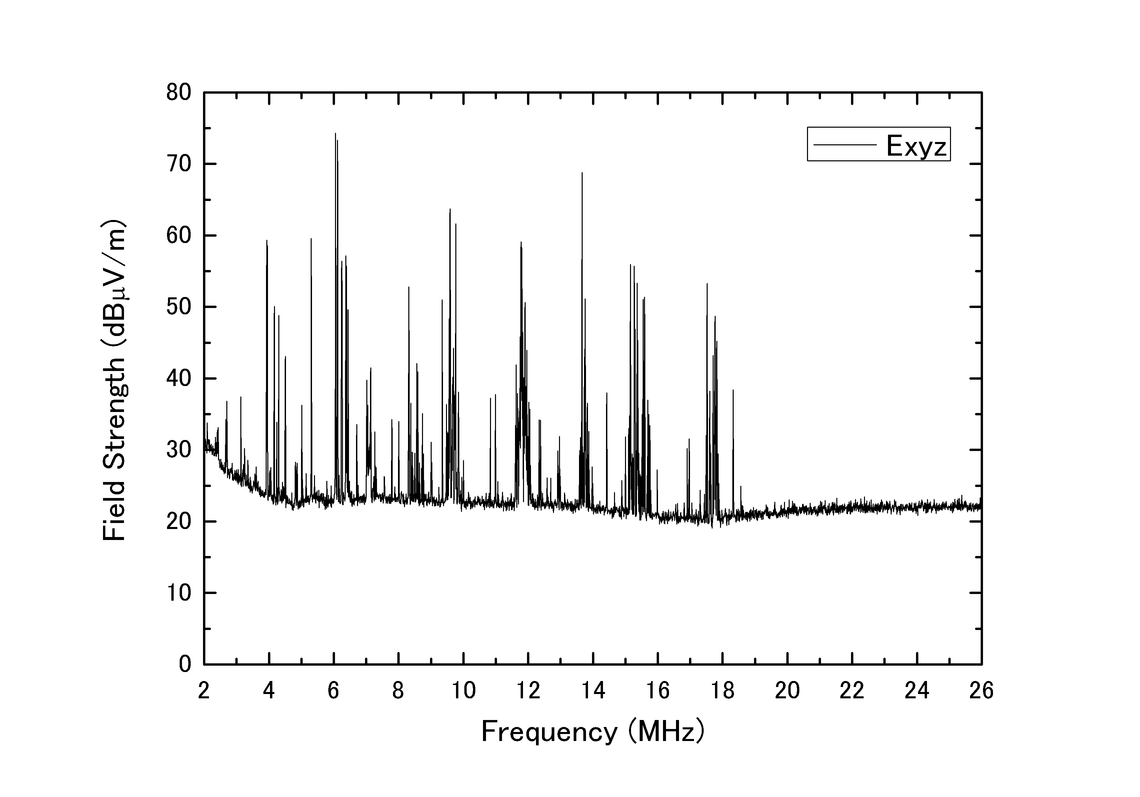
West
HD-PLC
5m
10m
LIMITS
30m
Ambient @ 10m

Slide 17
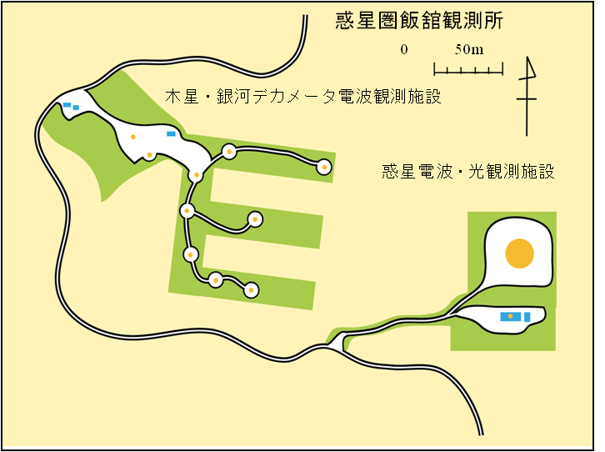
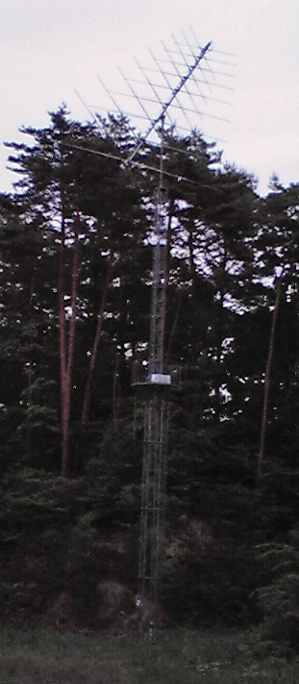
RAS antenna location
Antenna Symbol
ex) ER：Antenna/Pol.
House
Origin (ground)
B
：Antenna used
A
I
C
D
E
Relative coordinate wrt Origin
X: E-W （＋：E）
Y:: N-S （＋：N）
Z:: Height
 | X [m] | Y [m] | Z [m] | R [m]
A | 126.0 | -11.5 | 7.5 | 126.5
B | 43.5 | -9.0 | 10.0 | 45.5
C | 23.5 | -29.0 | 12.5 | 39.5
D | 16.0 | -59.0 | 11.6 | 62.0
E | 73.5 | -59.0 | 7.5 | 94.5
I | -19.0 | -22.0 | 13.5 | 32.0
5.9m
7.8m
Z-coord. Of antenna：
Upper edge of tower

Slide 18
Measurements by RAS Antennas
Log-Periodic antenna
  Two orthogonal antennas
  Height： 14m
Frontend RX
  R&K A-11
  NF=1.5dB
Backend
  Advantest R3131
  After 10 sec sampling, data was obtained by a PC through GPIB
CM current in the underground cable
  Fair-Rite #43 5943003801
  Primary: 1 turn
  Secondary: 7 turns
  CMI [dBμA]
  =P[dBm]+90
  CMI < 0 dBμA
  → Disturbance received by the RAS antennas are not those re-radiated from the cables

Slide 19
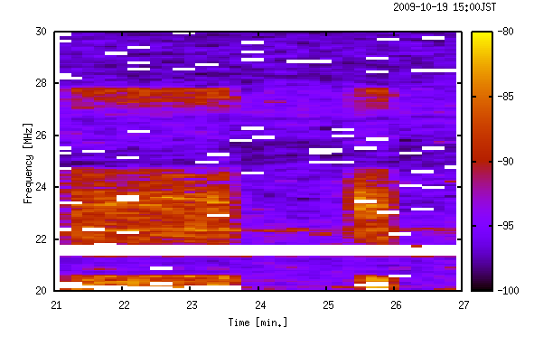
IR:2009/10/19
Average spectrum (10sec) / RBW=10kHz
HD-PLC on
RAS
Distance = 32 m

Slide 20
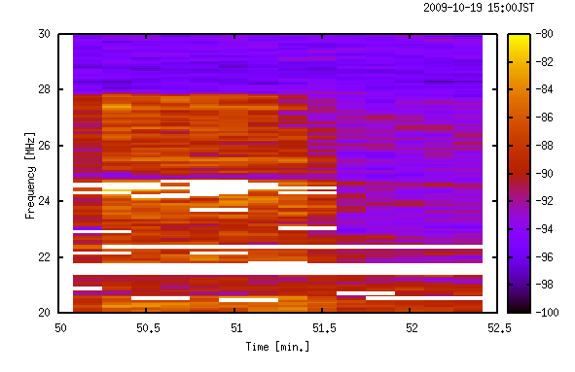
BL:2009/10/19
Average spectrum (10sec) / RBW=10kHz
HD-PLC on
RAS
Distance = 45.5 m

Slide 21
RAS wide band spectra
Average spectra for about 1 min. during HD-PLC on (red) and off (blue)
RBW=10kHz (IR & BL) or 30kHz (DL or ER), Detector mode : sample
32m
62m
45.5m
94.5m

Slide 22
RAS spectra around a astronomical band (25.61±0.06MHz)
Average spectra for about 1 min. during HD-PLC on (red) and off (blue)
RBW=10kHz , Detector mode : sample
45.5m
94.5m
On: -87.4±1.9dB / Off: -93.8±1.5dB (25.61±0.06MHz)
On: -97.5±0.6dB / Off: -98.6±0.6dB (25.61±0.06MHz)
62m
126.5m
On: -94.7±0.8dB / Off: -97.5±0.6dB (25.55 – 25.62MHz)
On: -97.7±0.6dB / Off: -90.0±0.7dB (24.67-24.74MHz)

Slide 23
Protection Criteria vs Leakage
System Noise
＝BG (Gal.) noise
+ Rx noise (NF=1.5 dB)
＝15,000 + 120
＝15,120 K
Criteria for 2000 sec integ. time ＝ 97.6 mK
Ant. | D [m] | Leakage [K] | Ratio
AL | 126.5 | 5,276 | 5.4 x 10(4)
ER | 94.5 | 4,358 | 4.4 x 10(4)
DL | 62.0 | 13,690 | 1.4 x 10(5)
BL | 45.5 | 50,880 | 5.2 x 10(5)

Slide 24
How can we avoid disturbance from PLTs?
Subtract the PLT disturbance by signal processing
NO! – PLT noise is polarized, thus the digital
signal processing technology in the RAS can not
subtract the PLT noise
Separation Distance
~ 33 km of separation distance is needed for
a pair of PLT modems
(for free-space propagation)

Slide 25
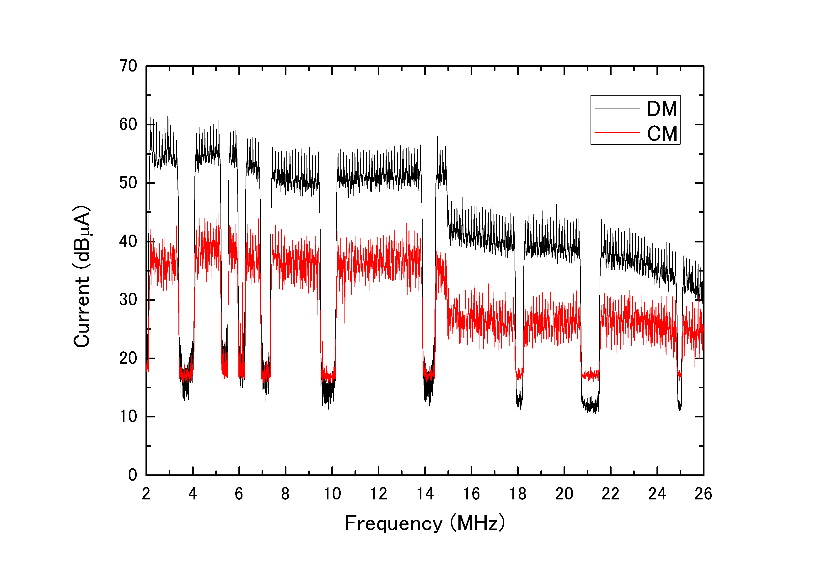
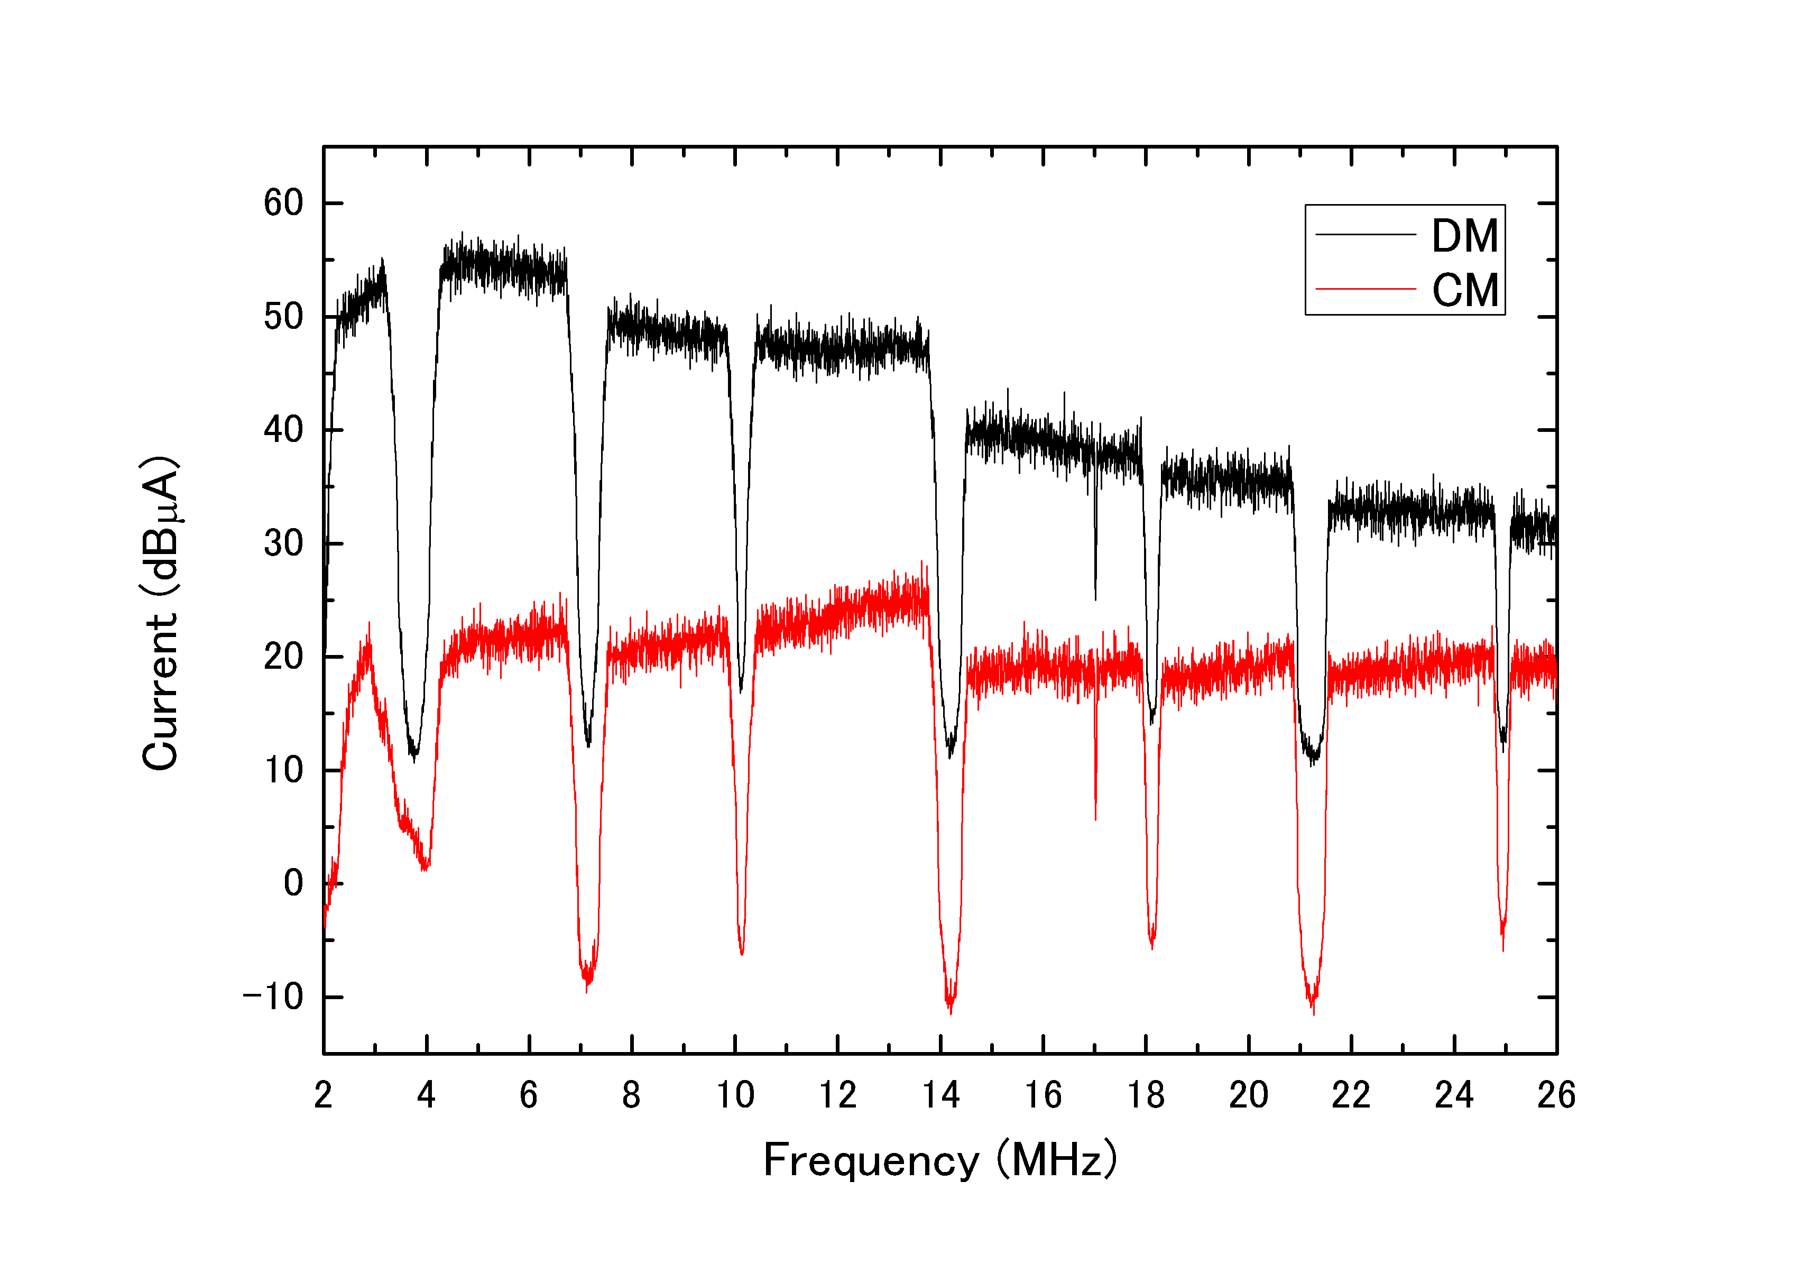
DMI/CMI at PLT output port
HD-PLC
UPA
PLT modem injects DMI of ~55 dBμA at maximum to power line
CMI exceeds the limit in a part of the 2-30 MHz range, however,
the limits are valid only when a PLT modem is connected to the ISN.
Therefore it is quite natural that the CMI exceeds the limits when
The PLT modems are connected to actual power lines.

Slide 26
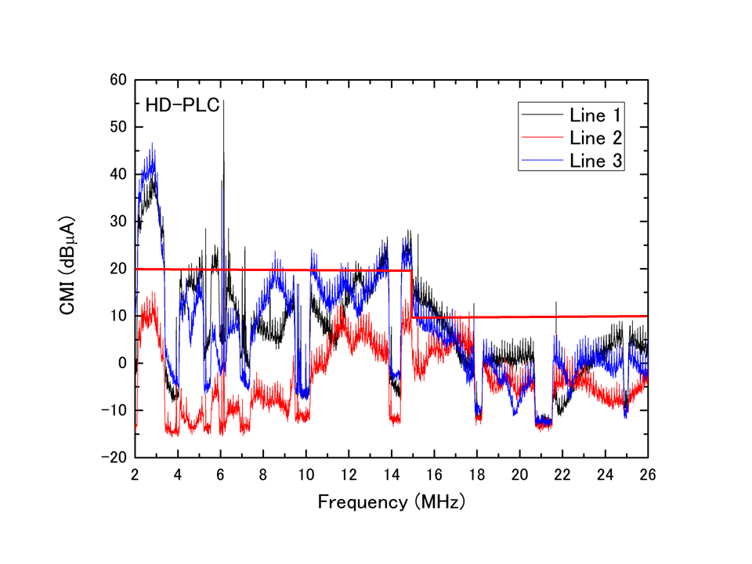
Common Mode Current (CMI) Distribution
Exceeds the CMI limit at around ~3MHz (by ~20dB)
Larger than at modem output
Very large variation：
Max - Min ~ 60dB
→ Standing wave / mechanism to generate CMI

Slide 27
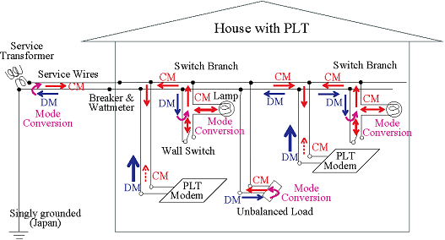
Radiation Mechanism

Slide 28
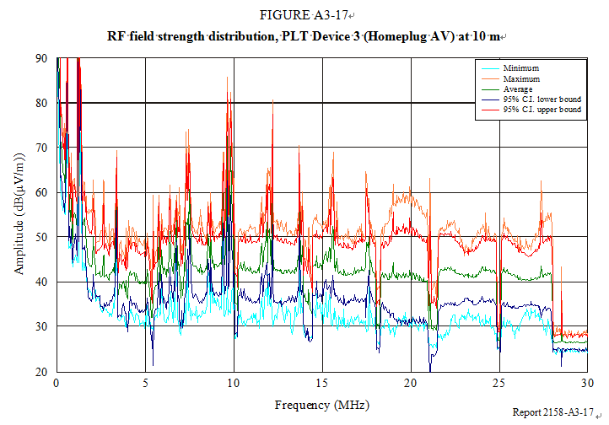
Measurements in Canada
(from Rep. ITU-R SM.2158)

Slide 29
Other Std. Bodies
ITU-T
  Rec G.9960
  for in-house wired network up to 200 (300 ?) MHz
  Max power: -55 dBm/Hz
  No consultation with ITU-R → complains from ITU-R !
CISPR
  Subcomm I
  Studies for 10 years with no consensus
  Limits by common mode current should not be applied to PLT

Slide 30
Summary
Very strong interference caused by the PLT systems was actually measured at 5/10/30 m from the house, which was also detected by the RAS antennas at a distance of up to 130m.
Received interference was found to be between 4.5 x 10(4) and 5.2 x 10(5) times the RAS protection criteria.
The radiation mechanism is qualitatively and partially qualitatively understood.
The data and the radiation mechanism have already been adopted in Report ITU-R SM.2158.

Slide 31
YouTube Video Clip
http://www.youtube.com/watch?v=z3yVu5IfaEY
50 -300 MHz PLT modem (Belkin) in the UK
FM radio is disturbed
Many others are found from the above link

