Slide 1
Submm & THz
Masatoshi Ohishi
NAOJ

Slide 2
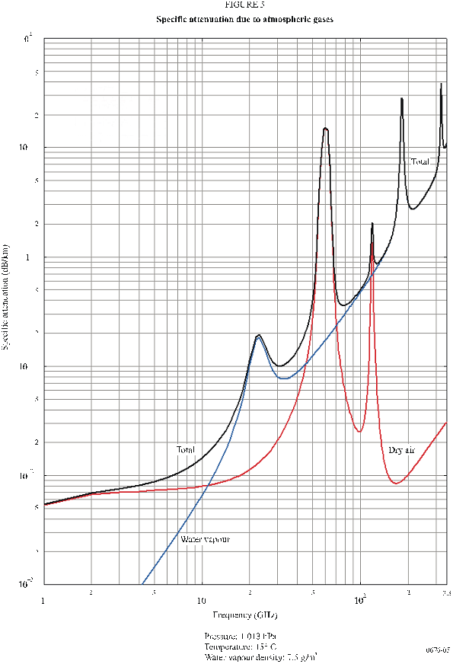
H₂O
O₂
Low ← absorption → High
O₂
H₂O

Slide 3
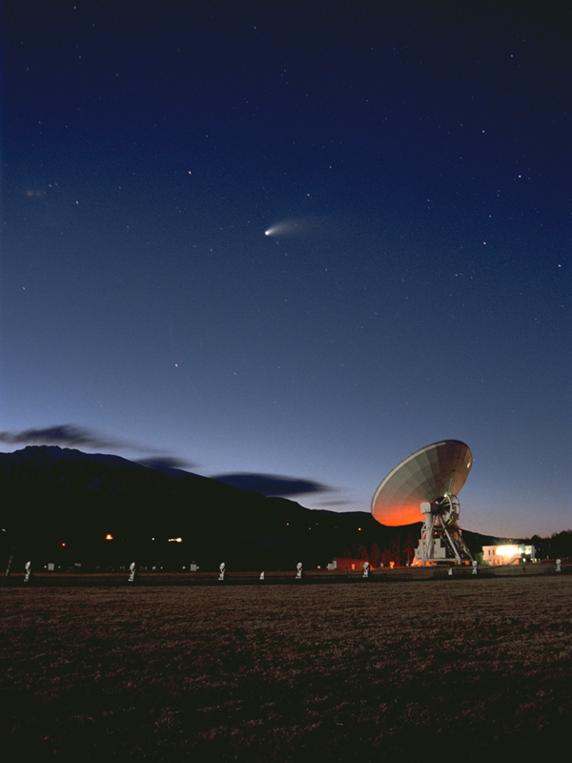

Slide 4
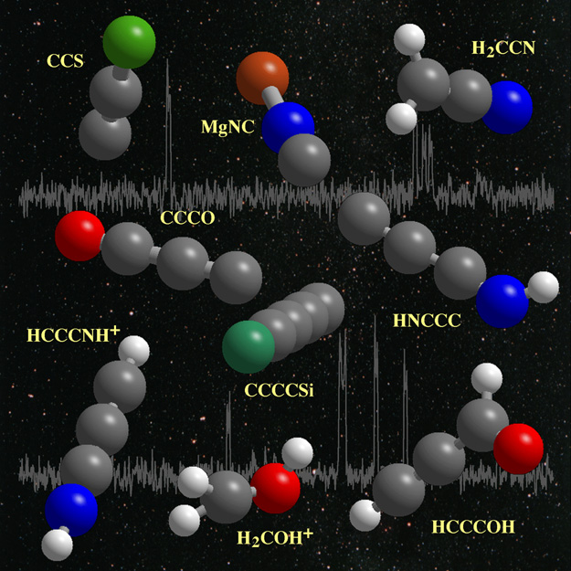

Slide 5
Rec ITU-R RA. 314
List of most important lines among observed 3,000/ possible 10,000 lines
Frequency bands for Continuum observations
Recommends to protect these bands
Bands not listed in the Rec are also important for RAS

Slide 6
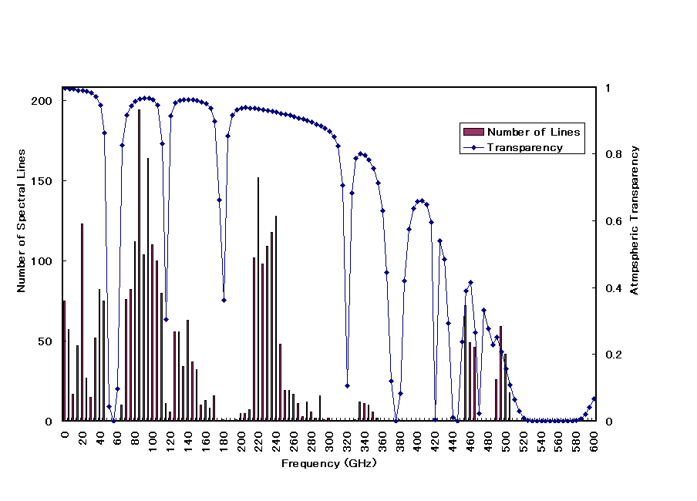

Slide 7
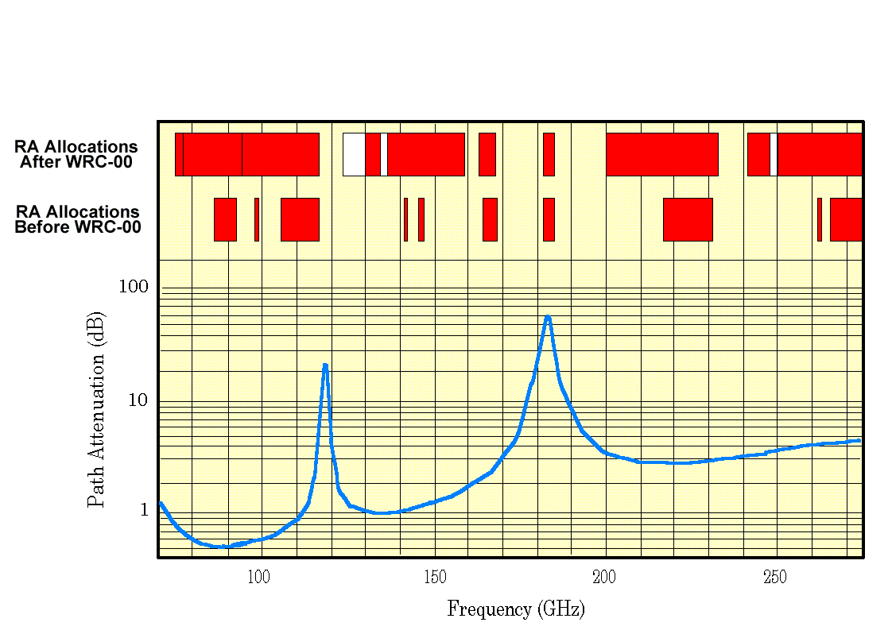
RA bands above 71 GHz

Slide 8
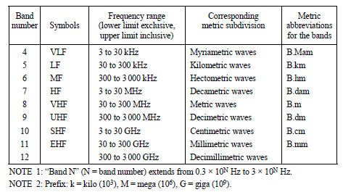
RR 2.1

Slide 9
Transmission in Submm
Transmission measurement: Matsushita, S. et al., PASJ, 51, 603 (1999)

Slide 10
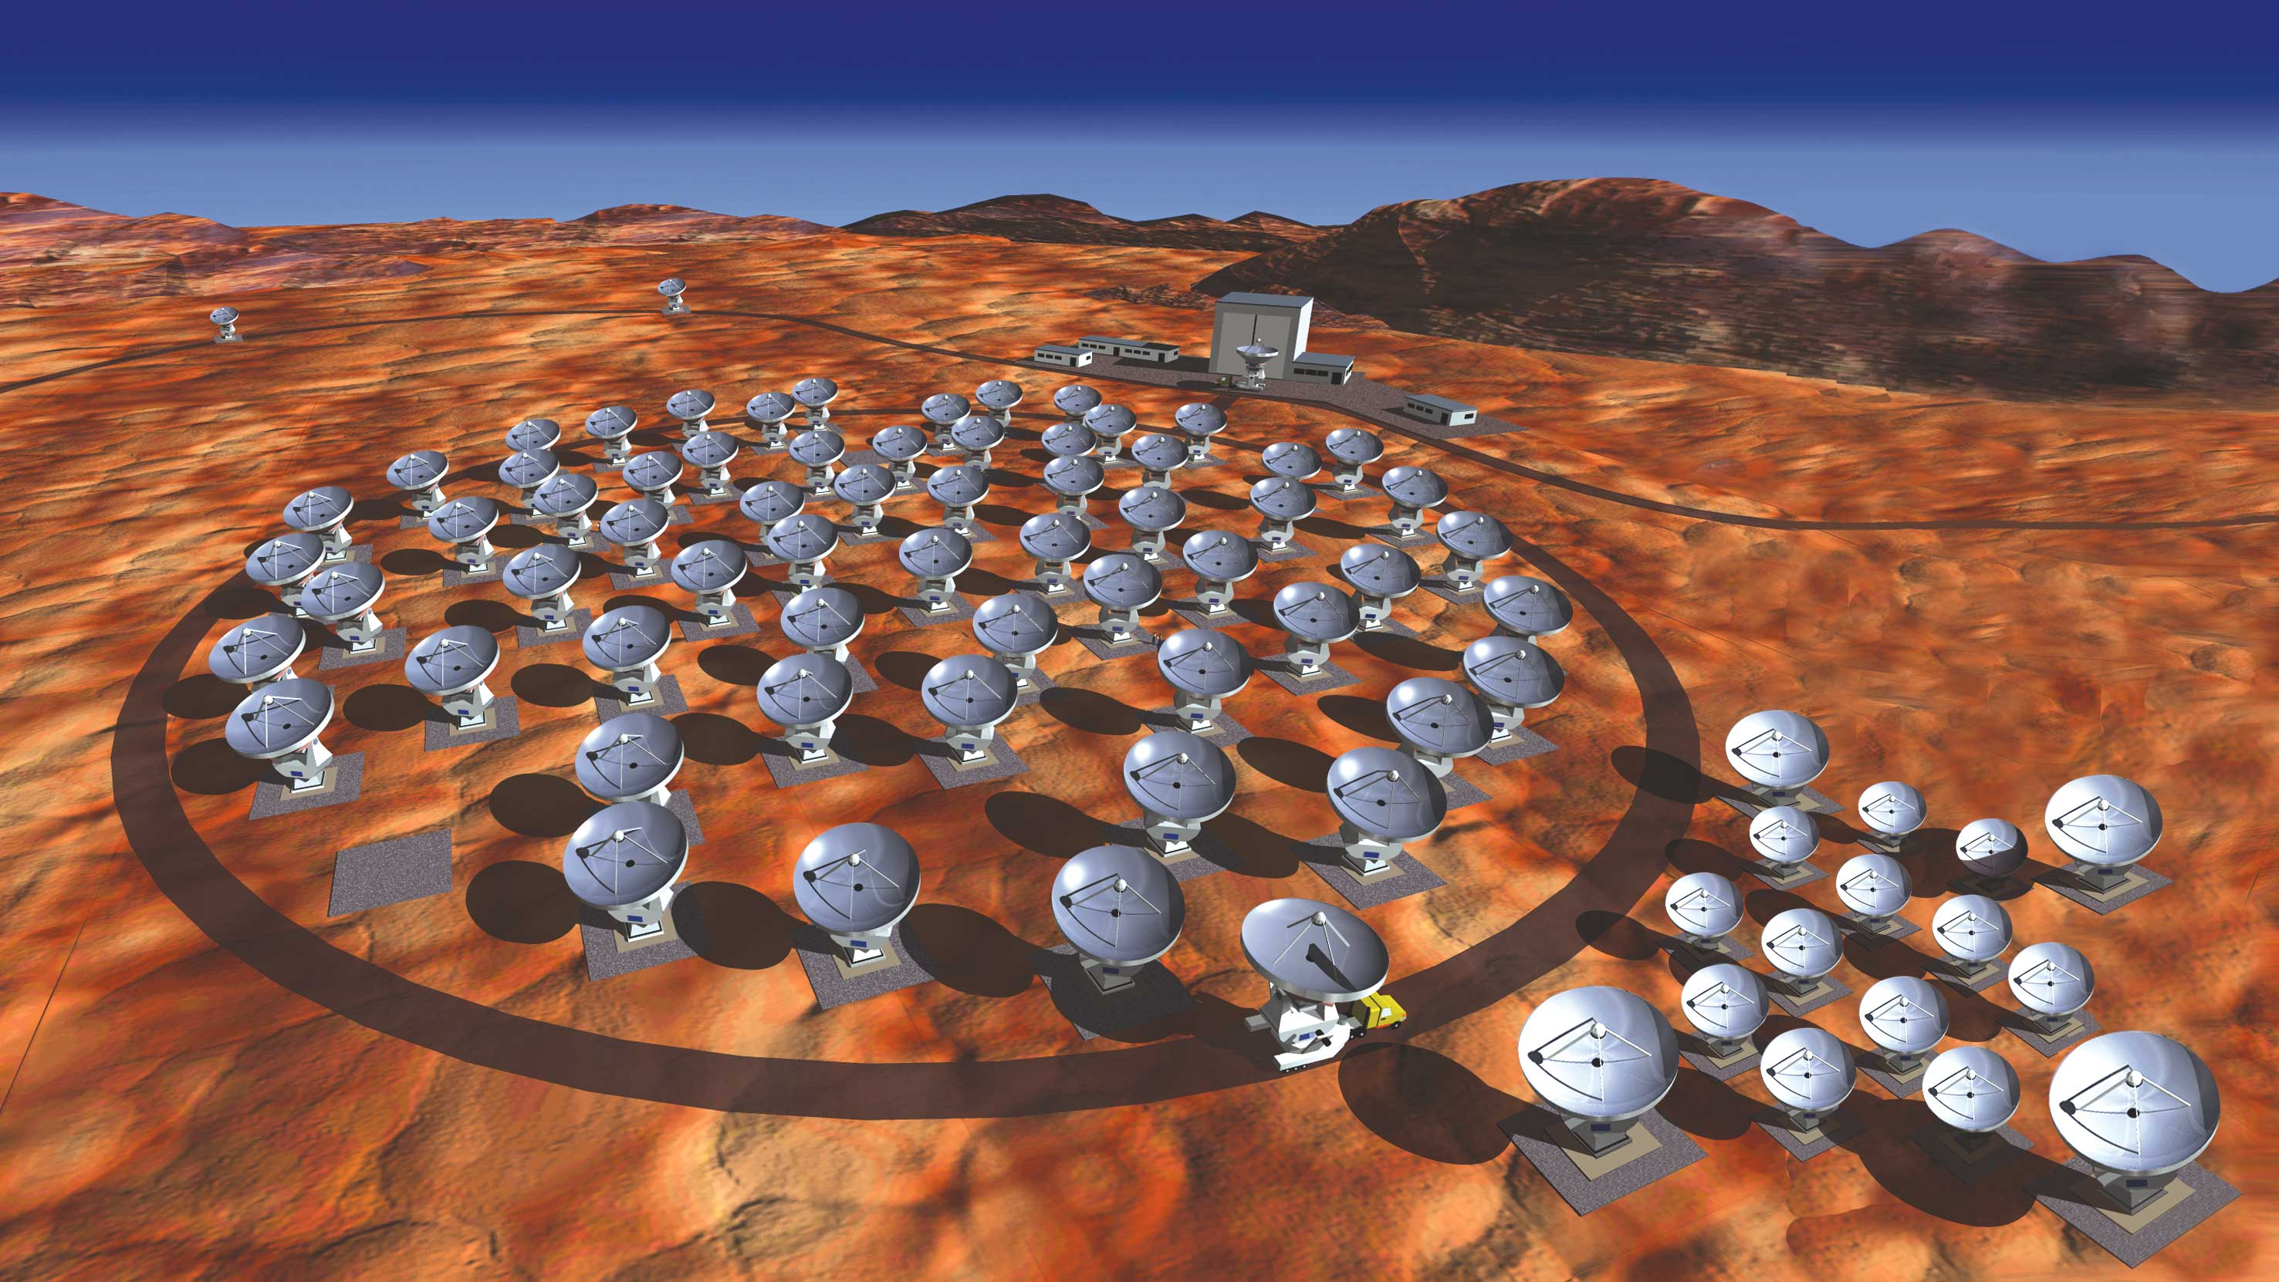
ALMA Project
© NAOJ

Slide 11
5.565 The frequency band 275-1000 GHz may be used by administrations for experimentation with, and development of, various active and passive services. In this band a need has been identified for the following spectral line measurements for passive services:
– radio astronomy service: 275‑323 GHz, 327‑371 GHz, 388‑424 GHz, 426‑442 GHz, 453‑510 GHz, 623‑711 GHz, 795‑909 GHz and 926-945 GHz;
– Earth exploration-satellite service (passive) and space research service (passive): 275-277 GHz, 294‑306 GHz, 316‑334 GHz, 342‑349 GHz, 363‑365 GHz, 371‑389 GHz, 416‑434 GHz, 442‑444 GHz, 496‑506 GHz, 546‑568 GHz, 624‑629 GHz, 634‑654 GHz, 659‑661 GHz, 684‑692 GHz, 730‑732 GHz, 851‑853 GHz and 951‑956 GHz.
Future research in this largely unexplored spectral region may yield additional spectral lines and continuum bands of interest to the passive services. Administrations are urged to take all practicable steps to protect these passive services from harmful interference until the date when the allocation Table is established in the above-mentioned frequency band. (WRC‑2000)

Slide 12
Allocation > 275 GHz
No allocation at present
(only footnote 5.565)
Agenda Item for WRC-2012
  AI 1.6 – to review RR 5.565 (Res. 950)
  No Allocations
  Rec ITU-R RA.1860
  Preferred frequency bands for radio astronomical measurements in the range 1-3 THz ← input from IAU Div.X through IUCAF

Slide 13
Use of submm / THz regions
Radio astronomers actually observe in submm
In submm region no com. company plans to introduce its service
High atmospheric attenuation
→ easier to share bands
PDN Rep. RA[THz-share]

Slide 14
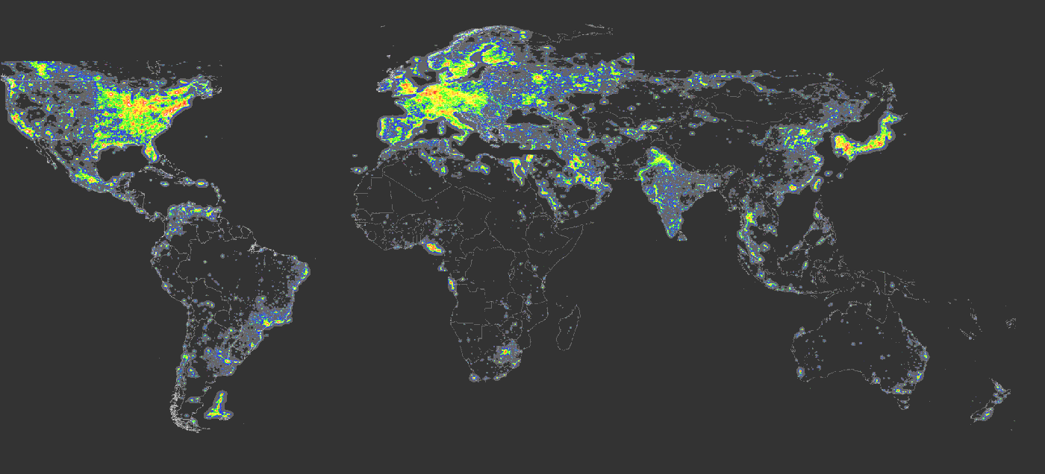
The Earth at Night (optical)

Slide 15
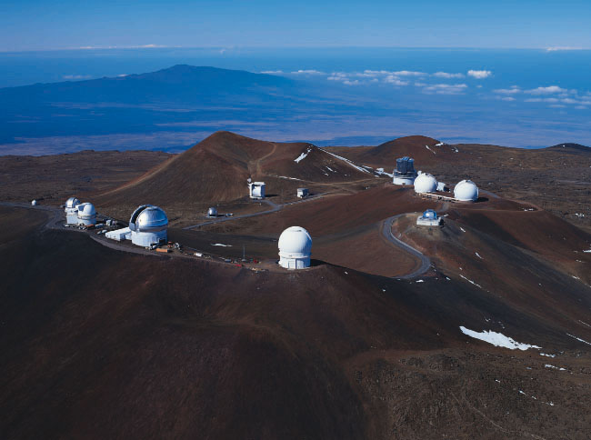

Slide 16
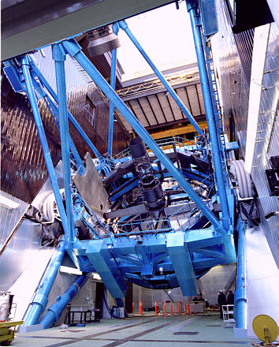

Slide 17
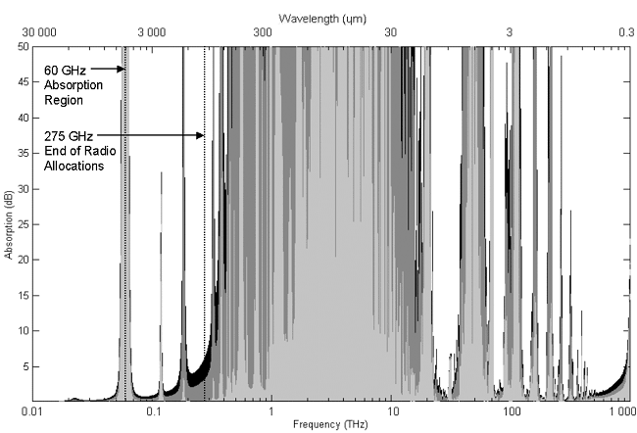
Above 10 THz
End of RR

Slide 18
Relevant Articles
RR 1.5 radio waves or hertzian waves: Electromagnetic waves of frequencies arbitrarily lower than 3 000 GHz, propagated in space without artificial guide.
ITU Constitution, Article 12,
78
….
– by carrying out studies without limit of frequency range and adopting recommendations on radiocommunication matters.

Slide 19
Optical Communication
Laser Communication by using f > 10 THz is under study (USA, Japan)
→ Interference at Optical/IR regions in near future ?

Slide 20
Usage
GSO/GSO, GSO/non-GSO crosslinks
Non-GSO/non-GSO crosslinks
GSO-ground links
See Rec. ITU-R S.1590
  Technical and operational characteristics of satellites operating in the range 20-375 THz

Slide 21
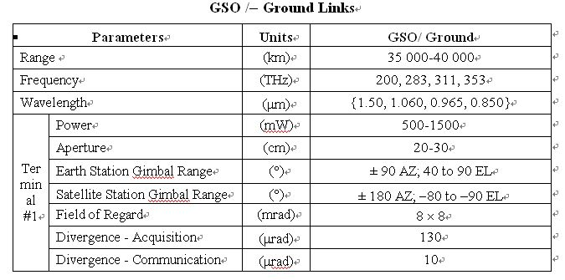
bands

Slide 22
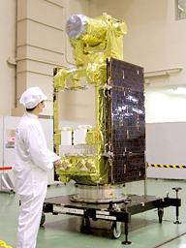
OIECTS by JAXA, Japan

Slide 23
RAS side
Rec. ITU-R RA.1630
  Technical and operational characteristics of ground-based astronomy systems for use in sharing studies with active services between
  10 THz and 1 000 THz
Lists major optical/IR astronomical observatories

Slide 24
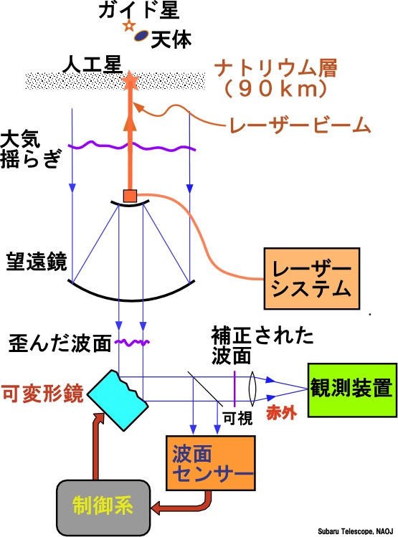
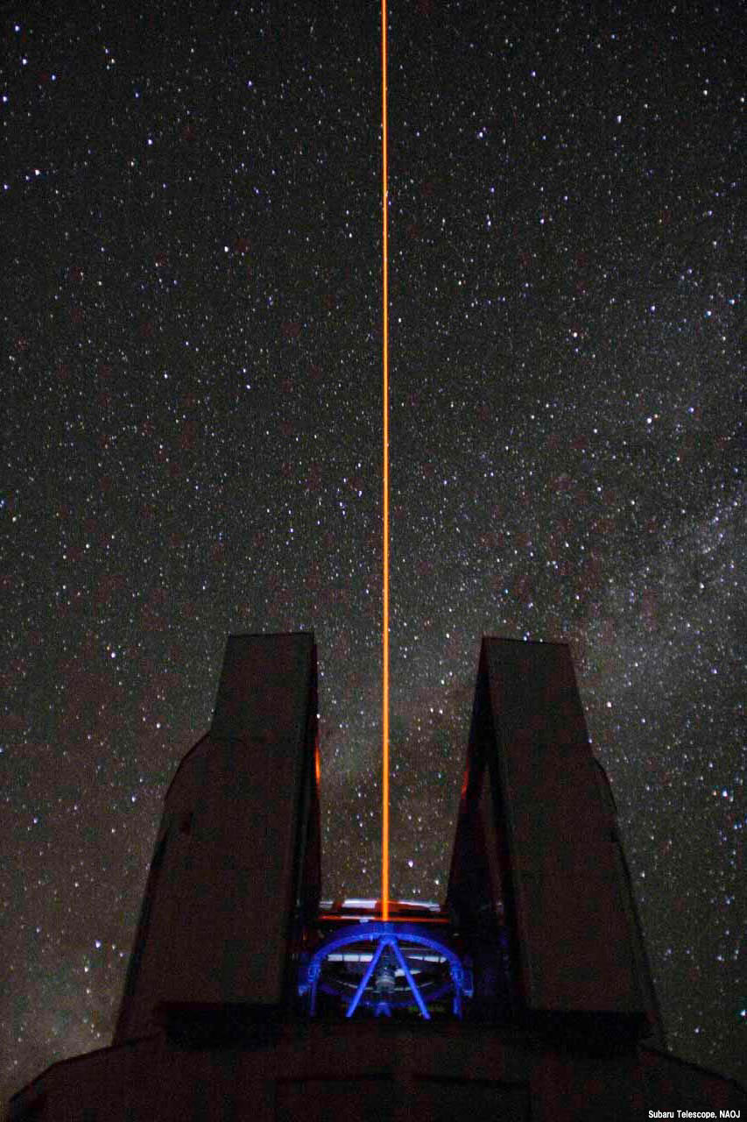
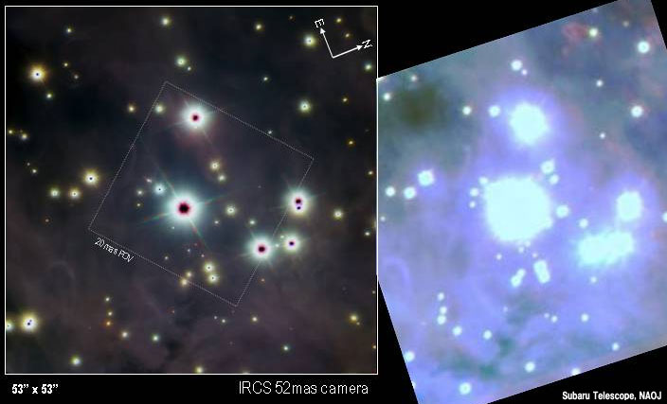
Adaptive Optics
λ = 589 nm (Na D2)

Slide 25
Collaboration with Optical/IR astronomers
IAU GA in Sydney
Com. 50 had a session with optical/IR people
Several people agreed to work with
Silence since then

